Slide 1
Animals

Slide 2
Today’s schedule
Today we will do a quick review on Animals.
After the review, we will divide into 4 groups and play a game called Categories

Slide 3
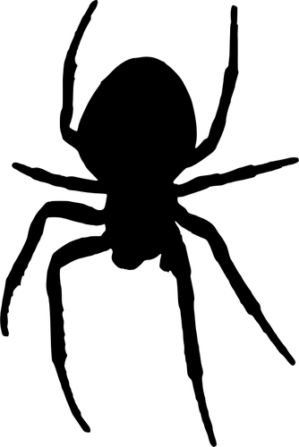
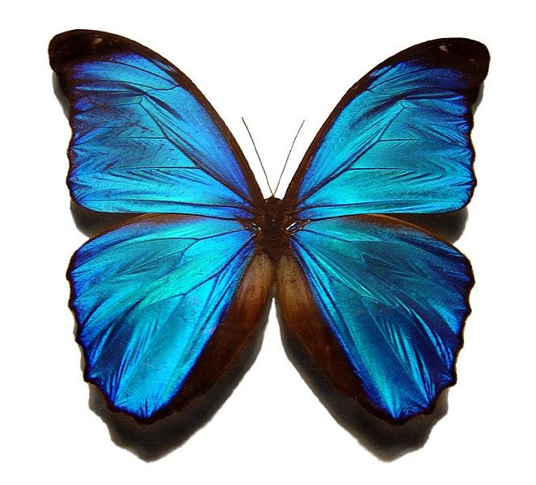
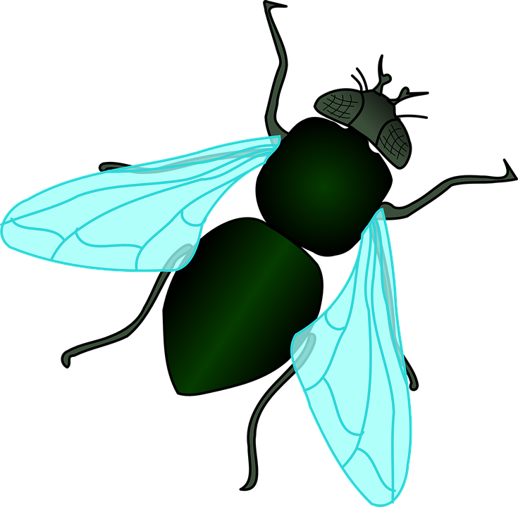
Animals (how many can you name?)
…that are insects?
Spider
Bee
Butterfly
Beetle
Fly

Slide 4
Animals (how many can you name?)
…that live in water?
Crocodile
Dolphin
Fish
Frog
Shark
Turtle
Whale

Slide 5
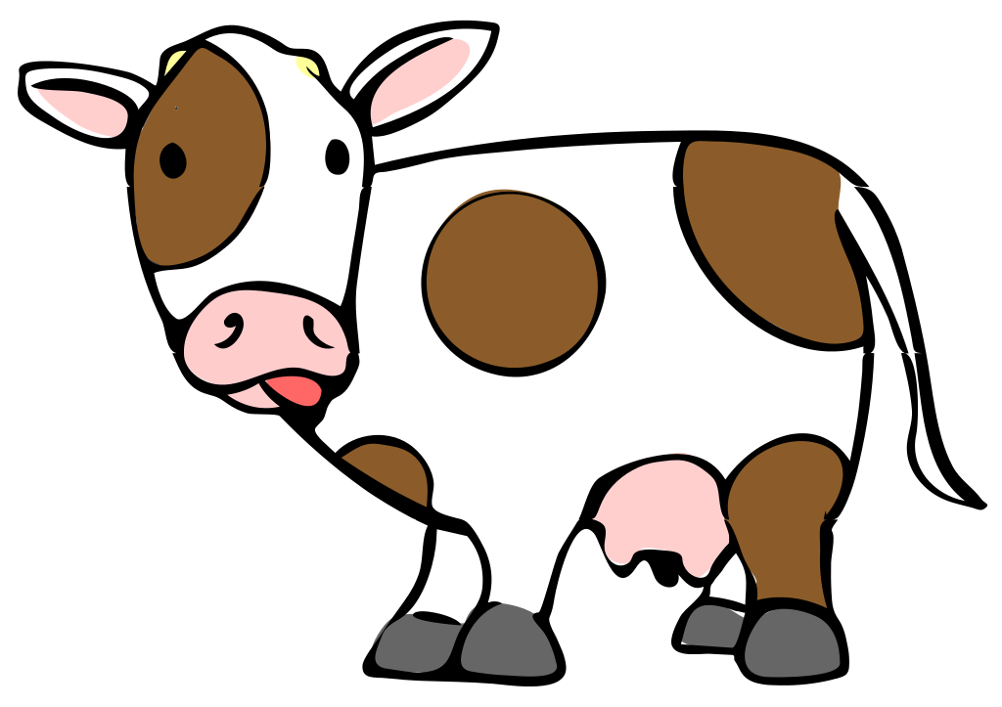
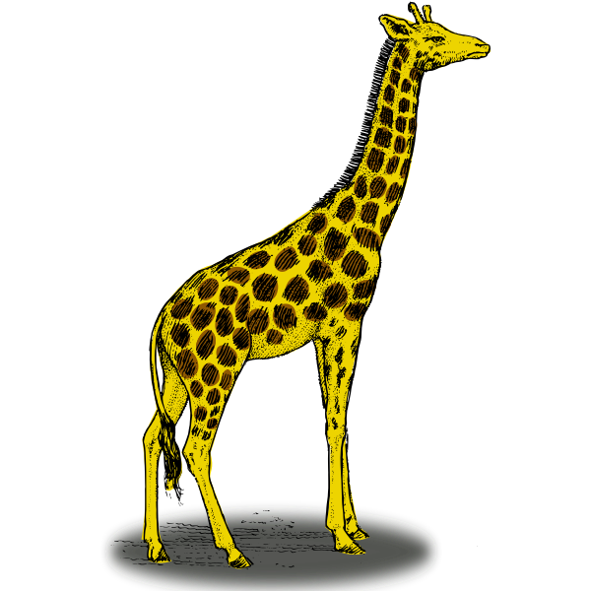
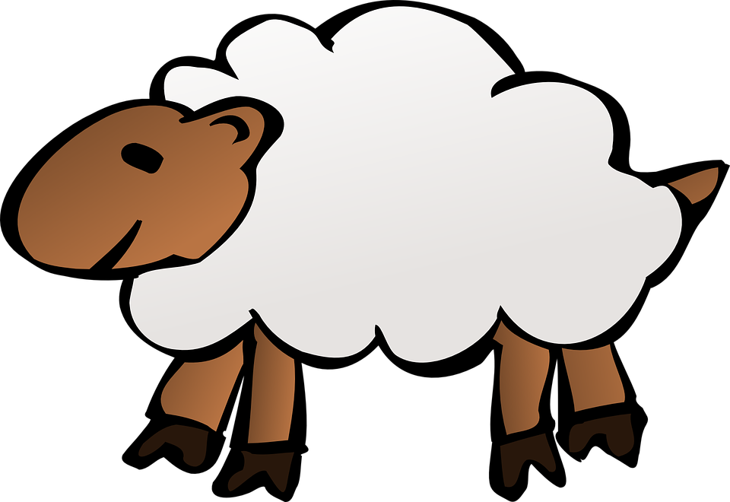
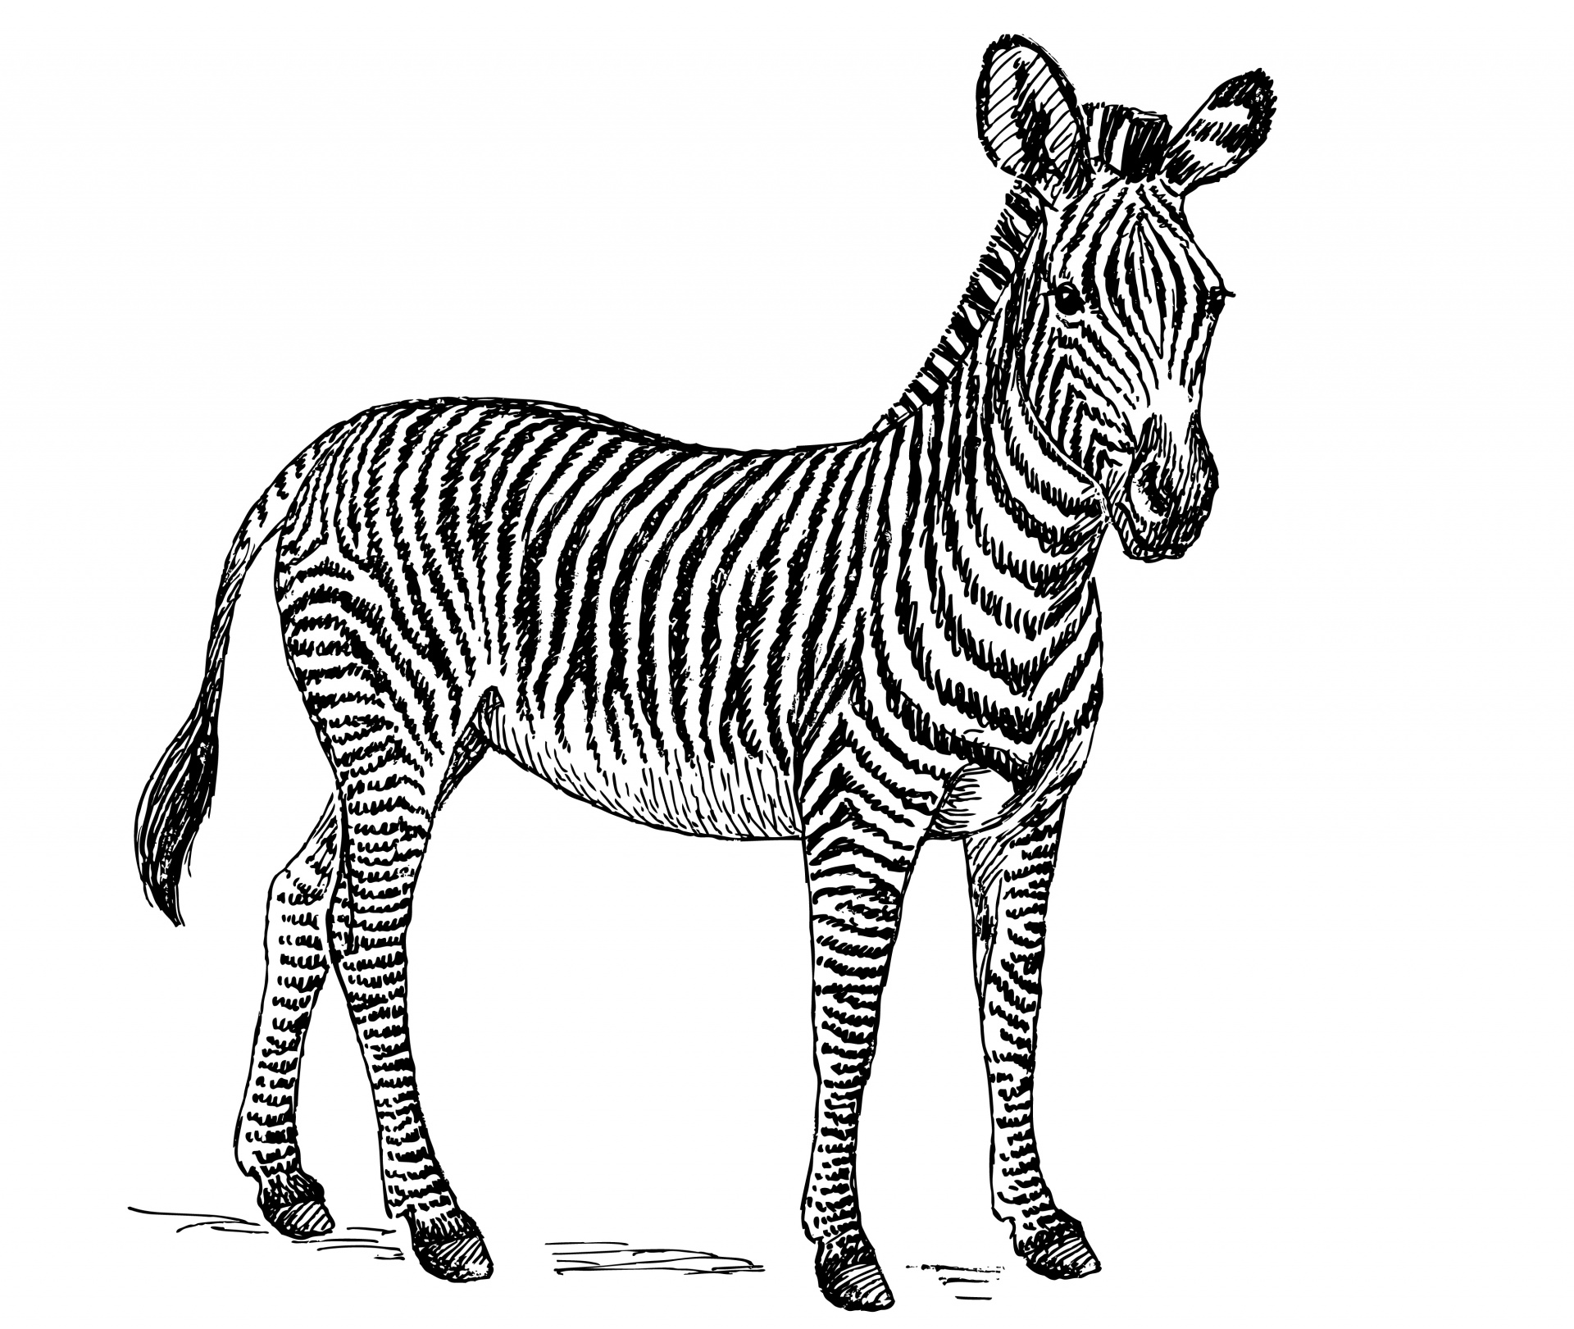
Animals (how many can you name?)
…that have 4 legs?
Cow
Elephant
Giraffe
Horse
Lion
Sheep
Tiger
Zebra

Slide 6
True or false
A lion is more dangerous than a Zebra
TRUE
A whale is not as large as a Dolphin
TRUE
Cows eat meat
FALSE
Turtles are faster than horses
FALSE

Slide 7
Comparatives
Elephants are (big) than cows
Elephants are bigger than cows
Turtles are (fast) as zebras
Turtles are not as fast as zebras
Dogs are (intelligent) than rabbits
Dogs are more intelligent than rabbits
Pigs are (dangerous) as tigers
Pigs are not as dangerous as tigers

Slide 8
Categories
There are 4 groups
There will be 6 rounds with 1 bonus round at the end
2 points per a category and 1 point for bonus
Each word is worth 1 POINT. You must give 2 words per a category EXCEPT for bonus category which is 1 word.
-Each team has 2 minutes to write and then you must STOP.
Spelling is important!
Tunder is 0 points, THUNDER is 1 point.
Weather (2 pt)
Animals (2 pt)
Names (2 pt)
Fruits and Vegetables (2 pt)
Bonus (1 pt)

