Slide 1
Atoms

Slide 3
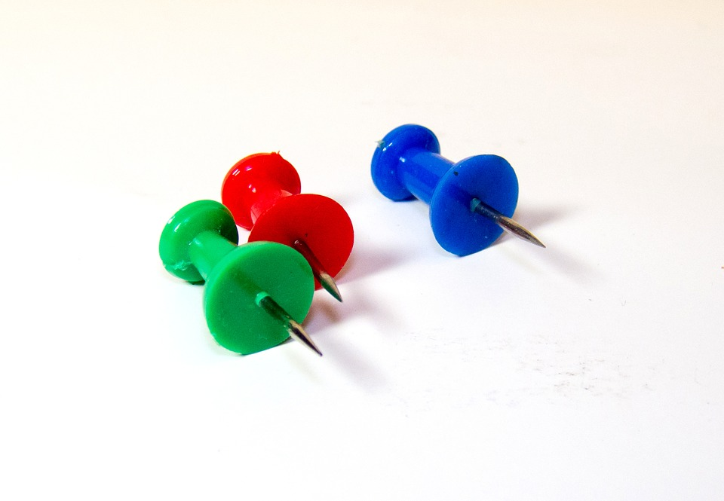
What is an Atom?
Before we start on what an Atom is, it is important to understand Matter. Matter is anything that has mass and takes up space. The smallest unit of matter is the Atom.
An atom is, by definition, the smallest particle of an element that retains(or keeps) the properties of that element. Atoms are incredibly small! You could fit a million atoms on the head of a pin
What is an element? An element is matter that is only composed of one single type of atom.
What this means is that we can identify identify an atom and find its corresponding element on the Periodic table. In other words, for every type of atom there is one element. So what is the periodic table?

Slide 4
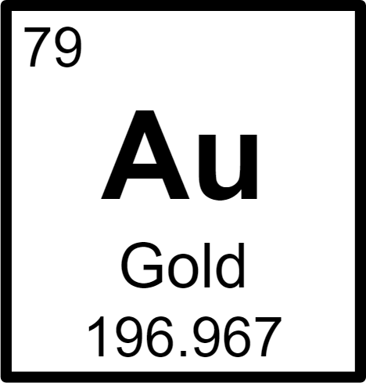
Periodic table
The periodic table is a list of ALL of the elements in the world(that we know of!). There are 118 elements in the periodic table.
There are 118 elements on the periodic table, which means that there are 118 different types of Atoms.
Let’s look at the element gold. The number on the top is called the Atomic Number, which is the number of protons an atom has. The second part (AU) is the element symbol. The bottom number is called the atomic mass, which is the average mass of the atom.

Slide 5
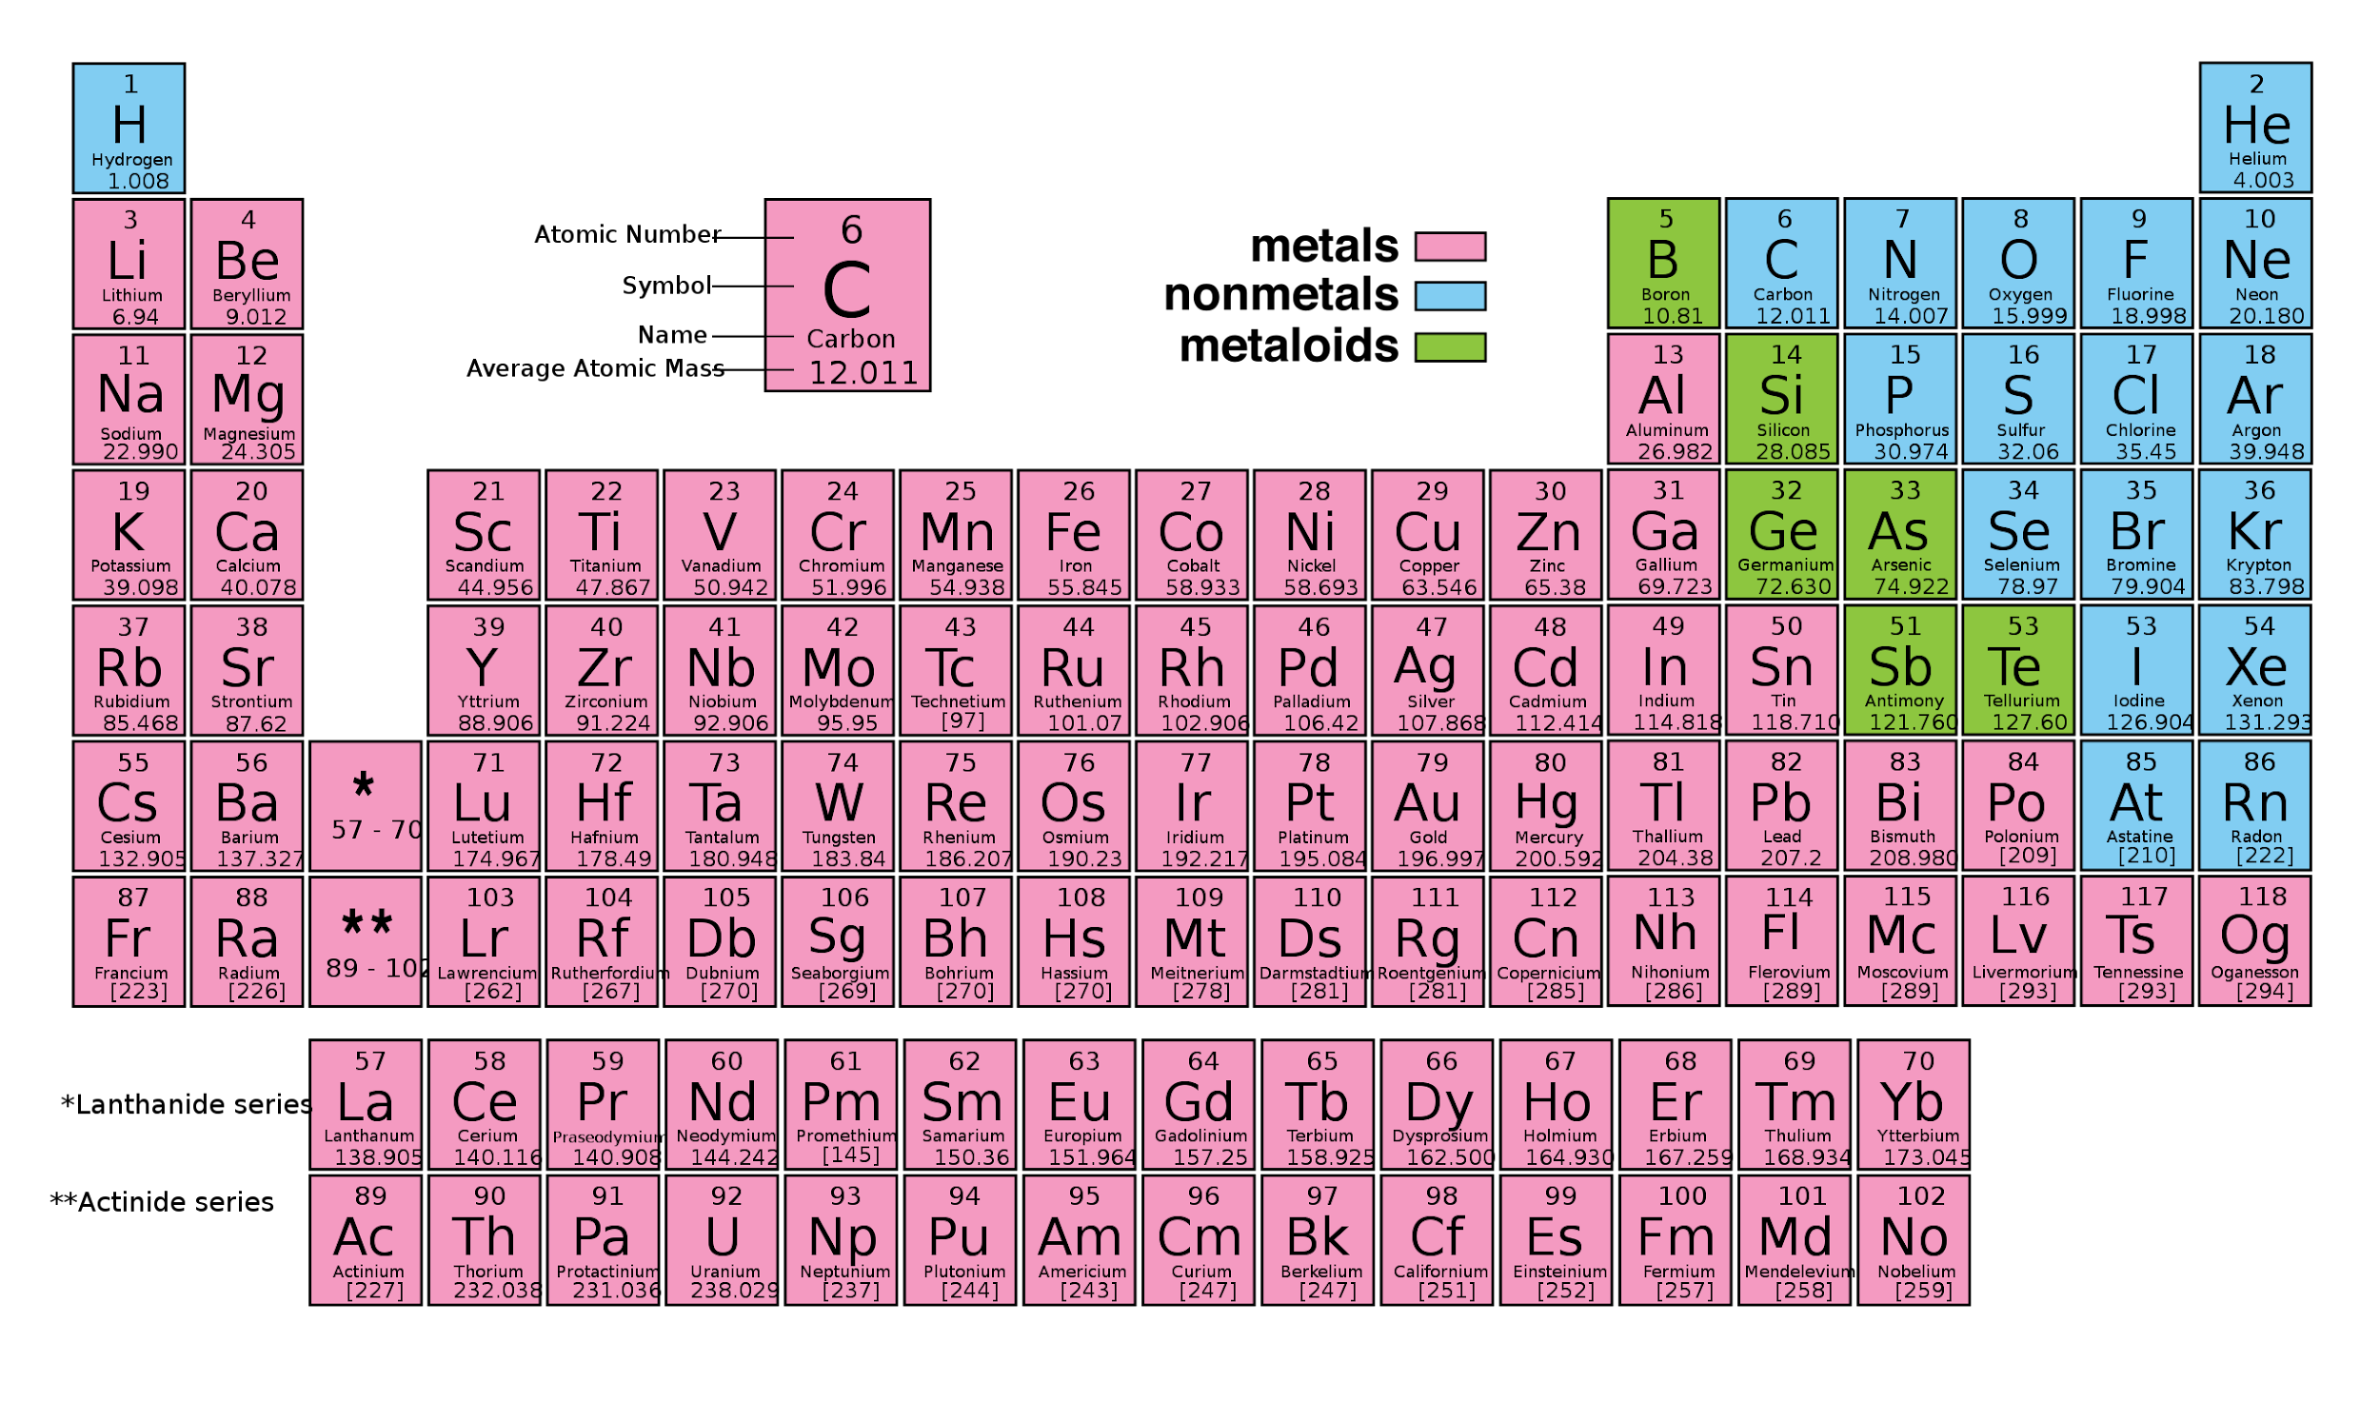

Slide 6
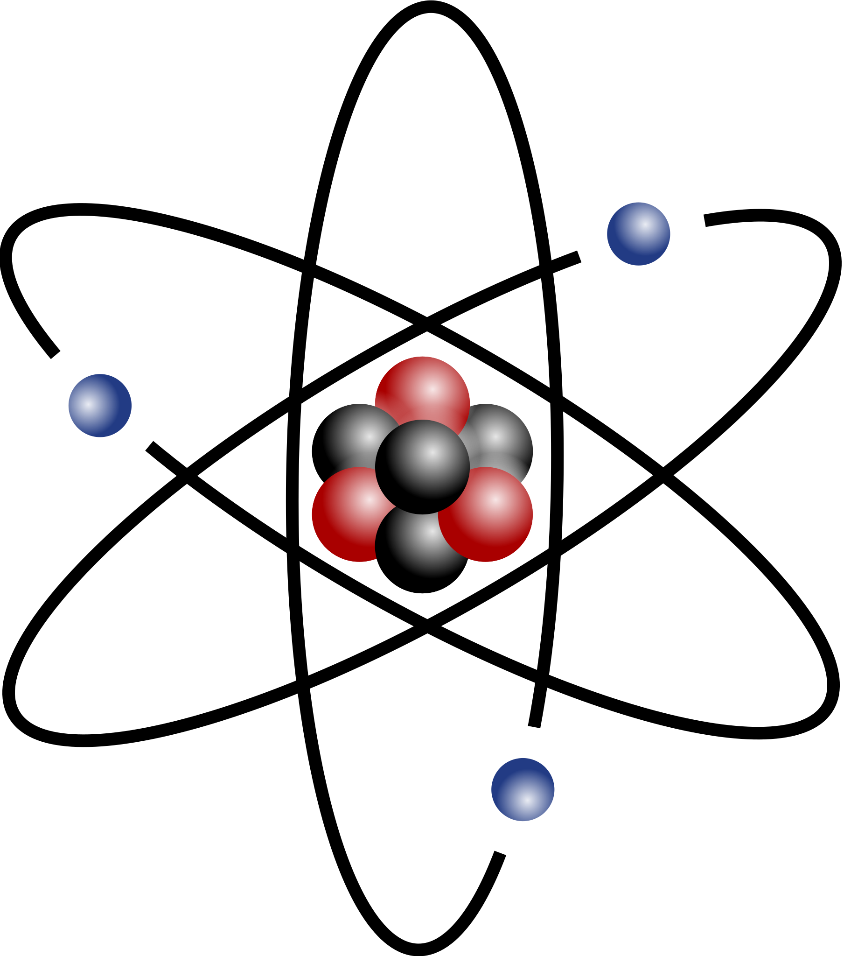
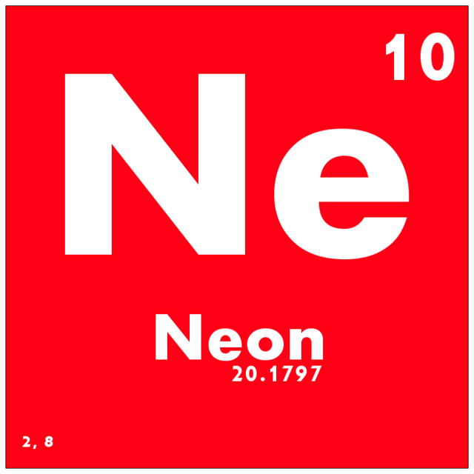
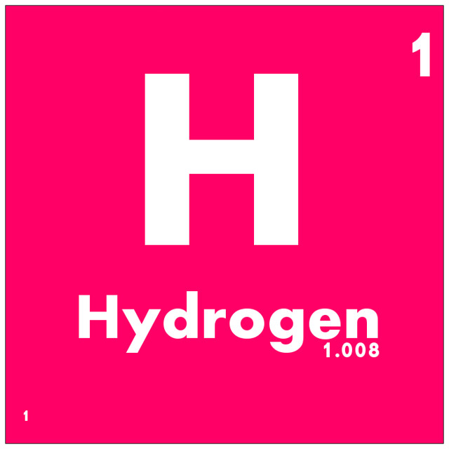
Structure of an Atom
An Atom is composed of 3 main parts, which are called subatomic particles. Protons, Neutrons, and Electrons
The protons and neutrons contain the majority of the weight of the atom(as they are much bigger than the electrons) and reside in the nucleus in the center of the atom. The nucleus is the core of the atom, made up of protons & neutrons.
Protons are positively charged particles(+) that are found in the center(or nucleus) of the atom.
Neutrons are neutrally charged particles also found in the center(or nucleaus) of the atom
Electrons are negatively charged particles that are found outside of the nucleus and travel in rings around the nucleus. Electrons are much smaller than protons and neutrons(about 2000 times smaller). \
Generally speaking, each atom have the same number of protons,electrons, and neutrons. For example, the element Neon has 10 electrons, 10 protons, and 10 Neutrons. However, the number of neutrons and electrons can vary, but the number of protons is ALWAYS the same.
Even smaller than electrons, are Quarks. Quarks are even smaller particles that make up neutrons and protons.
Did you know? The majority of an atom is empty space as an atom is 99.999999999% empty space

Slide 7
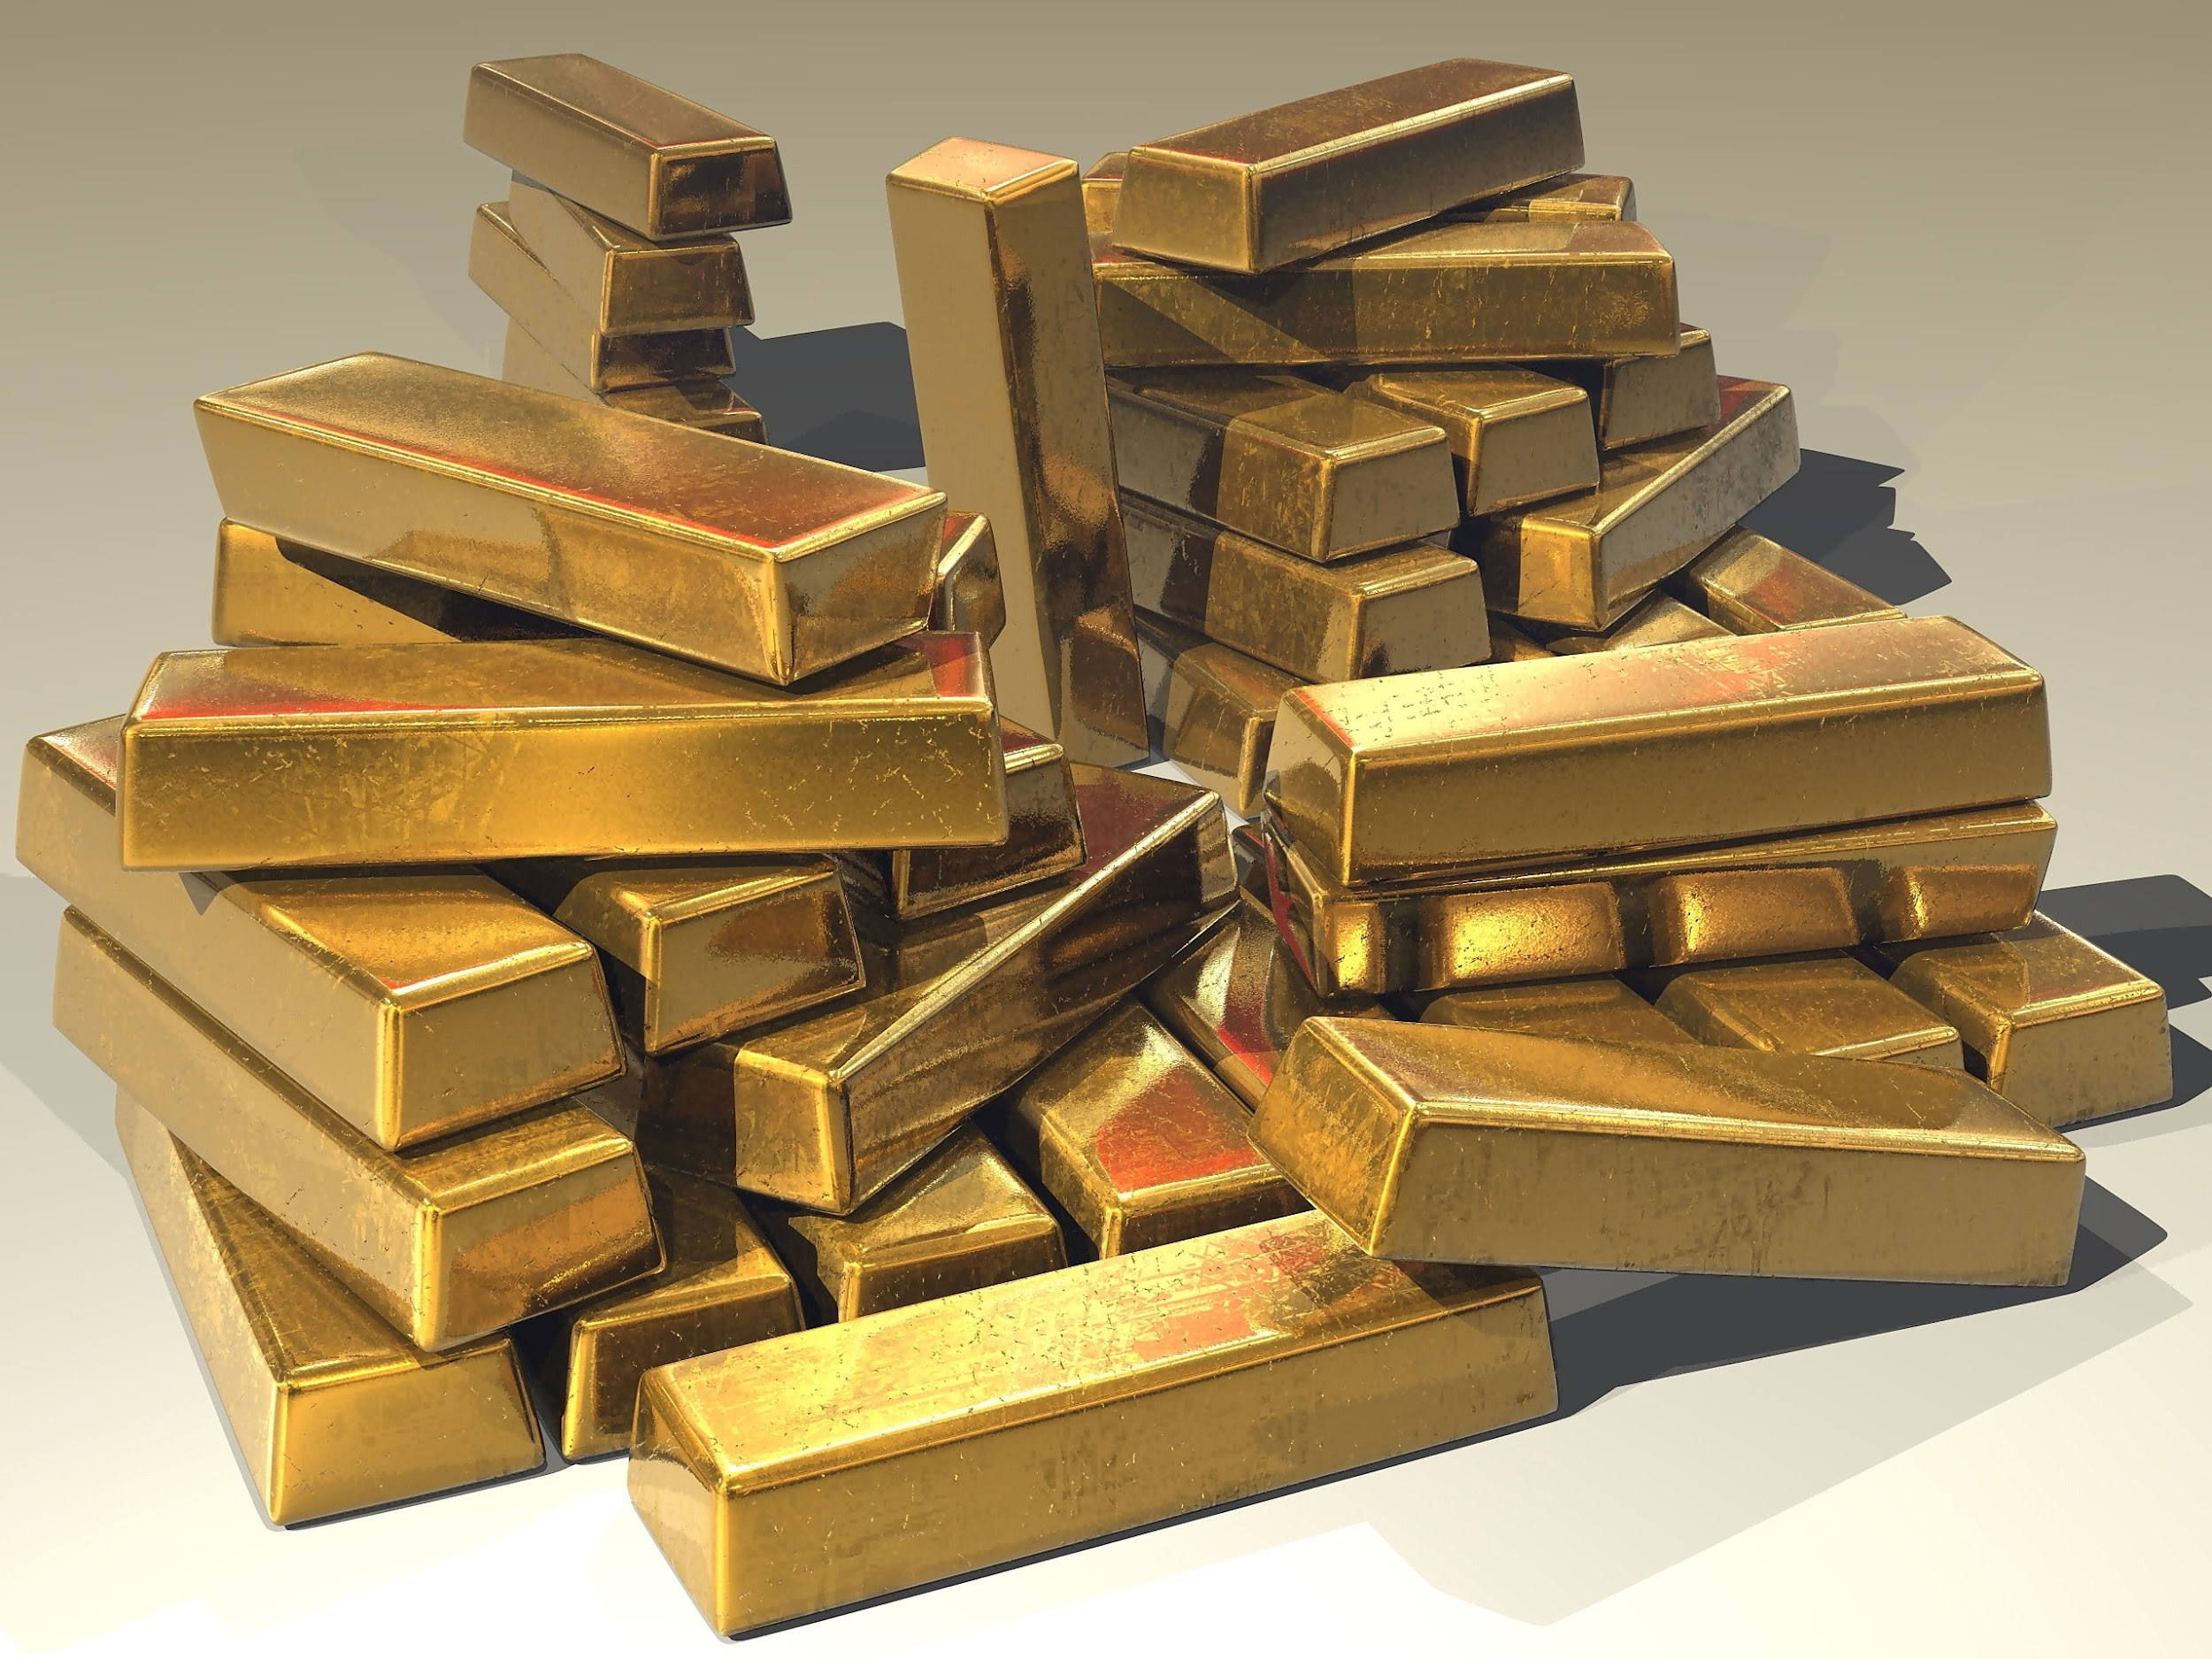
Atoms cont.
As said before, each atom can be identified as belonging to one of the 118 elements on the periodic table. But how? Simply, the number of protons an atom corresponds(is equal) to the atomic number on the periodic table. Gold, for example, has an atomic number of 79. Meaning it has 79 protons.

Slide 9
True or false
Atoms are mostly empty space.
Each element has a specific number of protons in the nucleus.
Electrons are the largest particles in an atom.
Neutrons are negatively charged.
A quark is a small particle that makes up protons & neutrons.
The atomic number tells you the number of electrons in the nucleus of an atom.
The atomic number and atomic mass are the same thing
Most of an atom’s weight comes from the protons and neutrons
True
True
False
False
True
False
False
True

Slide 10
Answer the questions
Atoms mostly consist of
Where are the electrons found?
What makes 1 atom different from another?
What does the atomic number tell you about an element?
Protons and electrons are located in the
Atoms are so small that you could fit how many on the head of a pin?
Empty space
Outside the nucleus
The number of protons
The number of protons it has
Nucleus
1 million

Slide 11
Fill in the correct Word
Anything that has mass and takes up space is
A positively charged particle in an atom is the
A(n) ______________________________ is matter that is composed of only one kind of atom
A negatively charged particle in an atom is the ______________________________________.
6. A(n) ________________________________ is the smallest particle of an element that retains the properties of that element; the building blocks of matter.
A particle with no charge that is found in an atom is the ________________________.
An elementary particle that makes up protons & neutrons is a(n) _________________________________.
The __________________________ is the core of the atom, made up of protons & neutrons.
Atom
Electron
Matter
Nucleus
Proton
Neutron
Quark
Element
Matter
Proton
Element
Electron
Atom
Neutron
Quark
Nucleus

