Slide 1
Nissan GT-R 2021
1-100 KMH: 2.7s
Top Speed: 328 KMH

Slide 2
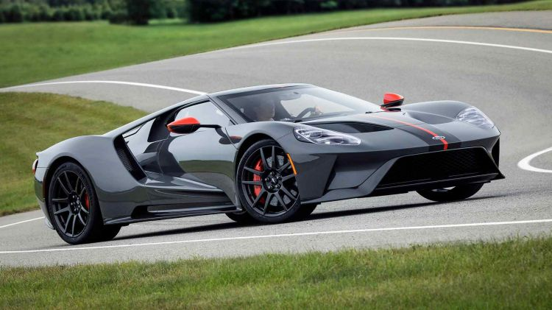
Ford GT 2020
1-60 MPH: 3.3s
Top Speed: 216 MPH

Slide 3
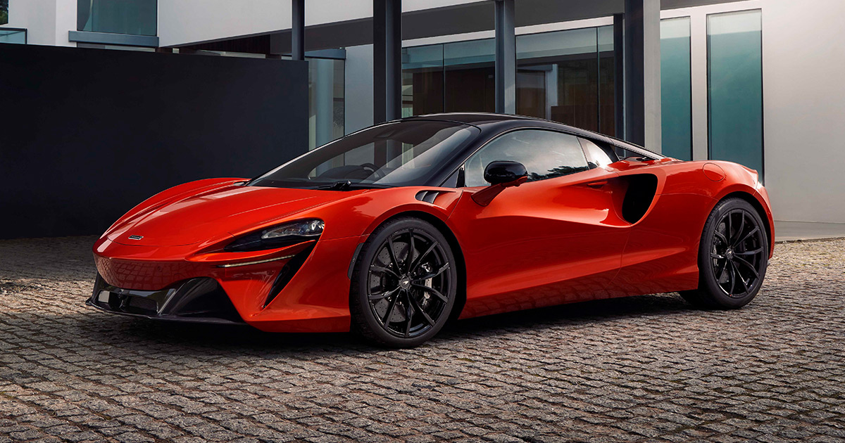
Mclaren Artura 2022
1-100 kmh: 3.0s
Top speed: 330 KMH

Slide 4
Imperial vs Metric
1 mile = 1760 yards/ 5280 feet
1 yard = 3 feet
1 feet = 12 inches
1 kilometer = 1000 meters
1 meter = 100 centimeters
If 1 foot is 0.305 meters, 1200 yards would be how many kilometers?

Slide 5
Some questions
1 mile = 5280 feet
1 foot = 30.48 cm
Nissan: 328 kmh
Ford: 216 mph
Mclaren: 330 kmh
Compare the three cars
How long would it take the Nissan to travel 65 km at top speed?
Which is the faster car between the Ford and Mclaren? (use the conversions on the side to figure this out)
How long would it take the ford to travel a distance of 40 Km?
The Nissan can reach 100 kmh in 2.7 seconds, the Ford can reach 60 mph in 3.0 seconds. Which is faster?

