Slide 1
Halloween

Slide 2
-UNKNOWN
"Trick or Treat, bag of sweets, Ghosts are walking down the street".

Slide 3
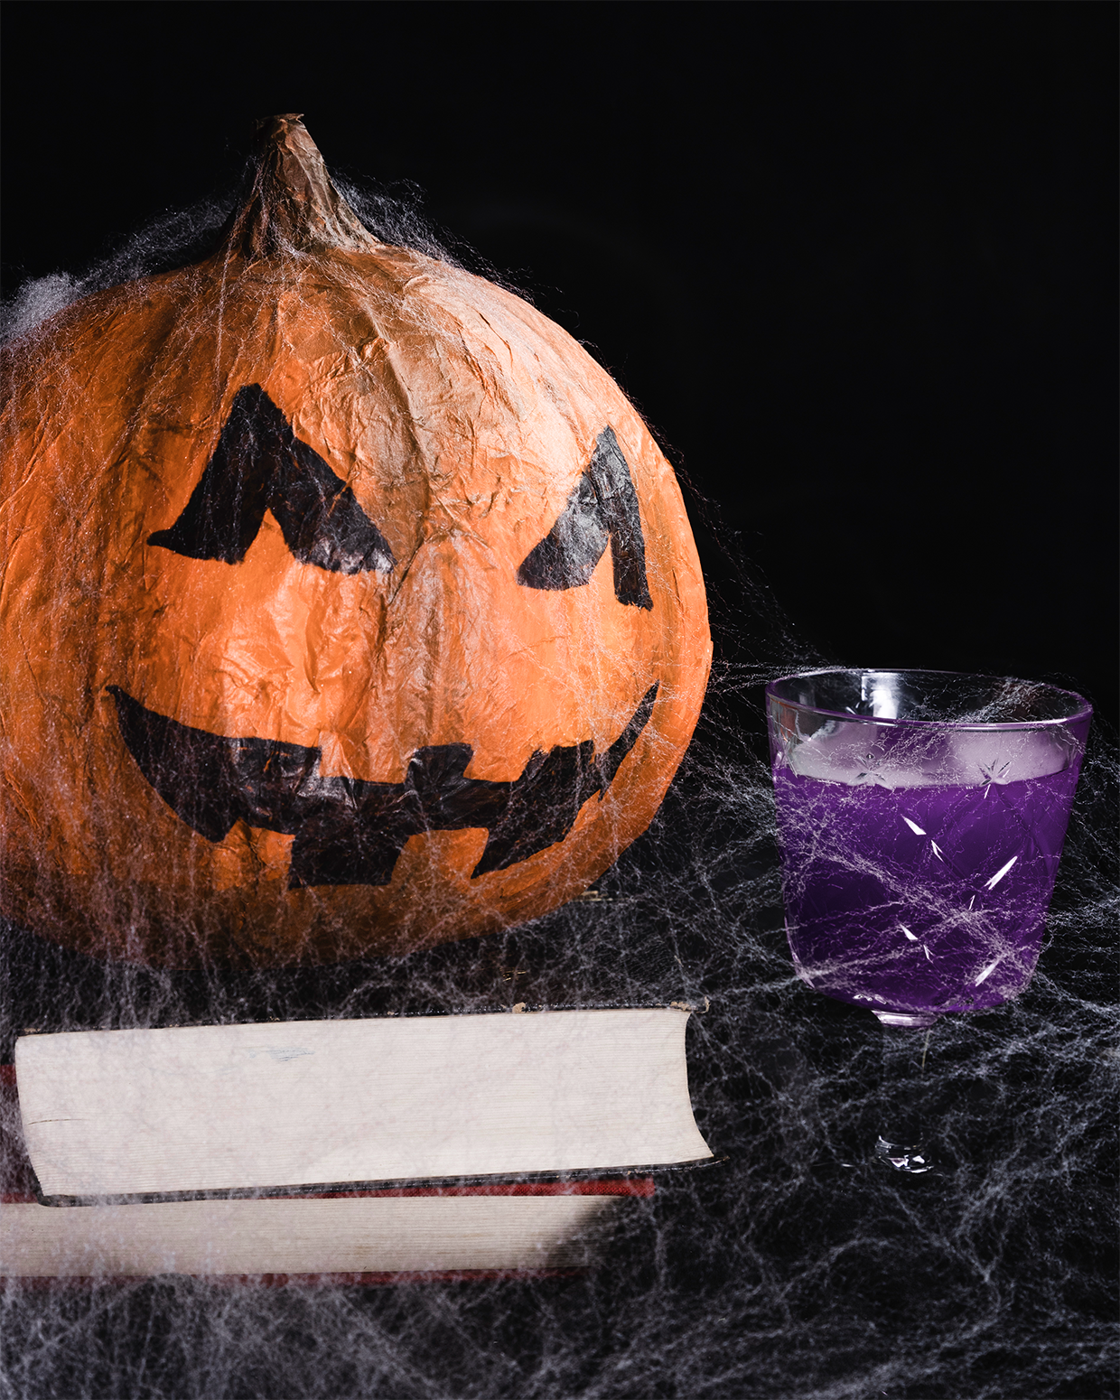
History of Halloween
The word Halloween means “Saint’s Evening”
Halloween was originally called “Samhain”, celebrated in Scotland and Ireland.
Samhain was the beginning of the “dark time” or winter.
People believed that on October 31, ghosts or spirits ( fantasma / espíritu) came back to life
People would leave food or drink outside their homes for the ghosts/spirits
Halloween became popular because of Scottish and Irish immigrants who came to America in the 1800’s and 1900’s.

Slide 4
WHAT DO WE DO ON HALLOWEEN?

Slide 5
Costumes
On Halloween, people like to wear a costume. (disfraz)
Costumes are usually scary (escalofriante) but not all costumes are.
What are some popular costumes?

Slide 6
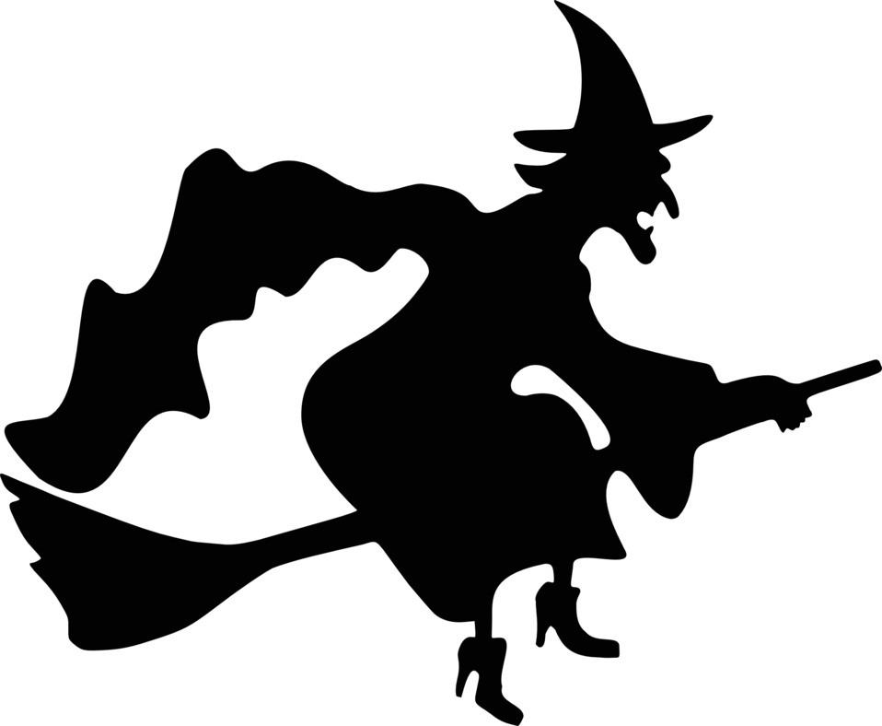
SOME POPULAR COSTUMES ARE….
GHOST (fanatasma)
WITCH (BRUJA)
SUPERHERO (SUPERHÉROE)

Slide 7
HAUNTED HOUSES
People like to decorate (decorar) their houses and make them scary. These are called haunted houses (casa encantada / casa embrujada)

Slide 9
MY EXPERIENCES WITH HALLOWEEN
AS A KID, HALLOWEEN WAS MY FAVORITE HOLIDAY.
MY MOM WOULD TAKE Me AND MY BROTHER AND SISTERS TO GO TO THE PUMPKIN PATCH, WHERE WE WOULD PICK OUR PUMPKINS.

Slide 10
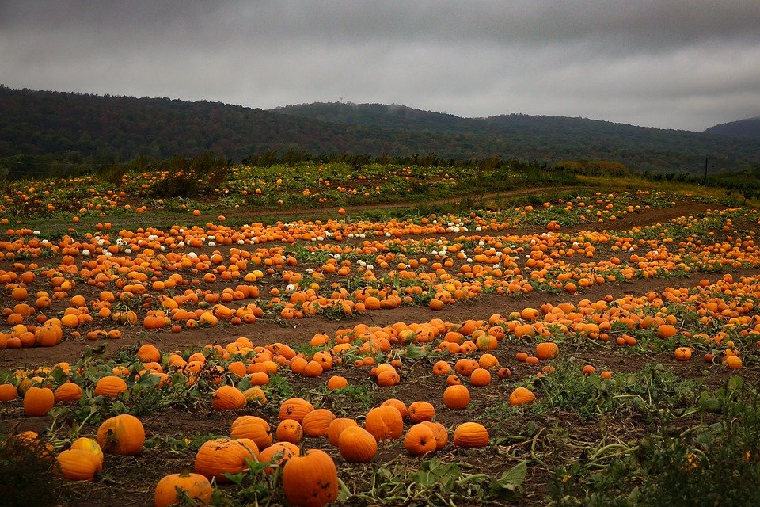
Pumpkin Patch

Slide 11
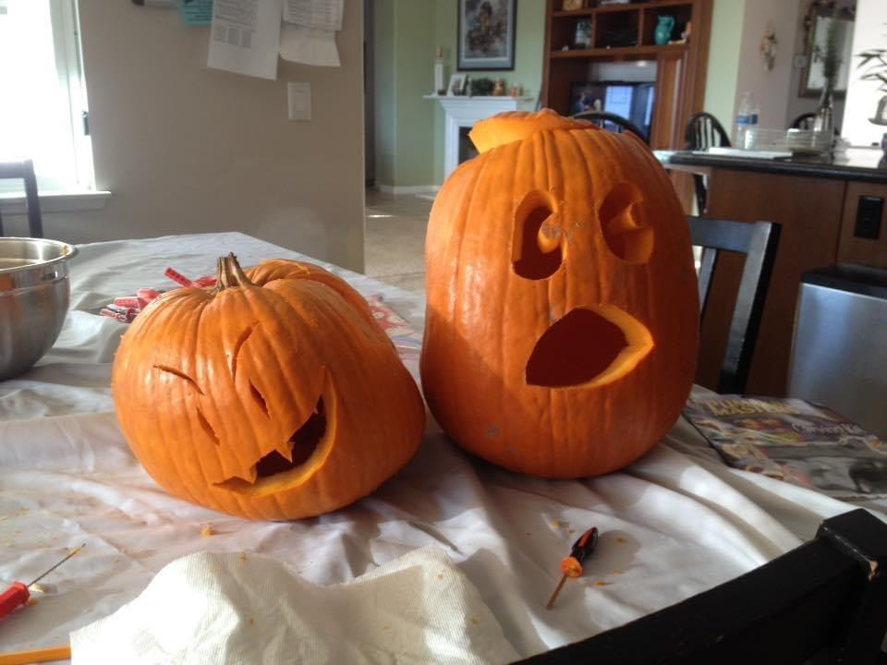
Jack O’ Lanterns
After getting a pumpkin, we would go home and carve the pumpkin (tallar una calabaza)
We call these pumpkins “Jack O’ Lanterns”

Slide 12
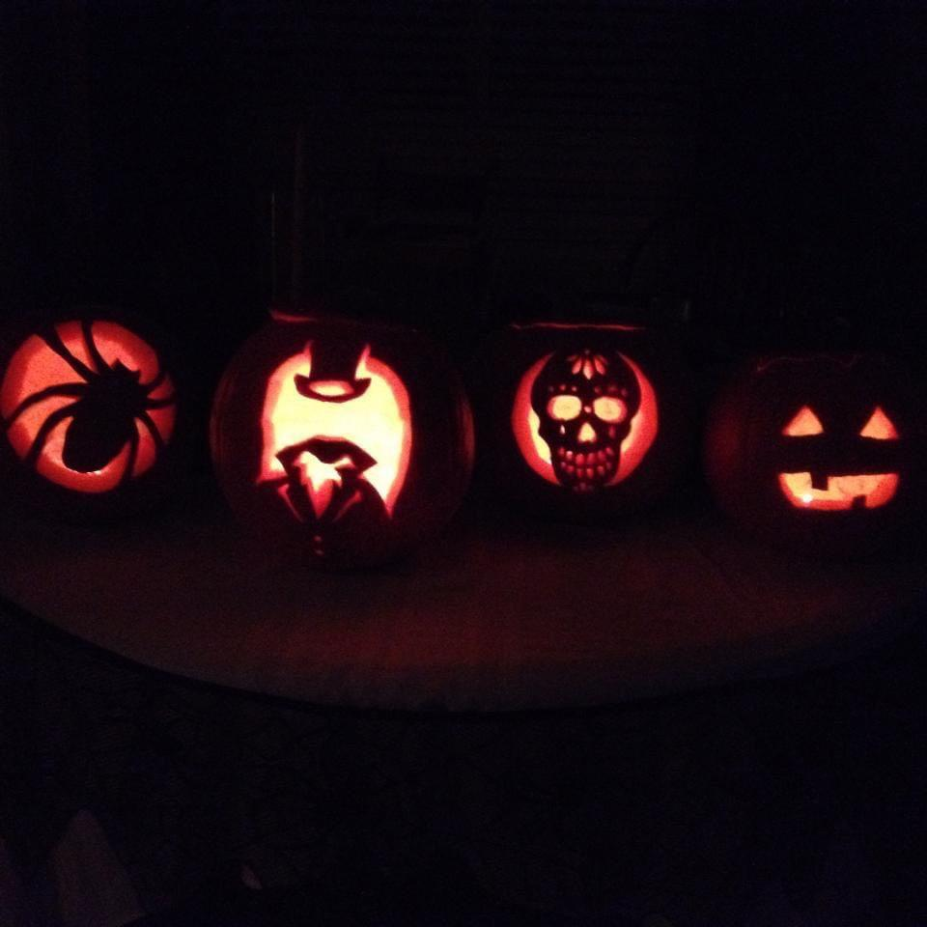

Slide 13
Trick Or Treat
On the night of Halloween (October 31), My friends and I would go Trick or treating.
TRICK OR TREAT (Dulce o Trato) IS WHEN PEOPLE, DRESSED IN COSTUMES, GO TO HOUSES AND GET CANDY.

Slide 14
How to trick or treat
Step 1
PICK A COSTUME
Step 2
GO TO A HOUSE AND KNOCK ON THE DOOR
Step 3
SAY “TRICK OR TREAT”
Step 4
GET CANDY (OR NOT?)

Slide 15
Vocab Review
This Halloween, my ____ is going to be Ironman!
My friends and I love to go ____. I want a lot of candy!
I am going to carve my pumpkin and make a ____
My mom and I went to the ____ to pick our pumpkins!
What AM i on the left? On the right?
I went to inside the ___, it was scary!
Jack O’lantern
Haunted House
Costume
Trick or Treat
Pumpkin Patch
Witch
Ghost

Slide 16
Other Activities
Not everyone goes trick or treating. Another common activity is having a party with your friends.

Slide 17
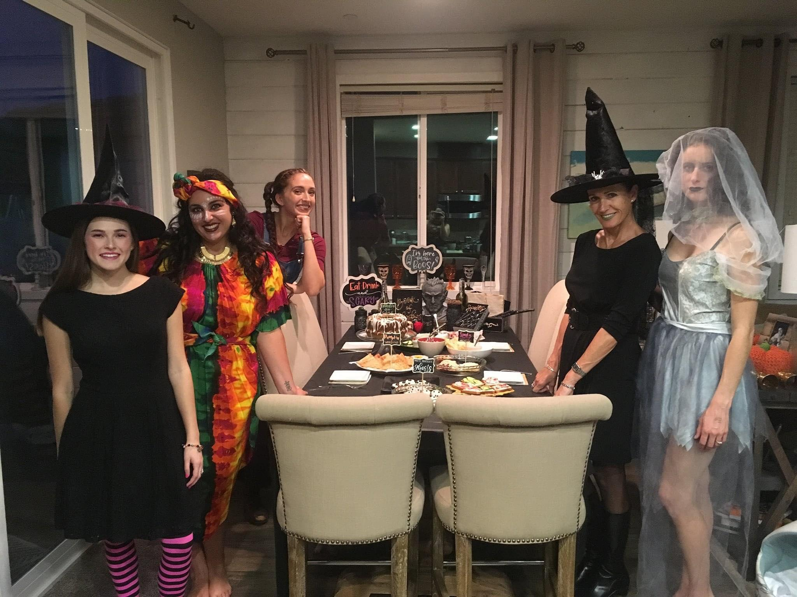
What costume is the girl on the left wearing?

Slide 18
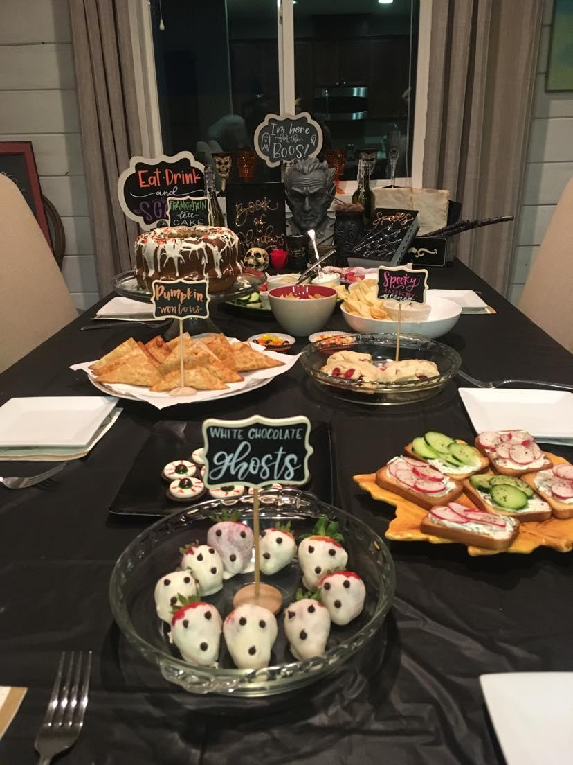

Slide 19
Watch Scary movies
A lot of people like to watch scary (horror) movies.
Can you Recognize any of these Movies?

Slide 20
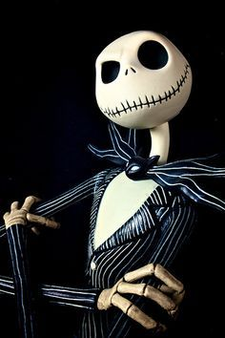
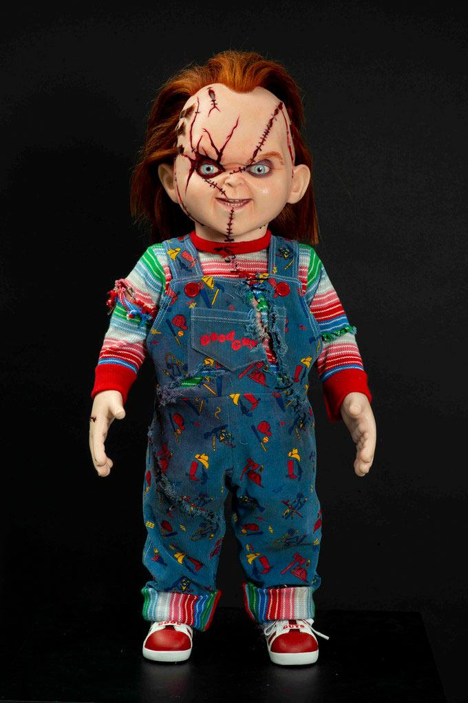
Nightmare Before Christmas (El Extraño mundo de Jack)
Chucky

Slide 21
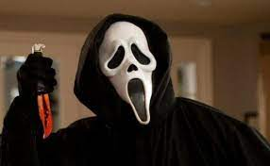
Scream

Slide 22
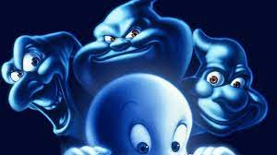
Casper the friendly ghost

Slide 23
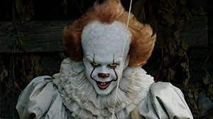
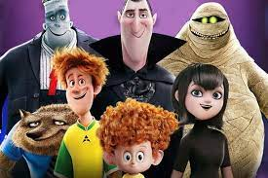
What are your favorite Halloween / Horror movies?

Slide 24
WHAT ARE YOUR EXPERIENCES WITH HALLOWEEN?
Halloween in Spain
Do you like Halloween?
What do you do on Halloween?
Have you ever dressed in a costume?
My costume is…
On Halloween, I like to….

Slide 25
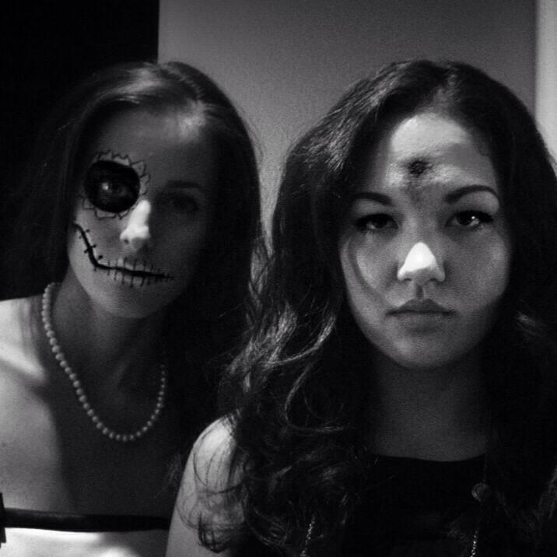
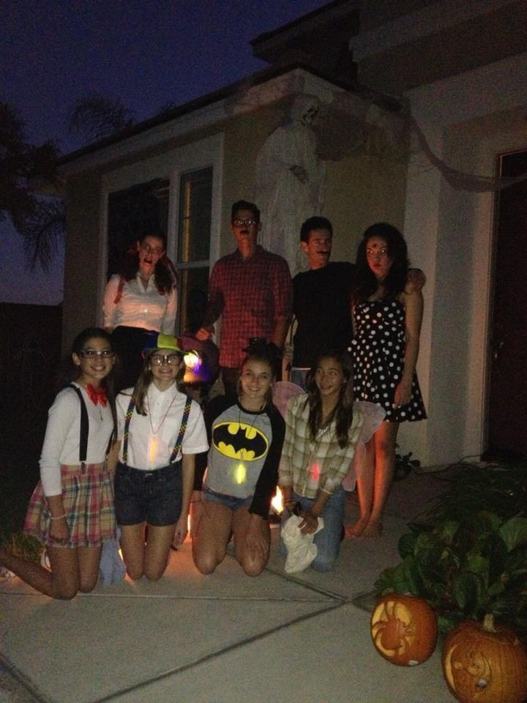

Slide 26
THE END

