Slide 1
Healthy Plate
A Patrick Wong production

Slide 2
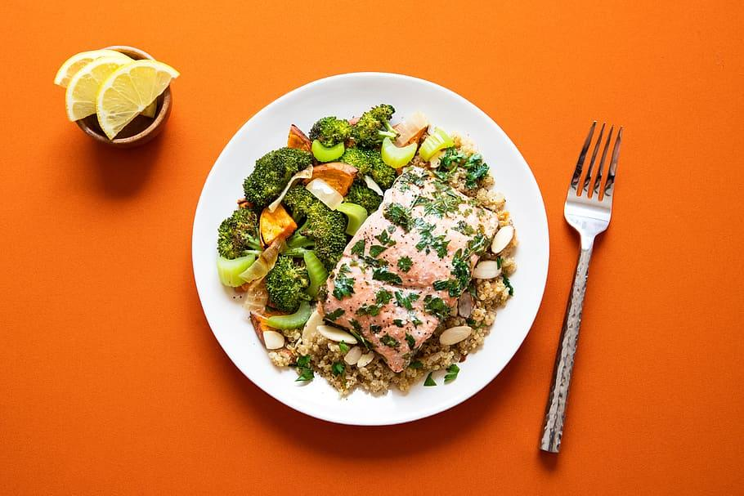
What is Healthy Plate?
Healthy Plate is a guide to help you eat healthier so you can live longer and better. Healthy plate has three parts
Vegetables/fruits, Protein, and Starch,

Slide 3
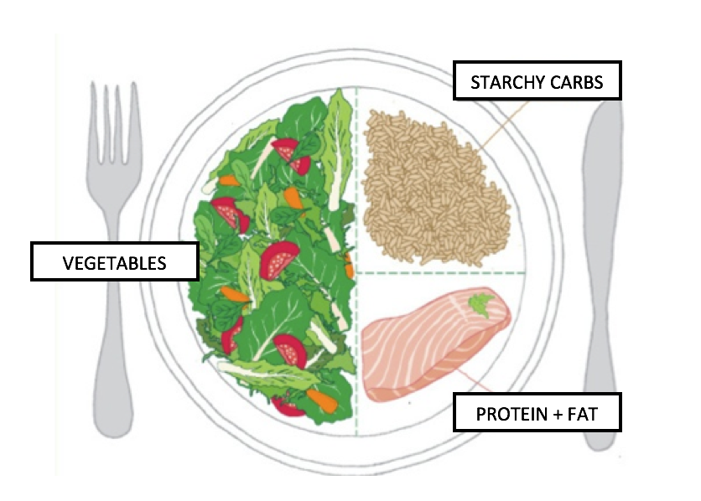
What a healthy plate looks like
The healthy plate is made of three categories and their sizes.
The first, and biggest category, is Vegetables/fruits. 50%
The second is Starches, which is at 25%.
And third is Proteins, which is also at 25%.

Slide 4
Vegetables/Fruits
Vegetables and fruits category should be 50% of the food on your plate, with vegetables being the most important.
It is important that you have a variety of different vegetables and fruits on your plate. The important thing to remember is: the more colors, the better! It is important to eat fruits and vegetables with many different colors!

Slide 5
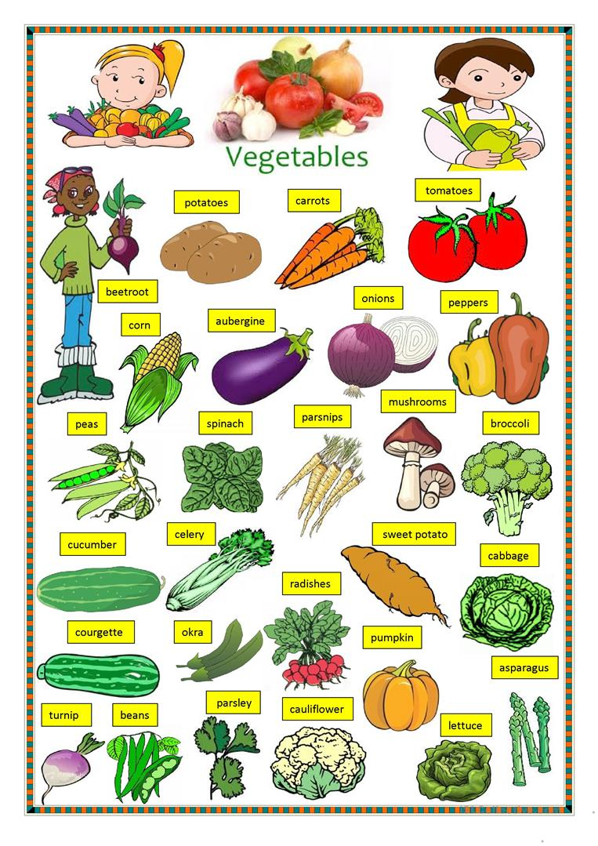
Vegetables
My favorite vegetables are broccoli, carrots, onions, and mushrooms!
Some vegetables have different names in the United Kingdom and the United States.
For example. We say Eggplant in the United States but in England they say Aubergine. Another example is Zucchini (USA) and Courgette (UK).

Slide 6
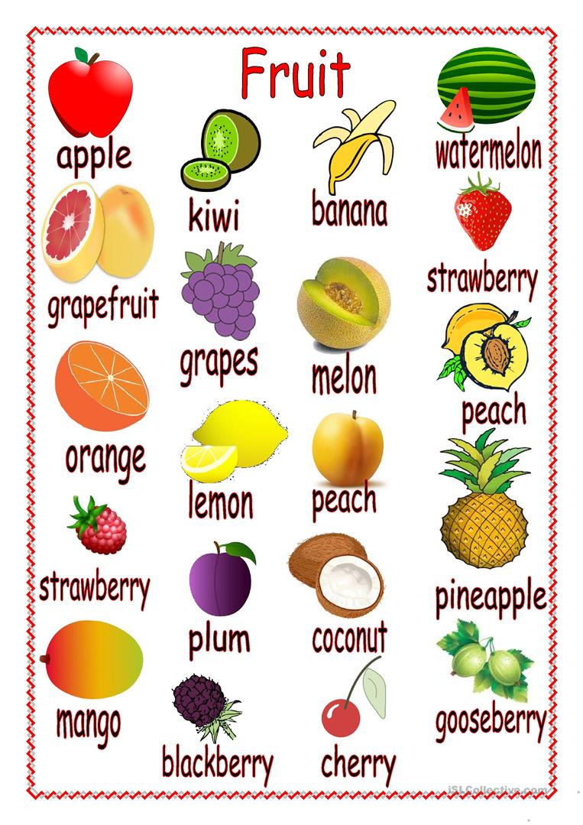
Fruits
Fruits are also very important. Some of my favorite fruits are pears, orange, strawberries, bananas, and grapes.

Slide 7
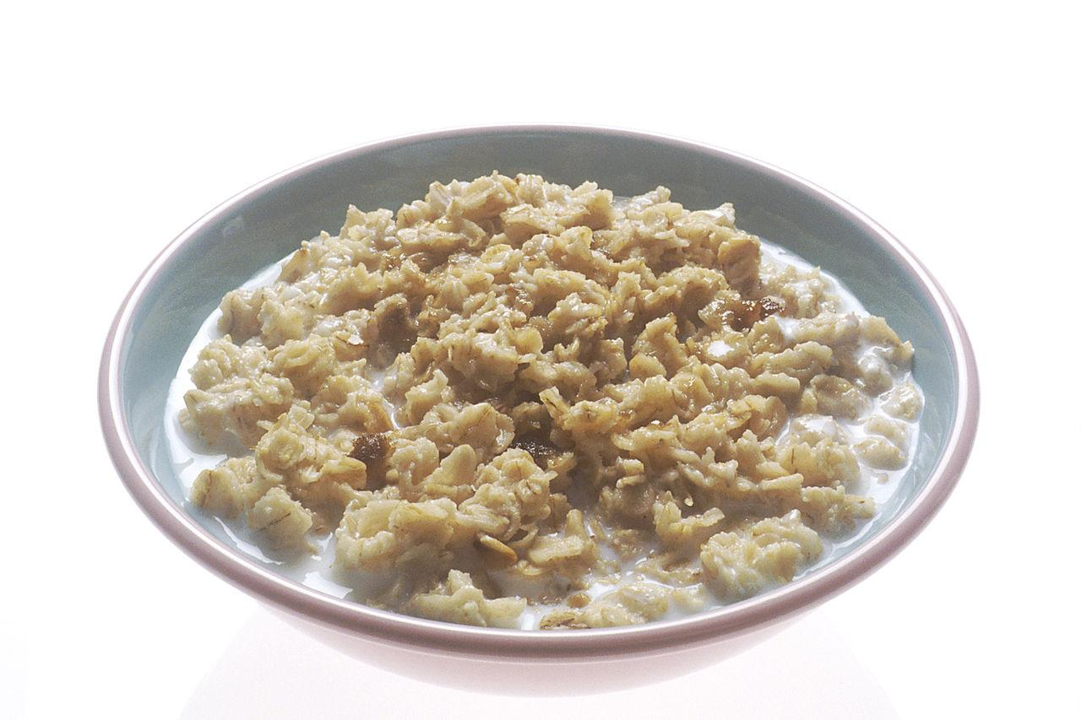
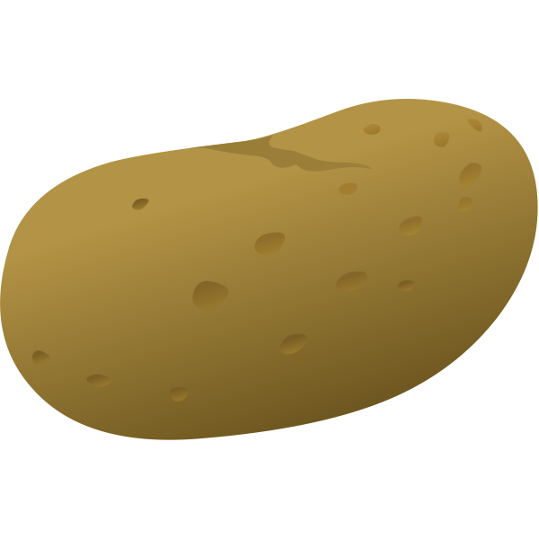
Starches
Starches (and whole grains) should be 25% of your plate. Starches are important because they contain carbohydrates.
Starches include rice, bread, potatoes, and cereals(like oats!).

Slide 8
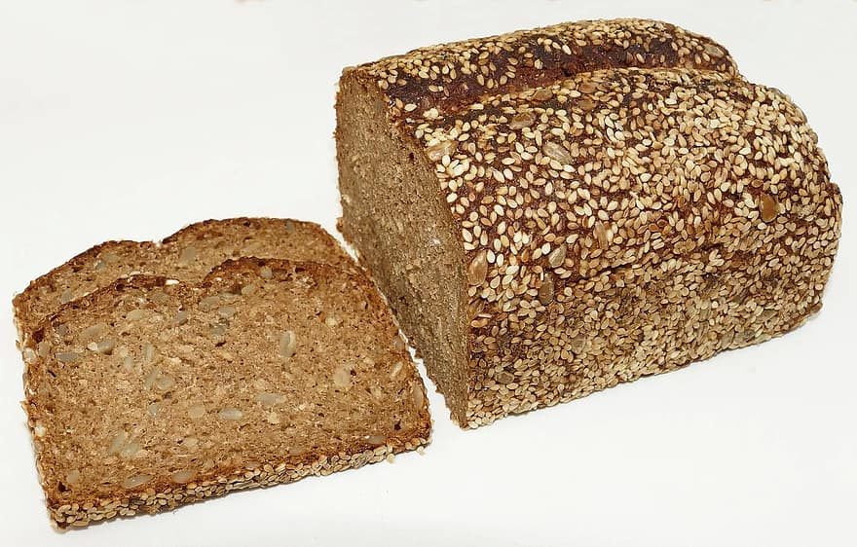
Healthy vs unhealthy starches
Some starches are better than others.
When eating bread, whole wheat bread is the healthier option.
Brown rice is better than white
Whole grain pasta is better than regular pasta.

Slide 9
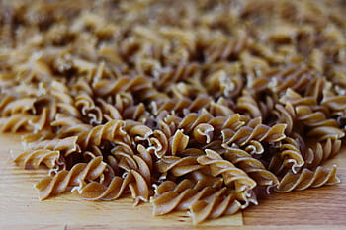
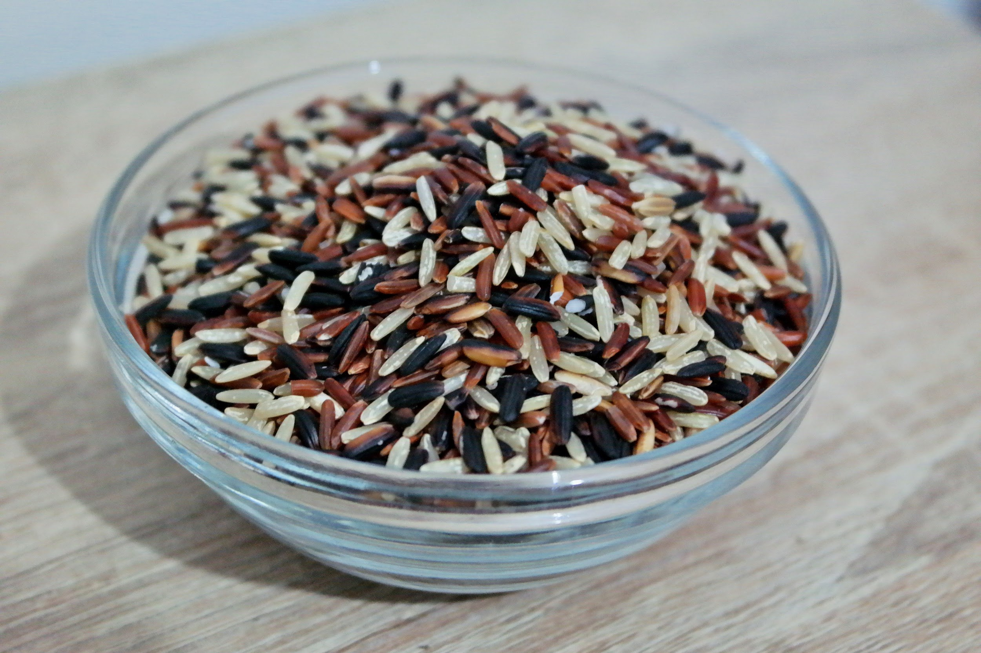

Slide 10
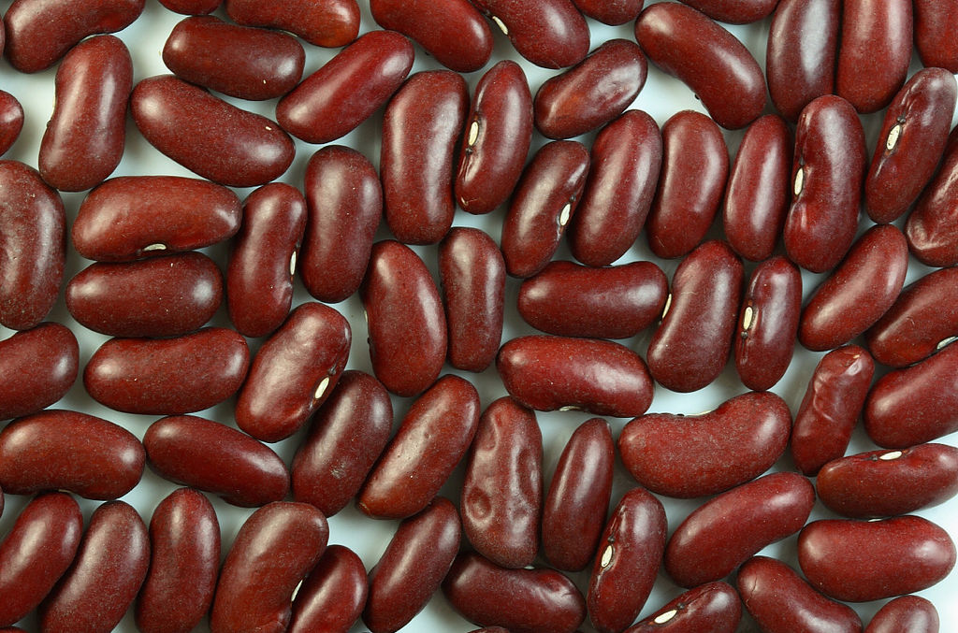
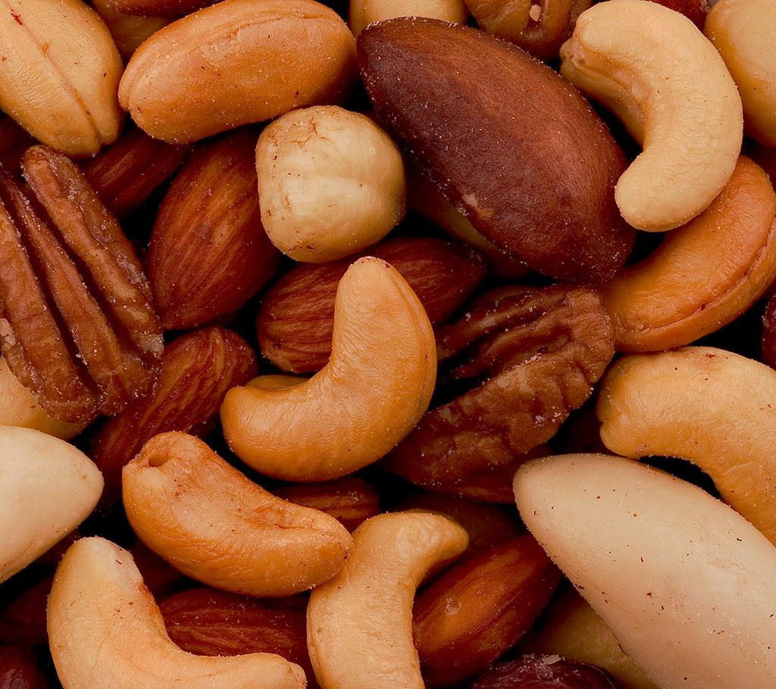
Proteins
Protein is the last category and should be 25% of your plate. One of the most common proteins is meat(chicken, fish, beef, pork). Meat is good for protein but it is not the only option. Dairy products, nuts, and beans are also good proteins.

Slide 11
Not all proteins are the same
Just like Starches, some proteins are better than others.
Lean meats, such chicken and fish are the best types of meat to get protein. Red meats (beef and pork) are also an option but are not as good for you as lean meats.
The worst meat is processed meat and bacon. Processed meats include ham, salami, and sausage. You should to avoid these meats as they are high in sodium and chemical preservatives.
Dairy products are any foods that come from a cow(milk, butter, yogurt, cheese). Like red meat, dairy products can be good but too much is bad. Some dairy products are healthier than others. Yogurt is good but butter is bad!

Slide 12
Some expressions
Here are some expressions you can use in your posters in order to compare and illustrate the healthiness of certain foods.
___ is/are high in both ___ and ___. (e.g. Bananas are high in both vitamins and potassium)
___ is/are higher in ___ but lower in ____ than ____ (Apples are higher in sugar but lower in vitamin C than broccoli)
___ has/have more ____ than ___ (Carrots have more vitamin A than ham)
___ is/are healthier than ___ (Fruits are healthier than processed meats)

