Slide 1
Hockey (NHL)

Slide 2
Hockey Rules
Basics
Each team has 6 players on at a time, with a maximum of 20 players total. On the field there are 2 defensemen, 3 forwards, and 1 goalie.
Each game is 3 periods of 20 minutes each; the clock is stopped when the game is stopped!
Points are earned for goals AND assists. Between 1 and 3 points can be made for each goal. Most goals are 2 points (1 assist + 1 goal) but 2 assists can be given to a goal for a maximum of 3 points (2 assists, 1 goal)

Slide 3
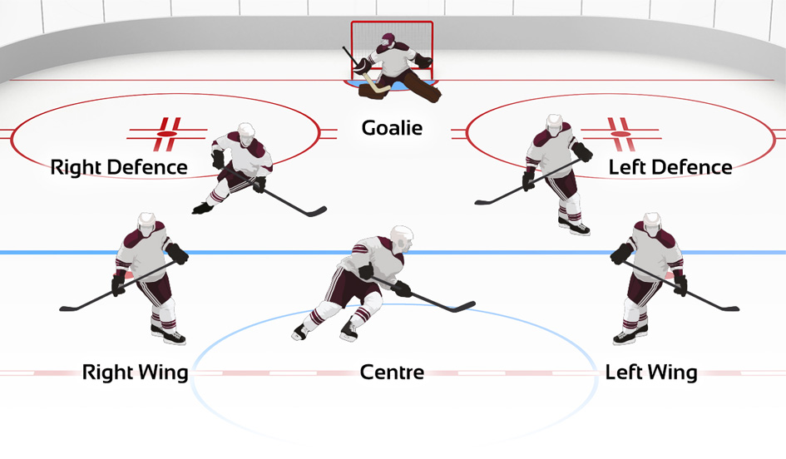

Slide 4
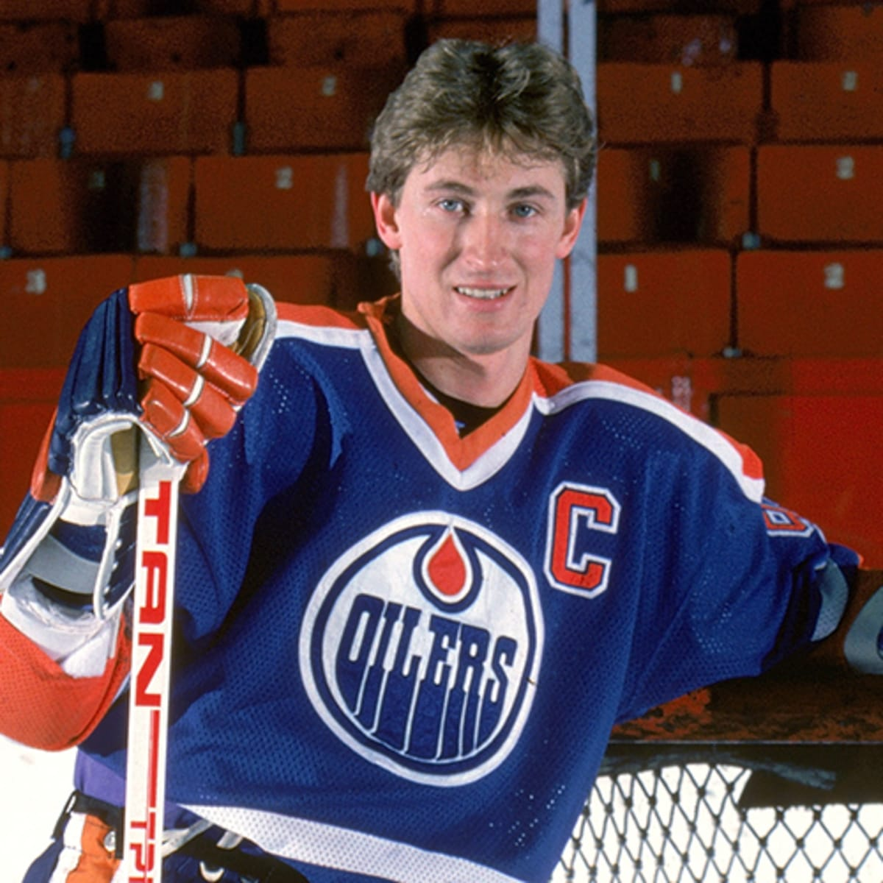
Wayne Gretsky (“The Great one”)
The most important player and, without a doubt, the best player to ever play the game is the Canadian player Wayne Gretsky.
Gretsky is one of the most dominant sportsman ever. Gretsky was more dominant in Hockey than Michael Jordan was in Basketball, or Messi/Ronaldo/Pele were in football.
Gretsky is the leader in the NHL in goals, assists, and points! Gretsky has more assists than any other player has points. That means that, even if Gretsky never scored a goal, he would still hold the record for most points in the NHL.
He is the only NHL player to score 200 points in a season; and he did this 4 times!

Slide 5
Fighting
Fighting is ALLOWED in Hockey and is even encouraged. Fighting in seen as a way to protect star players from being fouled constantly.
Fighting occurs in 20% of hockey games, down from 30-40% 10 years ago. Fighting is becoming less common due to the concern of head injuries to players.
The rules to fighting in Hockey are
Take gloves off
Don’t take your helmet off
Don’t use your hockey stick
A hockey fight ends when one player hits the ice or when the referee decides it’s time to stop. After the fight, both players are suspended for 5 minutes and then allowed to play again.

