Slide 1
The House

Slide 2
There is / There are
Affirmative
There is = hay (singular)
There are = hay (plural)
Negative
There is not / there are not = No hay
Question
Is there? / are there = Hay ?
Remember the articles in English. Un/una = a/an
We use ‘an” when the next word starts with a vowel ( ‘A’ ‘E’ ‘I’ ‘O’ ‘U’ )

Slide 3
Examples
Is there an animal?
There is an animal
There isn’t an animal
Are there any cats?
No, there aren’t any cats
Yes, there are some cats
What animal is there?
There is a dog
There isn’t a dog

Slide 4
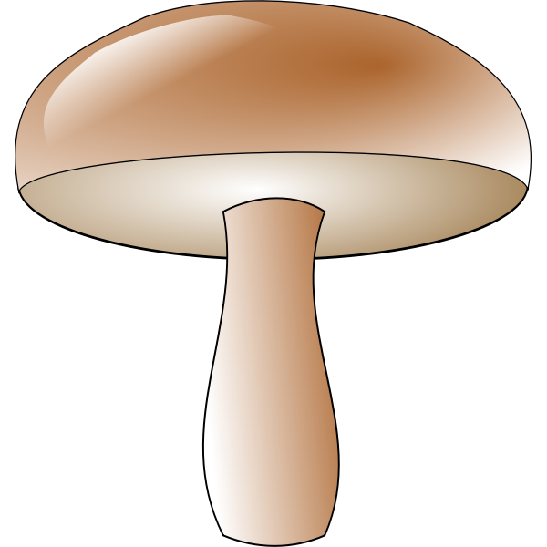
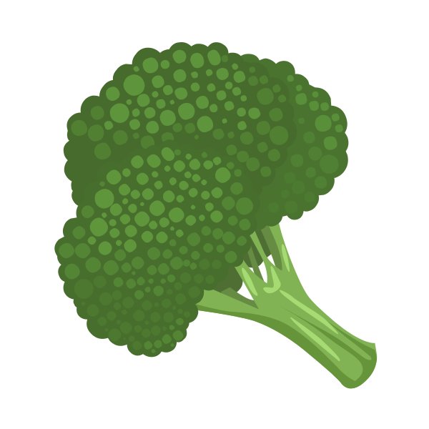
Let’s try with fruit!
Are there any bananas?
Yes, there are some bananas
Are there any mushrooms?
Yes, there is a mushroom
Is there any broccoli / corn?
There is some broccoli
There isn’t any corn
(note: broccoli & corn are the same in both singular and plural)
Are there any aubergines / eggplants?
Yes, there is an eggplant / aubergine

Slide 5
The Home
The rooms of the house.
Bedroom - el dormitorio
Bathroom - el baño
Kitchen - la cocina
Garage - el garaje
Living Room - el salón
Dining room - el comedor

Slide 6
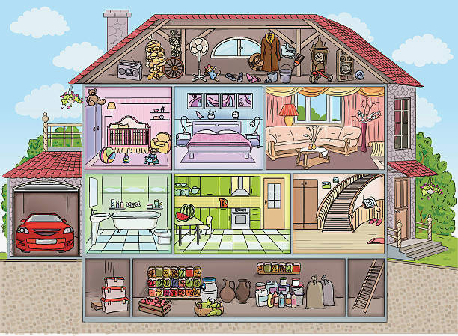

Slide 7
What will we find in a kitchen?
Cupboard - alacena / armario
Fridge - nevera
Rubbish bin - cubo de basura
Sink - fregadero
Cooker - vitrocerámica
Rubbish = basura, but in the united states we say “trash”.
Rubbish bin = trash can

Slide 8
What will we find in a bedroom?
Bed - cama
Curtain - cortina
Desk - escritorio
Lamp - lámpara
Shelf - estante
Wardrobe (for clothes) - armario

Slide 9
Bathroom / Dining room
Bathroom:
Shower - ducha
Toilet - indoro
Dining Room
Rug - alfombra
Table - mesa
Armchair - sillón

Slide 10
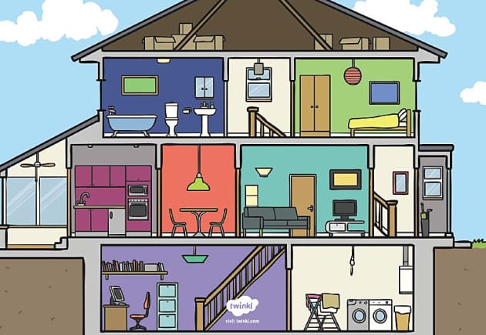

Slide 11
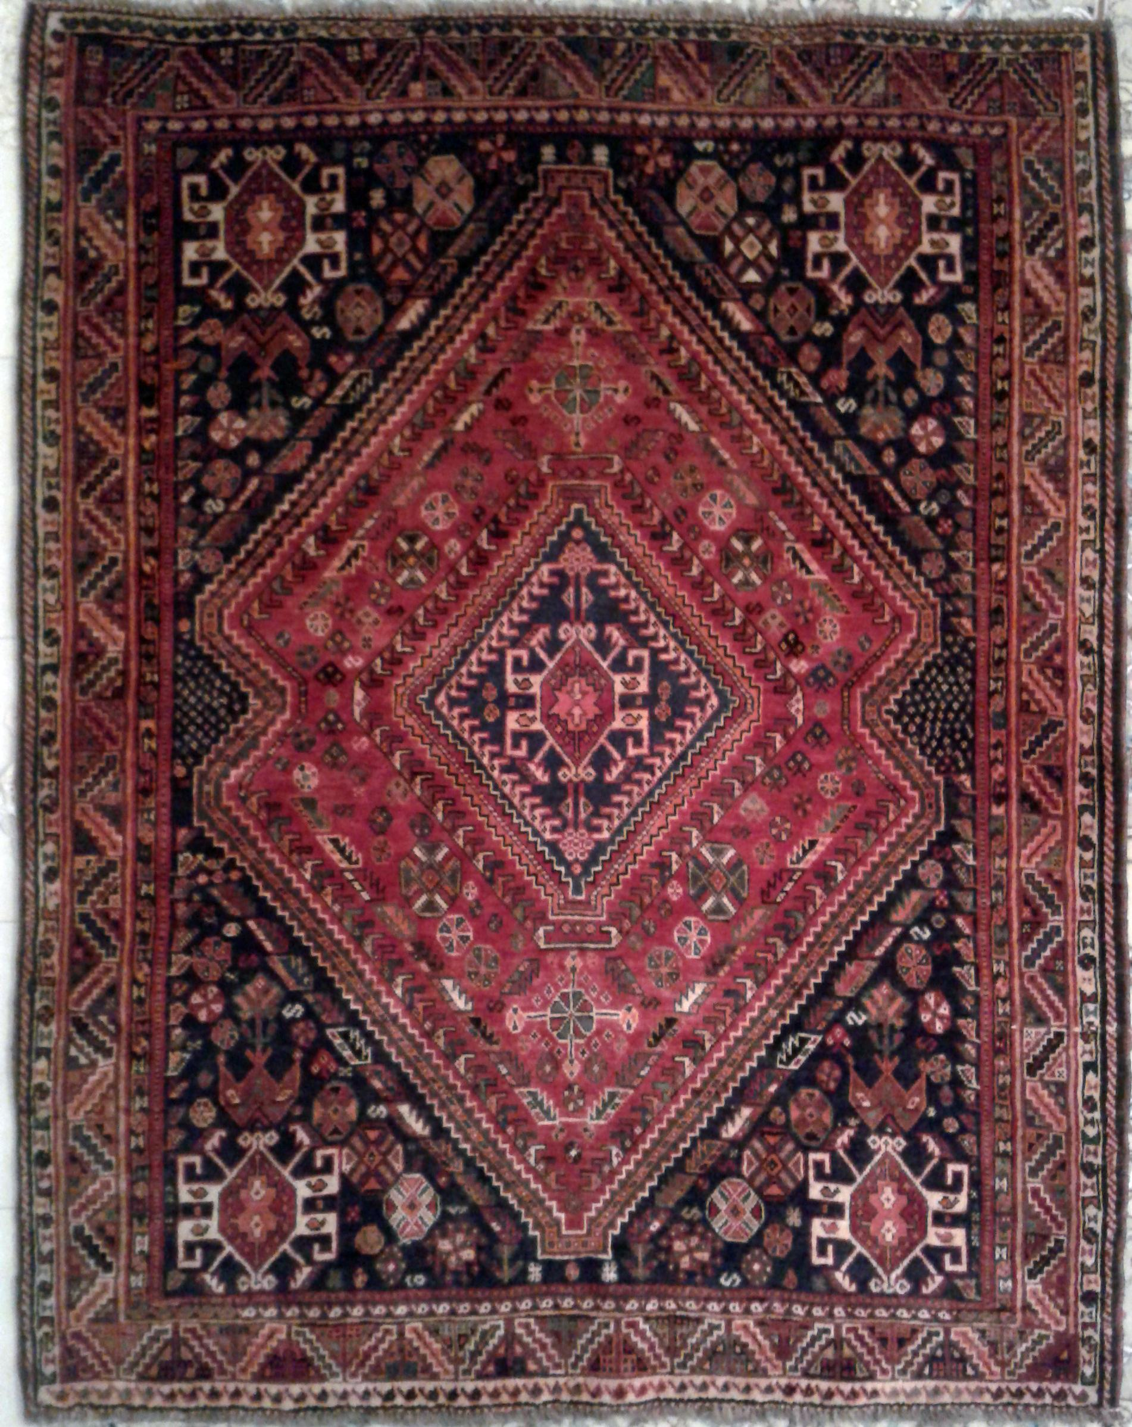
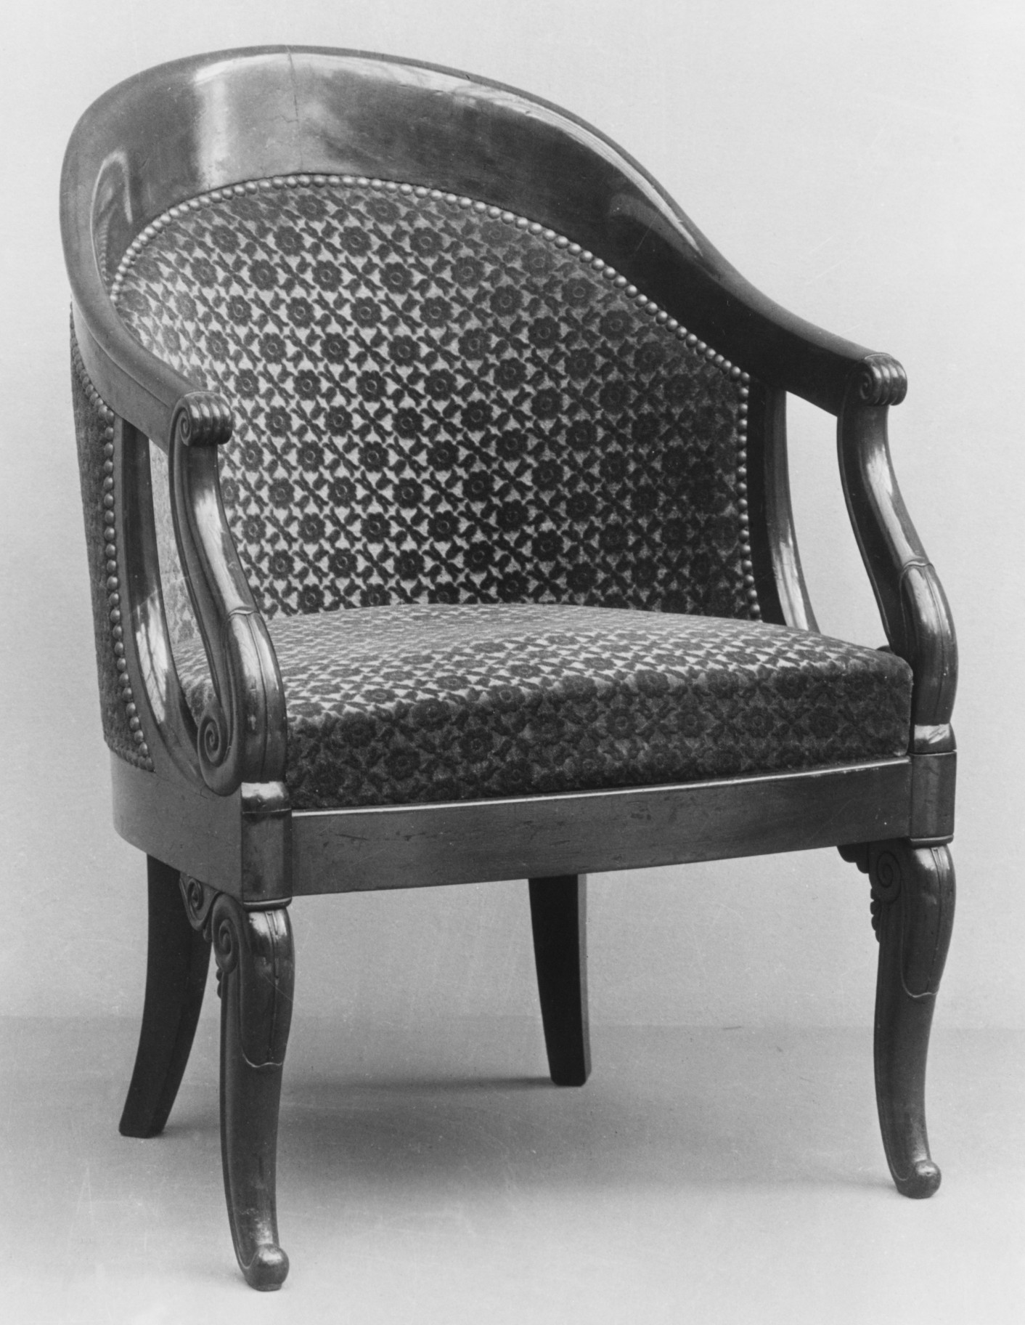
Rug
Armchair

