Slide 1
Today’s schedule
Today, we are going to do some exercises. These exercises will involve writing, listening, and vocabulary/grammar.
After these exercises, we will play a game (charades!)

Slide 2
Quick Review!
Today, I go to school.
(affirmative) Yesterday, I ____ to school
Yesterday, I went to school
(negative) Yesterday, I ____ to school
Yesterday, I did not go to school / Yesterday I didn’t go to school
There is a tornado
(affirmative) There ___ a tornado
There was a tornado
(negative) There ___ a tornado
There wasn’t a tornado / There was not a tornado

Slide 3
Now let’s try a couple more!
Did you study for the test?
No, I _____ for the test
No, I didn’t study for the test
Were you at school?
Yes, I ____ at school
Yes, I was at school

Slide 4
Listen and Answer
Where did Patrick and Robert go?
What did they do on their first day?
Did Patrick go surfing? Why or why not?
Why didn’t they go to the beach on the second day?
What did they do on the second day?
What did they do on the third day?
Patrick and Robert danced at the disco (True or false?)
What did they do on their last day?
How would you describe Robert

Slide 5
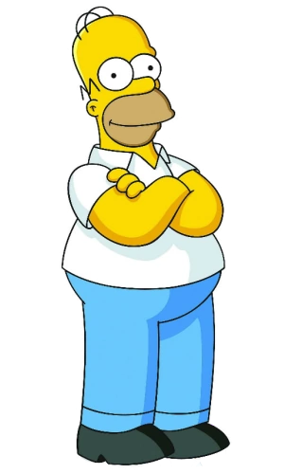
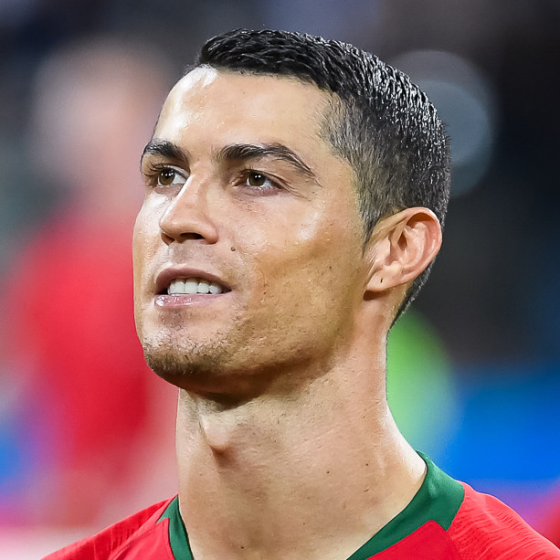
Descriptions.
Homer Simpson is:
Fun-loving
Funny
Lazy
How would you describe these people?
Cristiano Ronaldo is:
Athletic
Confident
Hard-working
Strong

Slide 6
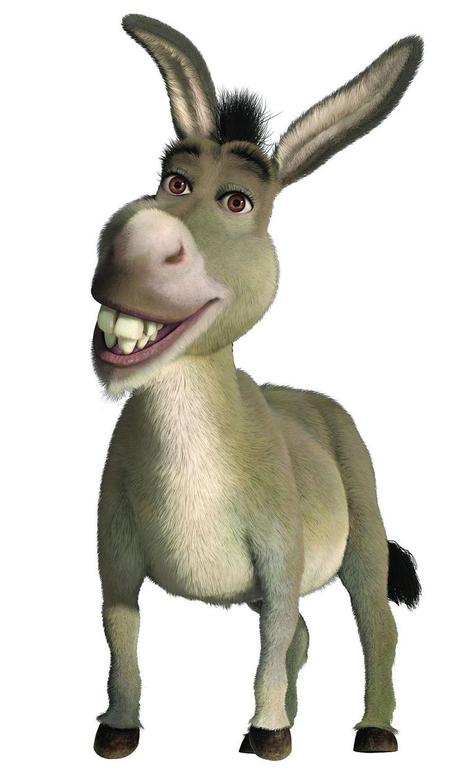
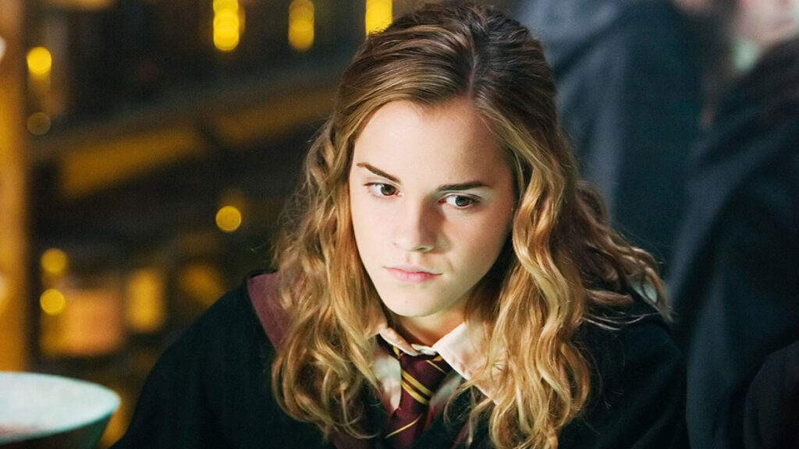
Donkey is:
Adventurous
Easy-going
Friendly
Fun-loving
Generous
Kind
Hermione is:
Brave
Clever
Hard-working
Honest

Slide 7
Let’s try writing!
Think of a friend. Please write a few sentences about your friend and compare YOURSELF to your friend. What is similar about you and your friend? What is different? Hint: Use comparatives! For example: Robert likes to play football and he is better than me. Robert is more athletic than me / Robert doesn’t like to cook. Robert is lazier than me.
Now think of a family member (mom, brother, uncle, etc). Write a few sentences (4 or more!) about them. What do they like to do? How would you describe their personality? How would you describe their physical appearance?

