Slide 1
Weather

Slide 2
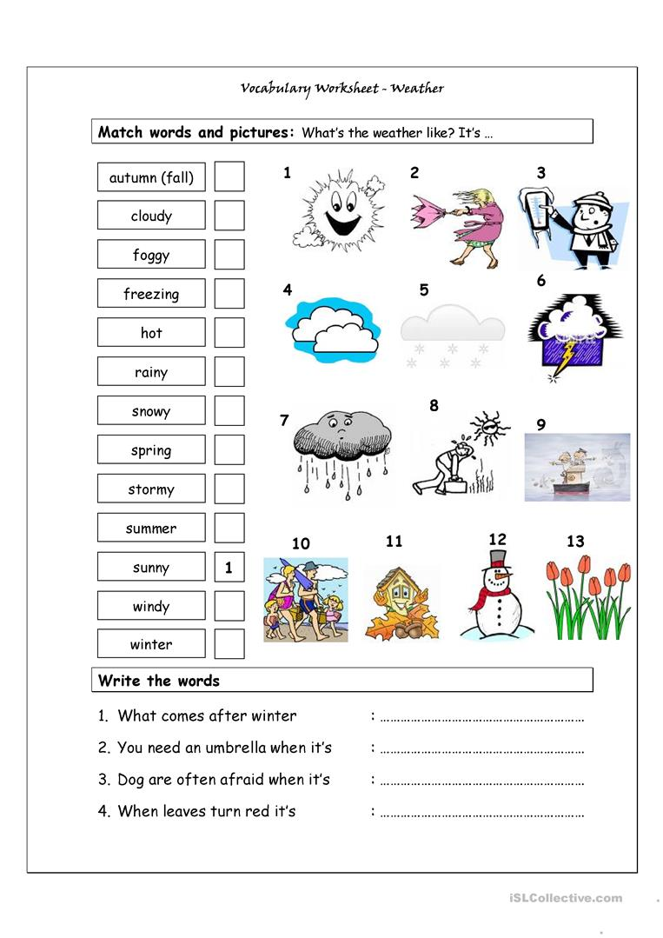
Let’s review together!
11
4
9
3
8
7
5
13
6
10
1
2
12
Spring
Rainy
Stormy (thunder)
Autumn (fall)

Slide 3
Now you try! Complete the sentences
Sometimes it’s so ___ that you can’t see anything!
It’s very ___ here, we need some rain!
I like to go to the beach when it’s ___ and ___
(t/f) Madrid is cooler in the winter than the summer
It’s so cloudy, that I can’t see the ___
Generally, the ___ is higher in the summer than the winter
Sun
Hot
Sunny
Foggy
Dry
Temperature
Foggy
Dry
Hot / sunny
True
Sun
temperature

Slide 4
Comparatives
Make a sentence using these words and the comparative!
Ex ) Norway / Spain / Cold ----> Norway is colder than Spain
Sahara Desert / Barcelona / Dry
Mountains / Beach / Cold
Malaga / Galicia / warm
Warm weather / cool weather / good
Madrid / Cazorla / far
The Sahara desert is drier than Barcelona
The mountains are colder than the beach
Malaga is warmer than Galicia
Warm weather is better than cool weather
Madrid is further / farther than Cazorla

Slide 5
Oral dictation
My favorite season is winter because it’s ___ and we can play in the ___
I think there’s a ___, I can hear ___
I don’t want to walk to school in the ___, it’s too ___
I think ___ weather is better than ___ weather
The south of Spain is drier and ___ than the north of Spain
It’s so cold that the rain turned into ___
It’s ___ and ___, I don’t want to go to the beach!
True or false?
True or false?
True or false?
Cold / snow
Storm / thunder
Rain / wet
Warm / cool
Hotter
Ice
Rainy / windy
False
True
True

