Slide 1
JEOPARDY BOARD
FINAL JEOPARDY
Fruits | Vegetables | Healthy Plate | Mystery | Protein/Starch
$100 | $100 | $100 | $100 | $100
$200 | $200 | $200 | $200 | $200
$300 | $300 | $300 | $300 | $300
$400 | $400 | $400 | $400 | $400
$500 | $500 | $500 | $500 | $500

Slide 6
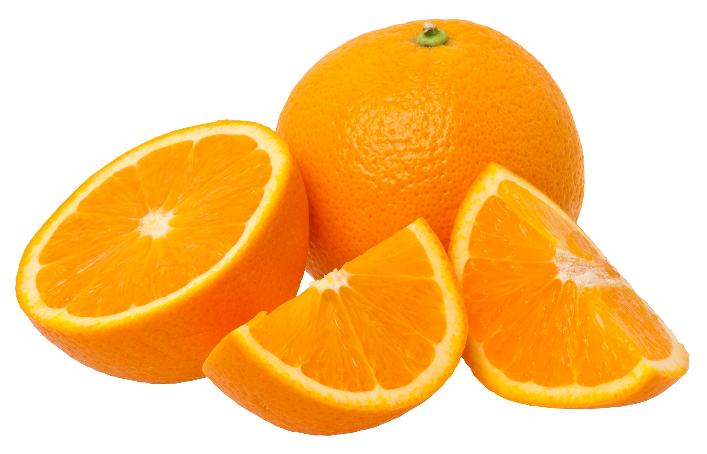
Topic 1 - $100 Question
Click to see answer

Slide 7
Topic 1 - $100 Answer
What is Orange?
Click to return to Jeopardy Board

Slide 8
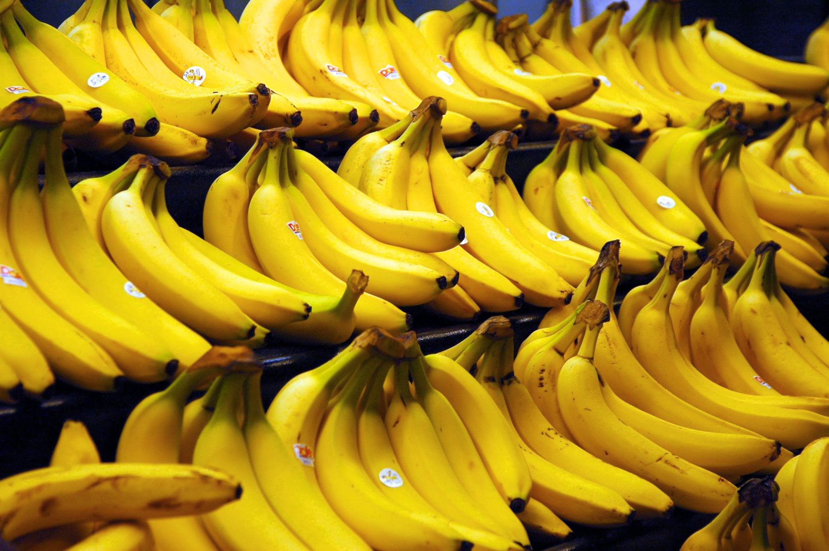
Topic 1 - $200 Question
Click to see answer

Slide 9
Topic 1 - $200 Answer
What is Banana?
Click to return to Jeopardy Board

Slide 10
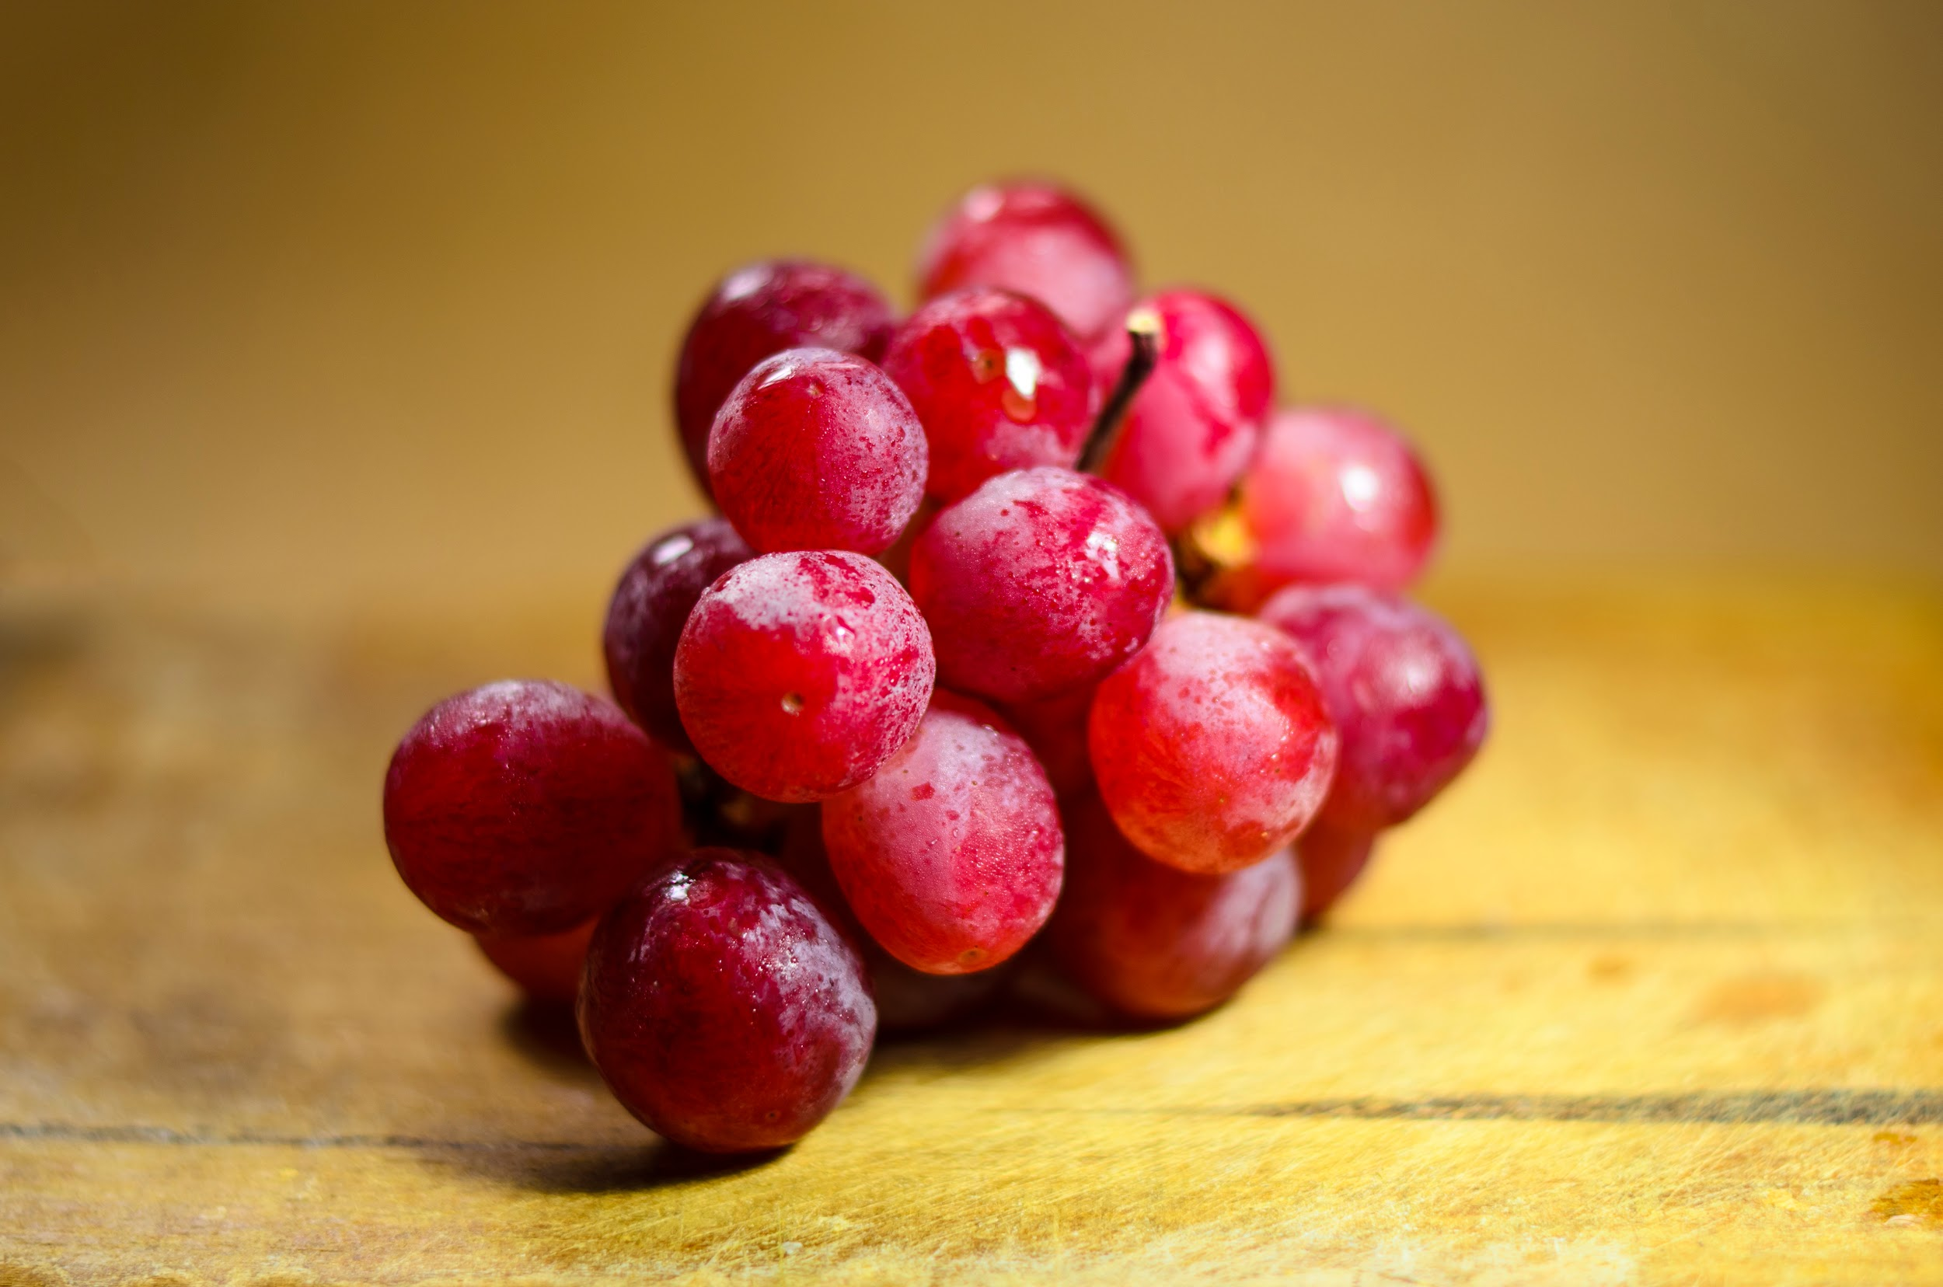
Topic 1 - $300 Question
Click to see answer

Slide 11
Topic 1 - $300 Answer
What is Grapes?
Click to return to Jeopardy Board

Slide 12
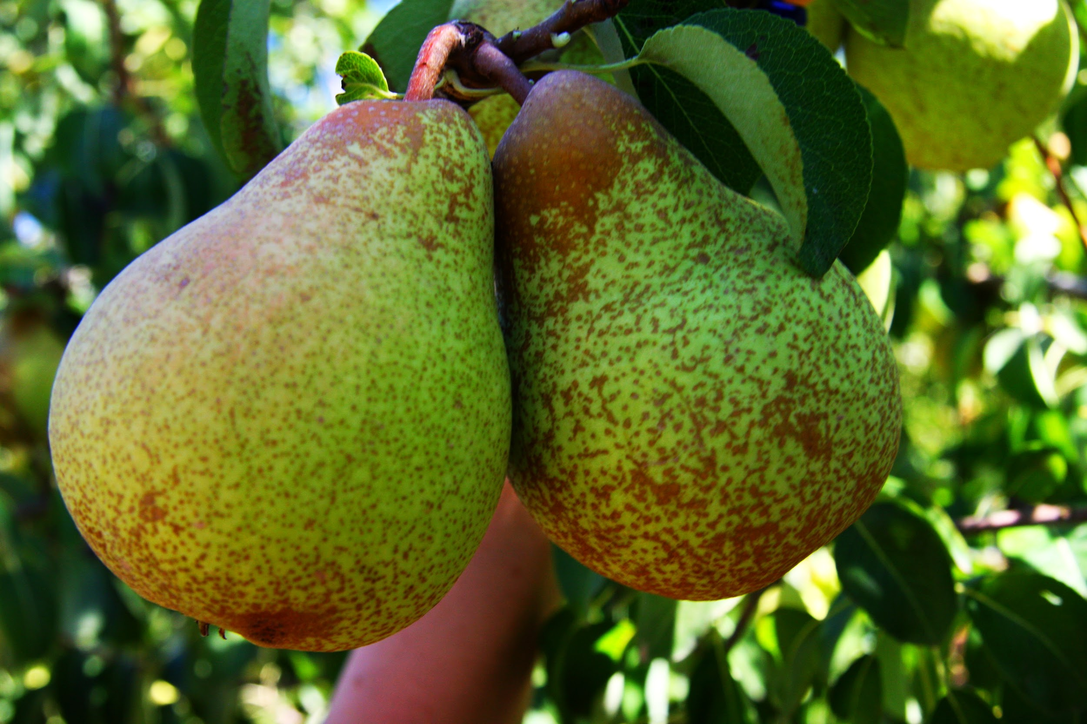
Topic 1 - $400 Question
Click to see answer

Slide 13
Topic 1 - $400 Answer
What is Pear?
Click to return to Jeopardy Board

Slide 14
Topic 1 - $500 Question
Click to see answer

Slide 15
Topic 1 - $500 Answer
What is Apple and Strawberry?
Click to return to Jeopardy Board

Slide 16
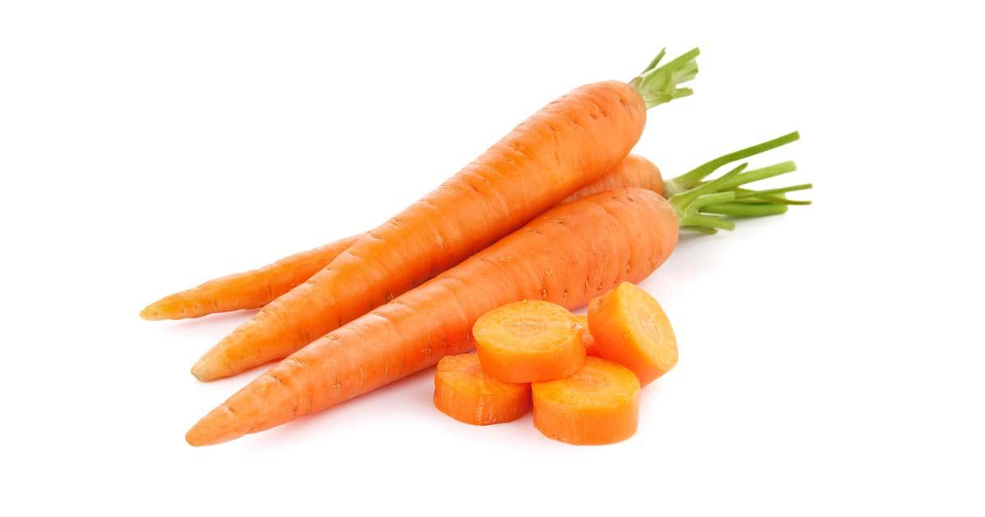
Topic 2 - $100 Question
Click to see answer

Slide 17
Topic 2 - $100 Answer
What is Carrot?
Click to return to Jeopardy Board

Slide 18
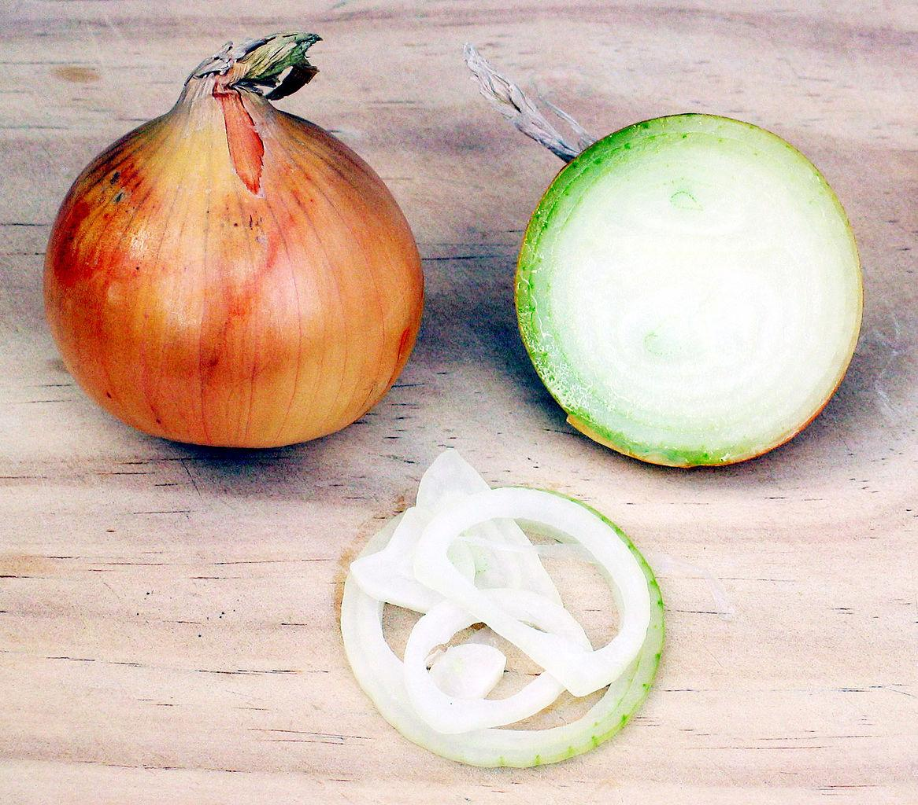
Topic 2 - $200 Question
Click to see answer

Slide 19
Topic 2 - $200 Answer
What is Onion?
Click to return to Jeopardy Board

Slide 20
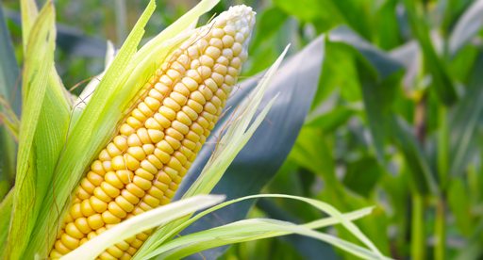
Topic 2 - $300 Question
Click to see answer

Slide 21
Topic 2 - $300 Answer
What is Corn?
Click to return to Jeopardy Board

Slide 22
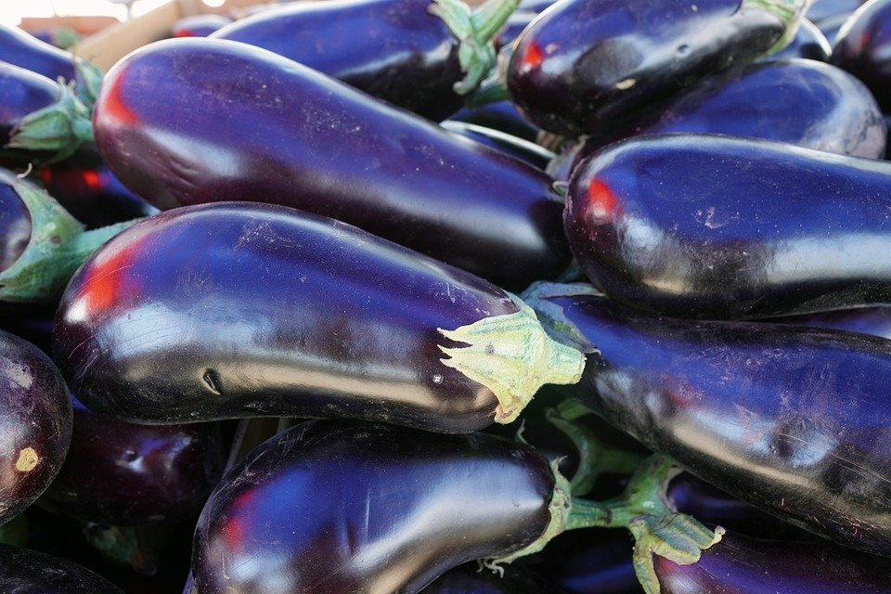
Topic 2 - $400 Question
Click to see answer

Slide 23
Topic 2 - $400 Answer
What is Aubergine / Eggplant?
Click to return to Jeopardy Board

Slide 24
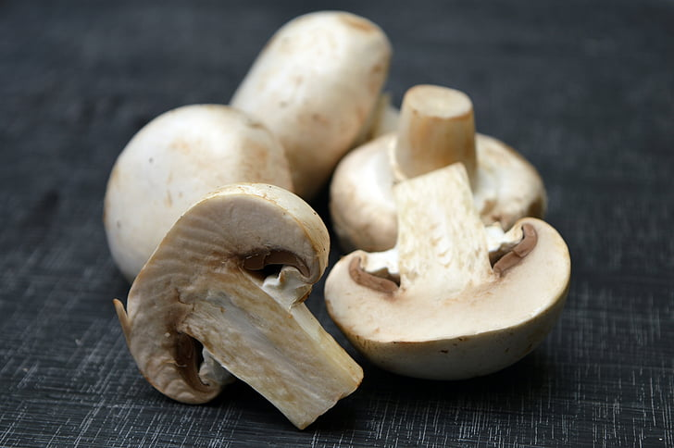
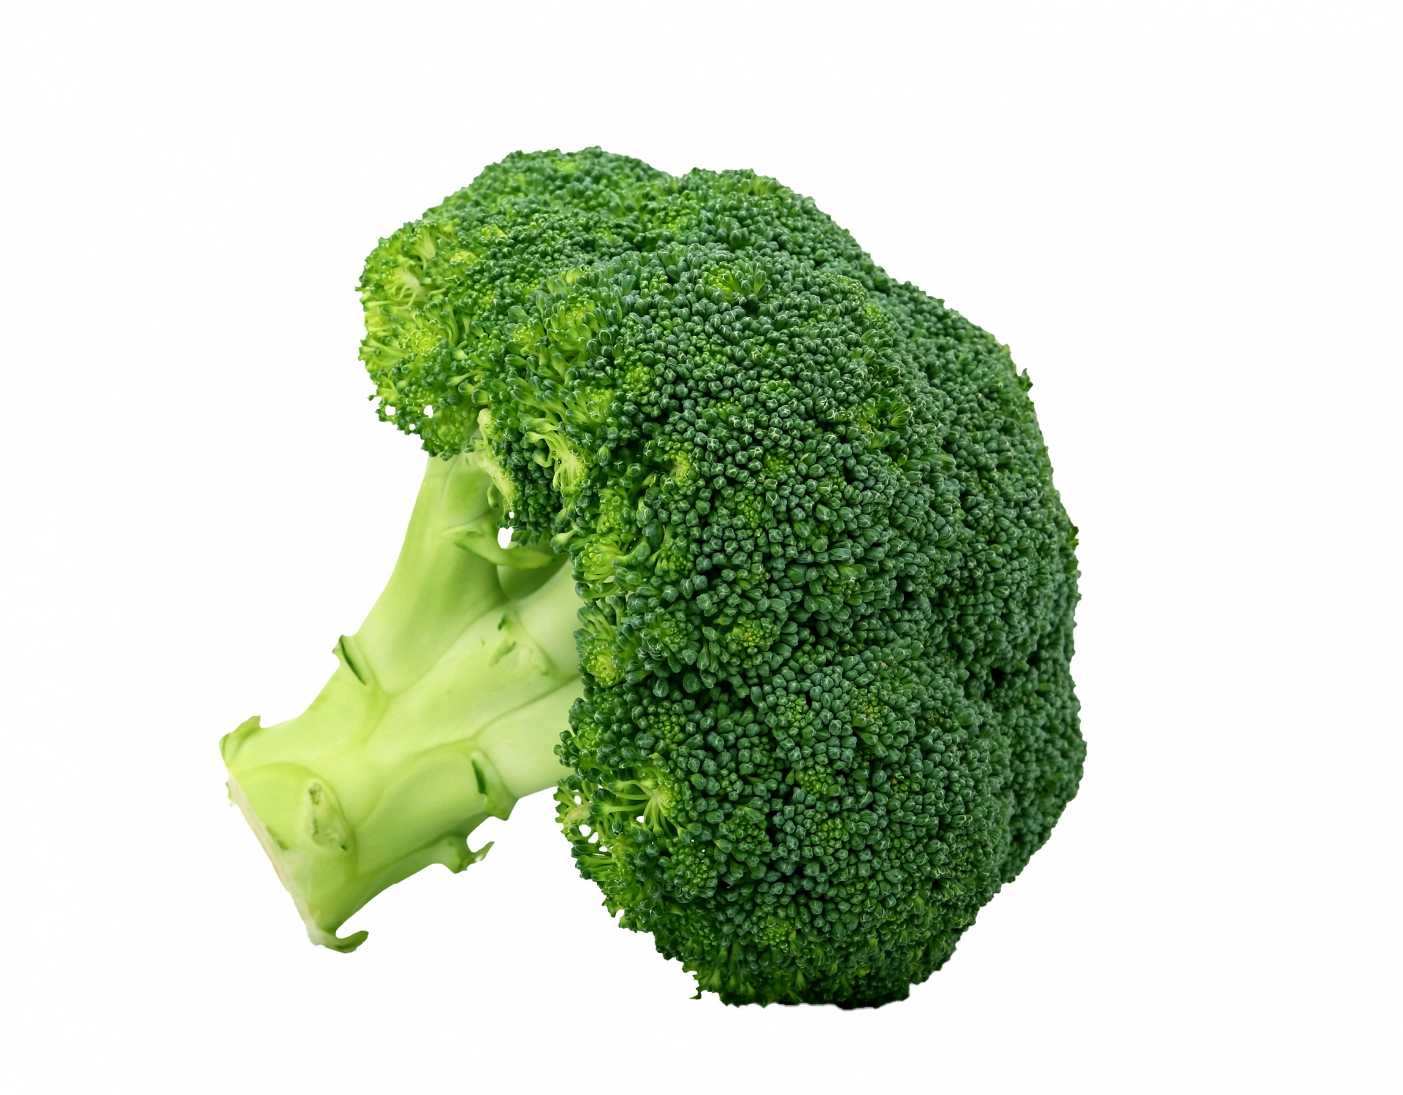
Topic 2 - $500 Question
Click to see answer

Slide 25
Topic 2 - $500 Answer
What is Broccoli and Mushrooms?
Click to return to Jeopardy Board

Slide 26
Topic 3 - $100 Question
How many parts are there on the healthy plate?
Click to see answer

Slide 27
Topic 3 - $100 Answer
What is three (parts)?
Click to return to Jeopardy Board

Slide 28
Topic 3 - $200 Question
What is the largest part of Healthy Plate?
Click to see answer

Slide 29
Topic 3 - $200 Answer
What is Fruits & Vegetables?
Click to return to Jeopardy Board

Slide 30
Topic 3 - $300 Question
Beans and Dairy are part of which category?
Click to see answer

Slide 31
Topic 3 - $300 Answer
What is Protein?
Click to return to Jeopardy Board

Slide 32
Topic 3 - $400 Question
Complete the sentence
You want fruits and vegetables of different _____; the more the better!
Click to see answer

Slide 33
Topic 3 - $400 Answer
What is colors?
Click to return to Jeopardy Board

Slide 34
Topic 3 - $500 Question
Which is healthier? (2 answers)
Beef or Fish?
White Bread or wholewheat?
Click to see answer

Slide 35
Topic 3 - $500 Answer
What is Fish and Wholewheat?
Click to return to Jeopardy Board

Slide 36
Topic 4 - $100 Question
What is this?
Click to see answer

Slide 37
Topic 4 - $100 Answer
What is a witch?
Click to return to Jeopardy Board

Slide 38
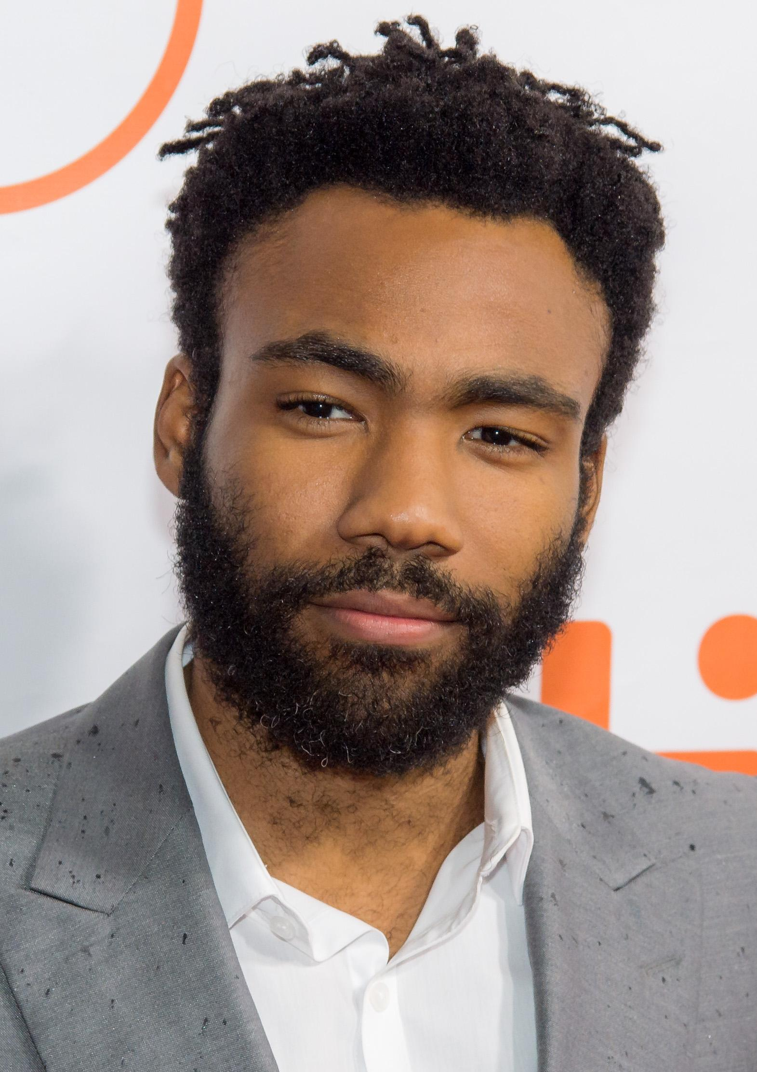
Topic 4 - $200 Question
Give two words to describe this man’s hair
Click to see answer

Slide 39
Topic 4 - $200 Answer
What is (short) (black) (curly)?
Click to return to Jeopardy Board

Slide 40
Topic 4 - $300 Question
On halloween, I am going to carve my pumpkin and make a _____
Click to see answer

Slide 41
Topic 4 - $300 Answer
What is Jack-o’-lantern?
Click to return to Jeopardy Board

Slide 42
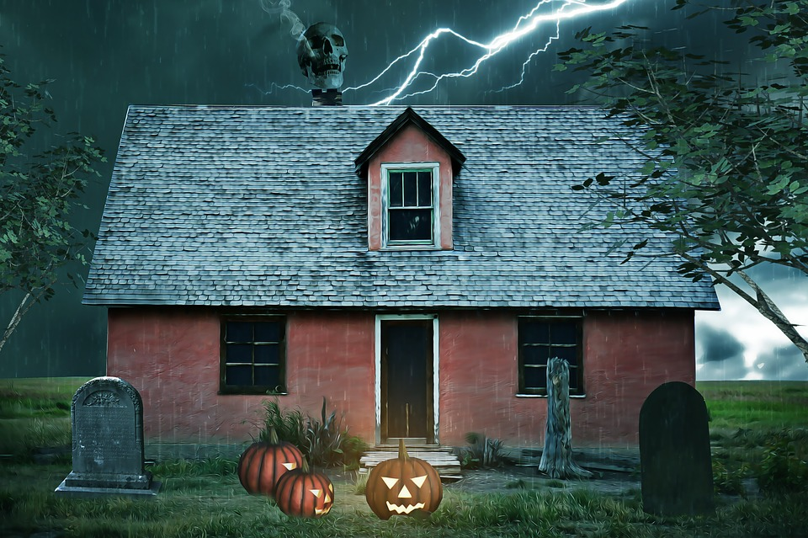
Topic 4 - $400 Question
What is this?
Click to see answer

Slide 43
Topic 4 - $400 Answer
What is Haunted House?
Click to return to Jeopardy Board

Slide 44
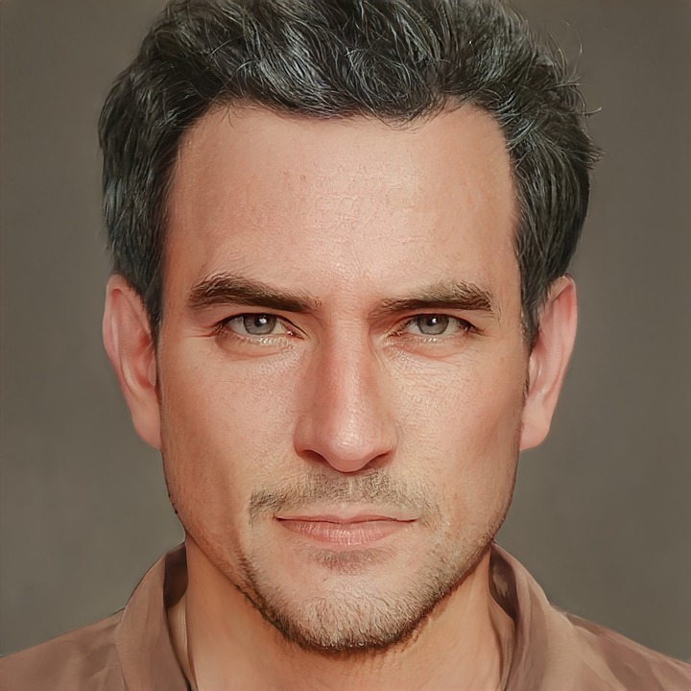
Topic 4 - $500 Question
He’s not young, he’s not old, he’s _____
Click to see answer

Slide 45
Topic 4 - $500 Answer
What is middle-aged?
Click to return to Jeopardy Board

Slide 46
Topic 5 - $100 Question
Which is healthier(better for you), white or brown rice?
Click to see answer

Slide 47
Topic 5 - $100 Answer
What is Brown rice?
Click to return to Jeopardy Board

Slide 48
Topic 5 - $200 Question
Beans and nuts belong to which category, starch or protein?
Click to see answer

Slide 49
Topic 5 - $200 Answer
What is Protein?
Click to return to Jeopardy Board

Slide 50
Topic 5 - $300 Question
Name three foods from the starch category
Click to see answer

Slide 51
Topic 5 - $300 Answer
What is (bread) (pasta) (rice) (potatoes) (cereal)
Click to return to Jeopardy Board

Slide 52
Topic 5 - $400 Question
Which is healthier?
Chicken or Ham ?
Beef or Bacon?
Click to see answer

Slide 53
Topic 5 - $400 Answer
What is Chicken and Beef?
Click to return to Jeopardy Board

Slide 54
Topic 5 - $500 Question
Whole -____ Pasta and Whole-____ bread are healthier than regular pasta and white bread
Click to see answer

Slide 55
Topic 5 - $500 Answer
What is (whole) wheat and (whole) grain?
Click to return to Jeopardy Board

Slide 56
FINAL
On a piece of paper, write down how much money you want to use.
On the same piece of paper, write down your answer
After you’re done, I will collect the papers and see who is correct
Click to see question

Slide 57
Final Jeopardy Question
Name three dairy products
Click to see answer

Slide 58
Final Jeopardy Answer
What is (milk) (cheese) (yogurt) (butter) (ice cream)
Click to return to Jeopardy Board

