Slide 1
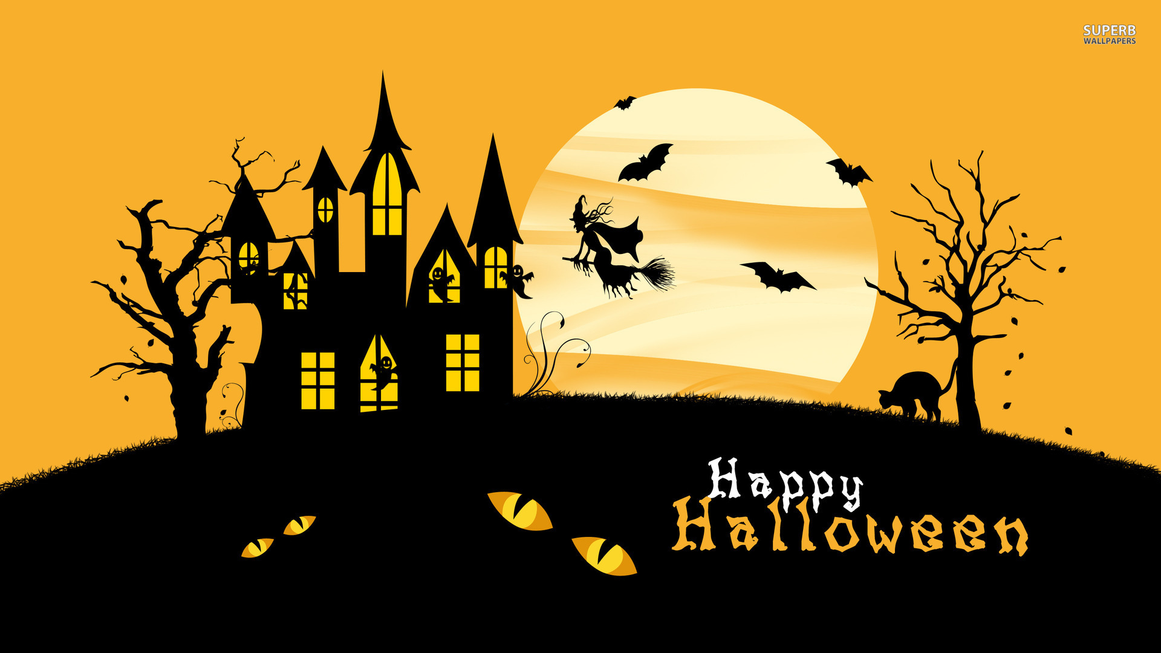

Slide 2
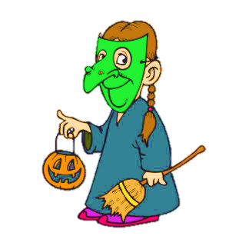
Guess the hidden picture by turning around the smallest number of boxes.

Slide 3
1/10
What’s the hidden picture?
It’s a Jack o’lantern
NEXT
CHECK

Slide 4
2/10
What’s the hidden picture?
It’s a black cat
NEXT
CHECK

Slide 5
3/10
What’s the hidden picture?
It’s a bat
NEXT
CHECK

Slide 6
4/10
What’s the hidden picture?
It’s a witch
NEXT
CHECK

Slide 7
5/10
What’s the hidden picture?
It’s a ghost
NEXT
CHECK

Slide 8
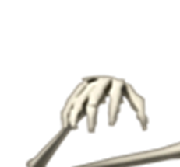
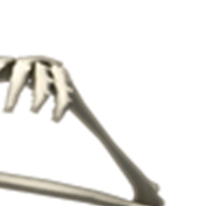
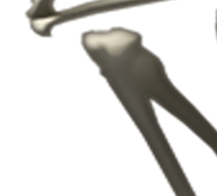
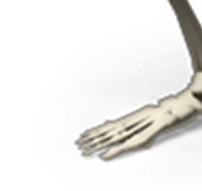
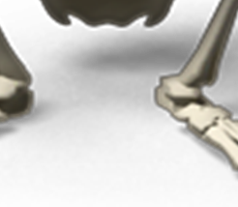
6/10
What’s the hidden picture?
It’s a skeleton
NEXT
CHECK

Slide 9
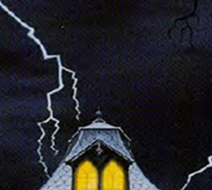
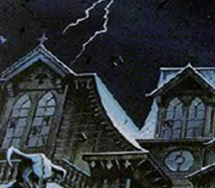
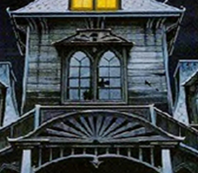
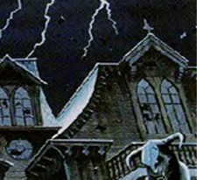
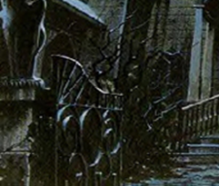
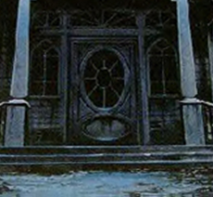
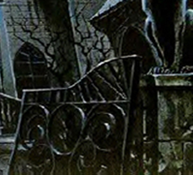
7/10
What’s the hidden picture?
It’s a haunted house
NEXT
CHECK

Slide 10
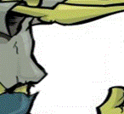
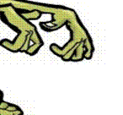
8/10
What’s the hidden picture?
It’s a zombie
NEXT
CHECK

Slide 11
9/10
What’s the hidden picture?
It’s a vampire
NEXT
CHECK

Slide 12
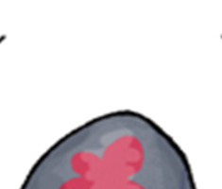
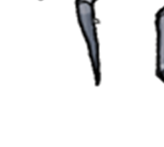
10/10
What’s the hidden picture?
It’s a spider
NEXT
CHECK

Slide 13
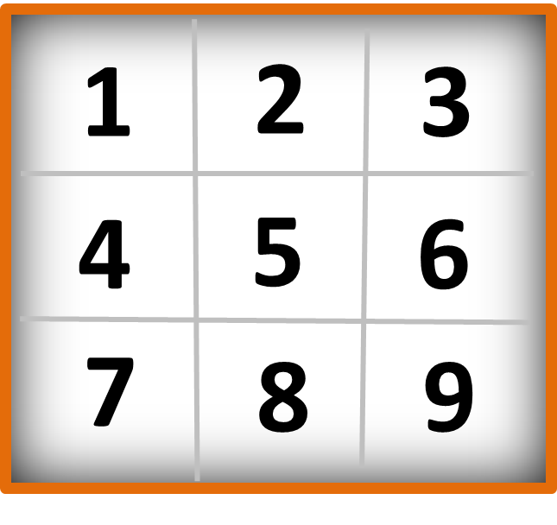
What piece fits into number one?

Slide 14
What piece fits into number two?

Slide 15
What piece fits into number three?

Slide 16
What piece fits into number four?

Slide 17
What piece fits into number five?

Slide 18
What piece fits into number six?

Slide 19
What piece fits into number seven?

Slide 20
What piece fits into number eight?

Slide 21
What piece fits into number nine?

Slide 22
What’s this?
It’s a black cat
NEXT
CHECK

Slide 23
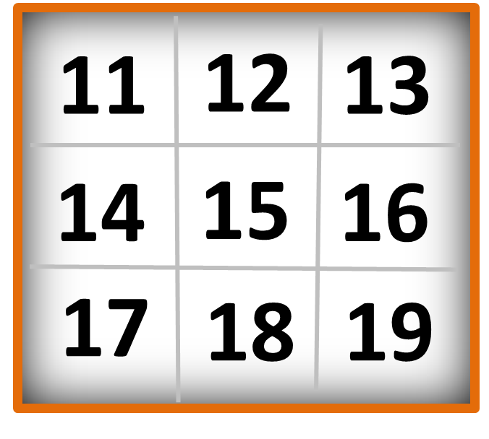
What piece fits into number eleven?

Slide 24
What piece fits into number twelve?

Slide 25
What piece fits into number thirteen?

Slide 26
What piece fits into number fourteen?

Slide 27
What piece fits into number fifteen?

Slide 28
What piece fits into number sixteen?

Slide 29
What piece fits into number seventeen?

Slide 30
What piece fits into number eighteen?

Slide 31
What piece fits into number nineteen?

Slide 32
What’s this?
It’s a bat
NEXT
CHECK

Slide 33
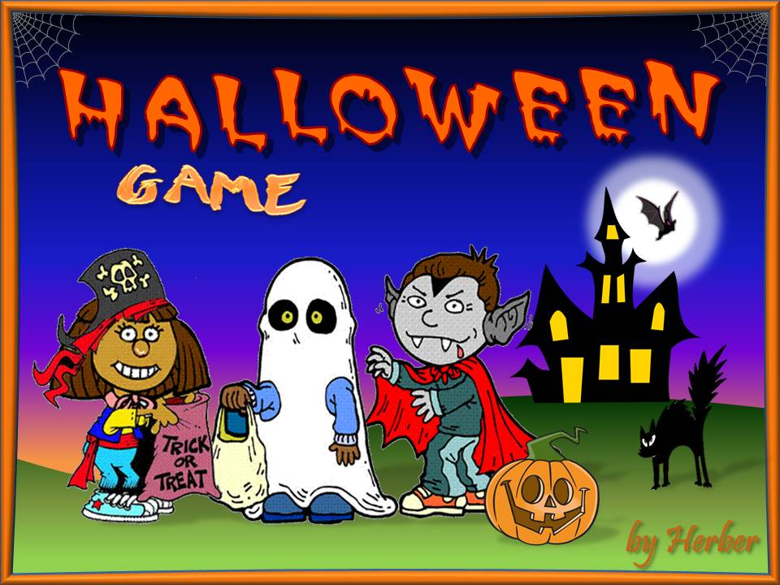
Click on this picture to get another game on Halloween
EXIT

