Slide 1
ANATOMY: HUMAN ORGANS
REVIEW

Slide 2
What is this?
Lungs

Slide 3
What is this?
Heart

Slide 4
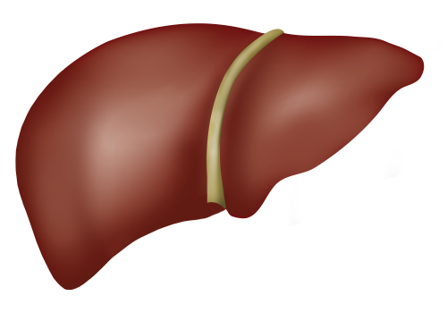
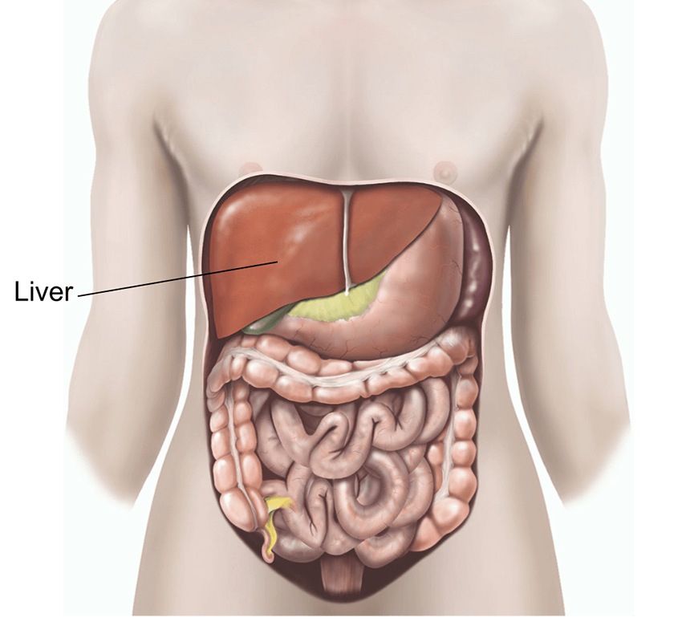
What is this?
Liver

Slide 5
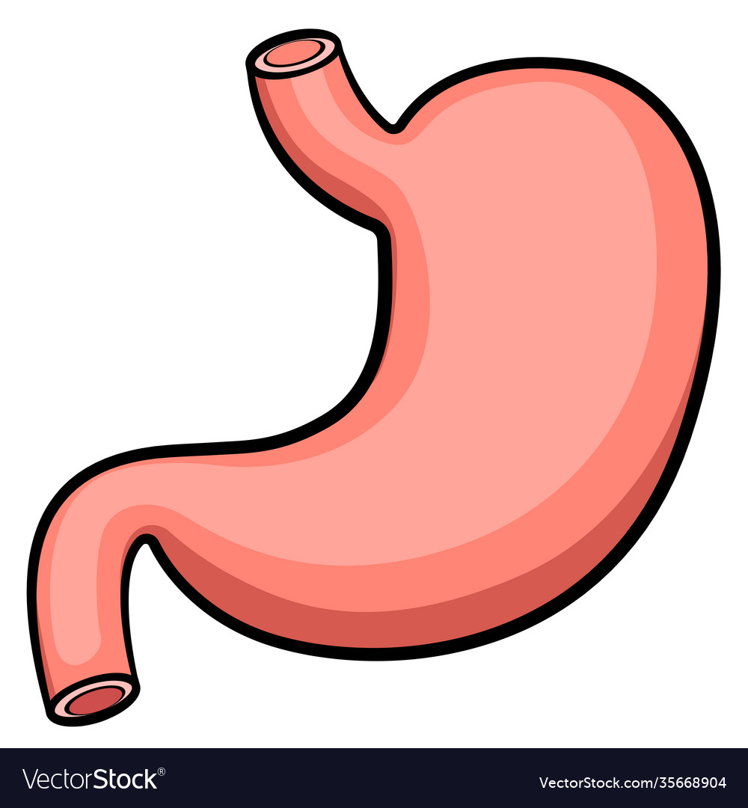
What is this?
Stomach

Slide 6
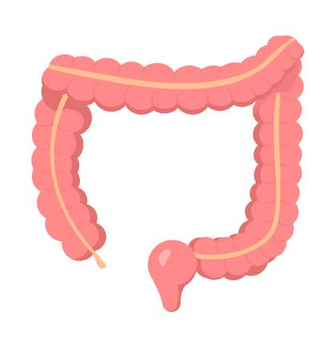
What is this?
Large intestine

Slide 7
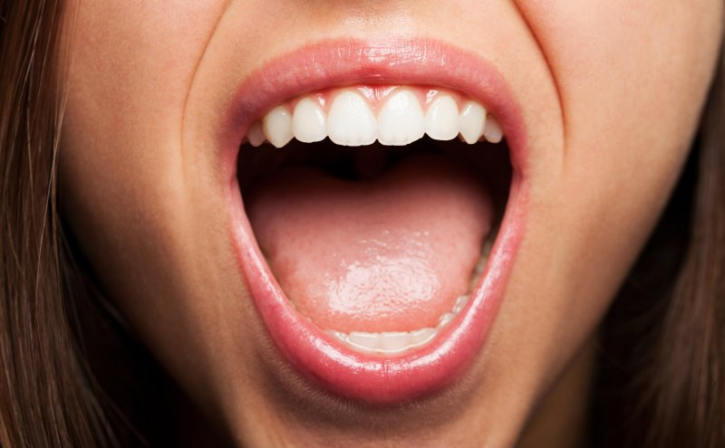
What is this?
mouth

Slide 8
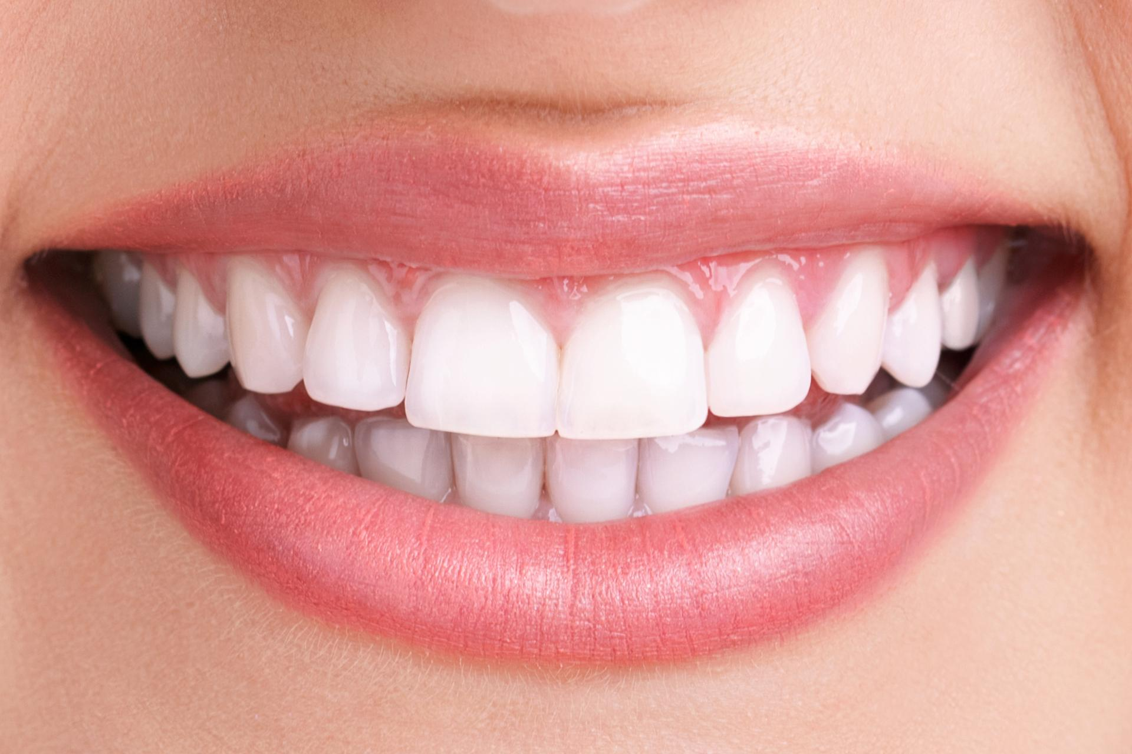
What is this?
teeth

Slide 9
What is this?
eye

Slide 10
What is this?
brain

Slide 11
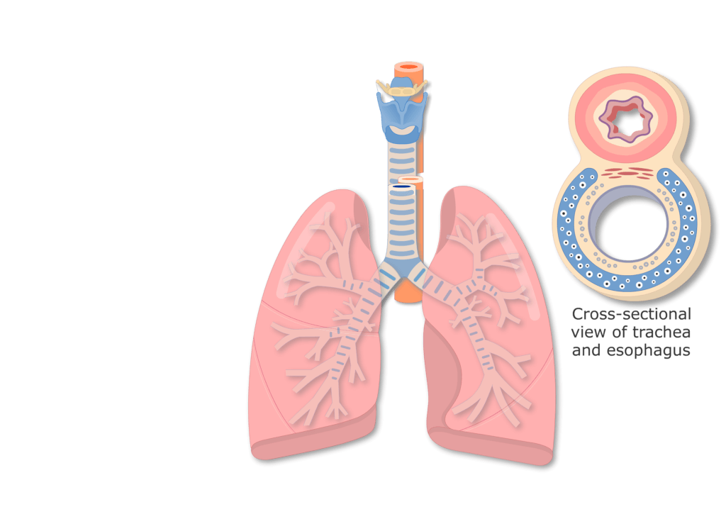
What is this?
trachea

Slide 12
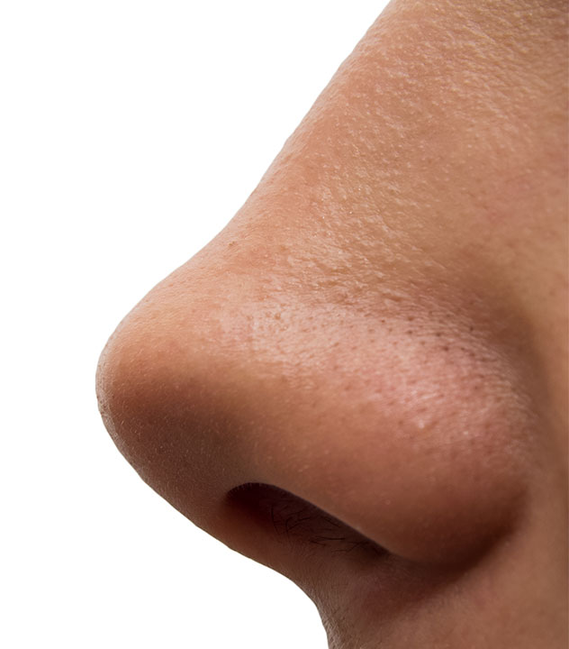
What is this?
nose

Slide 13
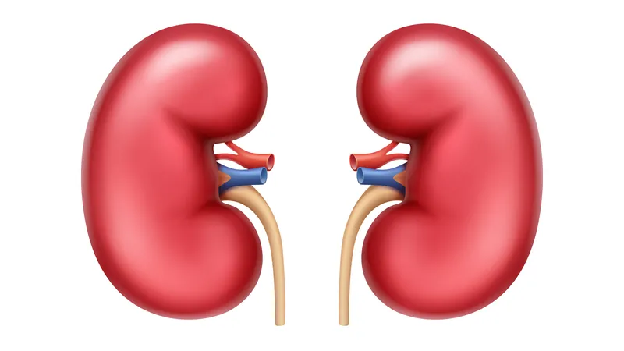
What is this?
kidneys

Slide 14
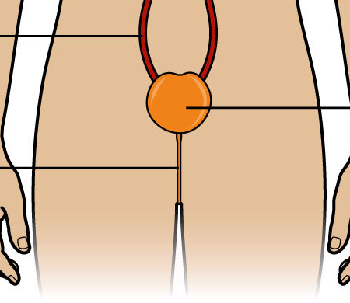
What is this?
bladder

Slide 15
Game: What is Missing?

Slide 16
Memorize the photos:

Slide 17
What is missing?

Slide 18
What is missing?

Slide 19
What is missing?

Slide 20
What is missing?

Slide 21
What is missing?

Slide 22
What is missing?

Slide 23
What is missing?

Slide 24
What is missing?

Slide 25
What is missing?

Slide 26
What is missing?

Slide 27
What is missing?

Slide 28
What is missing?

Slide 29
What is missing?

Slide 30
Harder

Slide 31
Memorize the photos:

Slide 32
What is missing?

Slide 33
What is missing?

Slide 34
What is missing?

Slide 35
What is missing?

Slide 36
What is missing?

Slide 37
What is missing?

Slide 38
What is missing?

Slide 39
What is missing?

Slide 40
What is missing?

Slide 41
What is missing?

Slide 42
What is missing?

Slide 43
What is missing?

Slide 44
What is missing?

Slide 45
Good job!
The end

