Slide 1
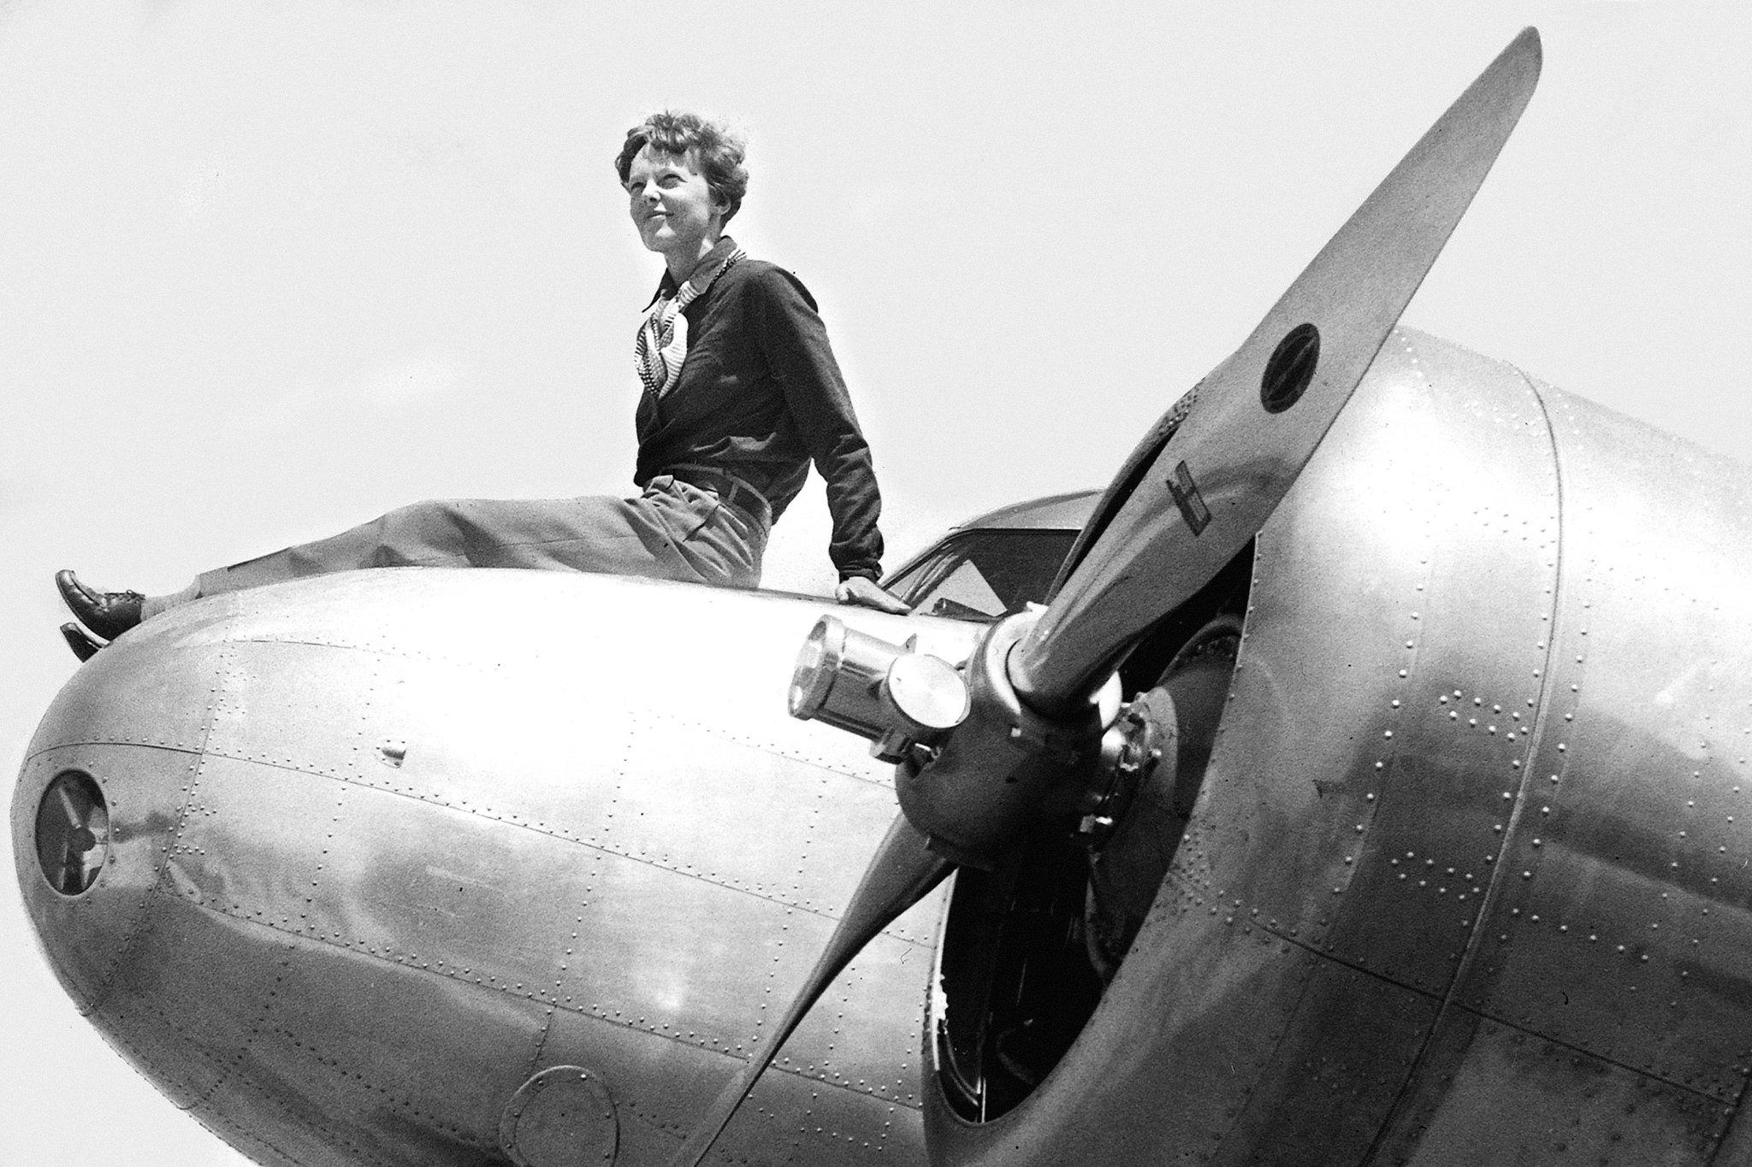
Amelia Earhart
International Women's Day
https://youtu.be/CVJIV9BknDw?si=lQ3sghBUpP_FcyDn

Slide 2
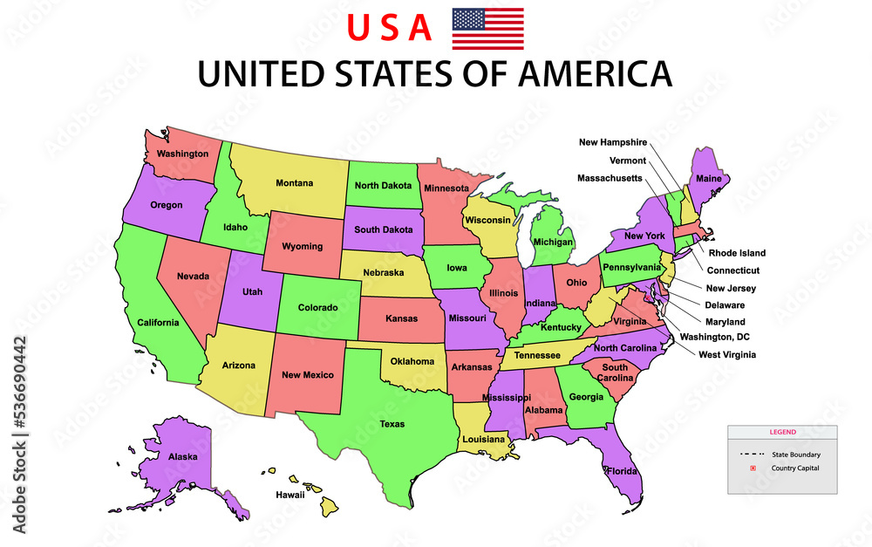
Born in Kansas, United States of America

Slide 3
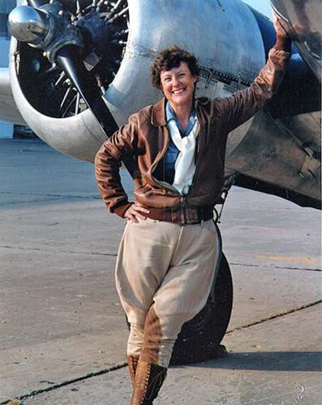
She was a pilot. She learned to fly planes

Slide 4
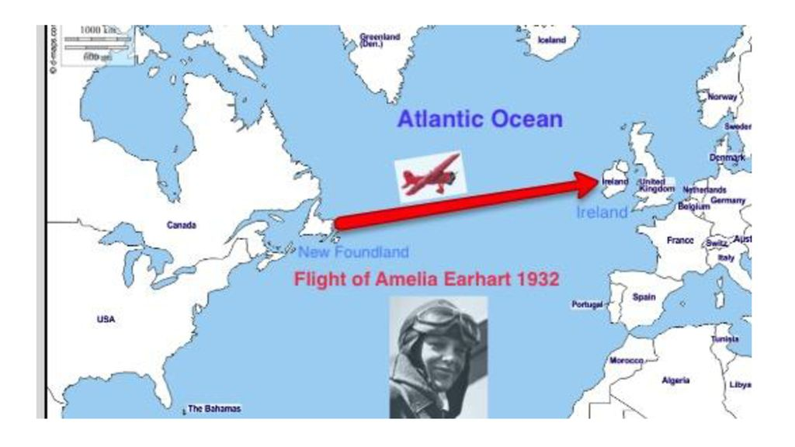
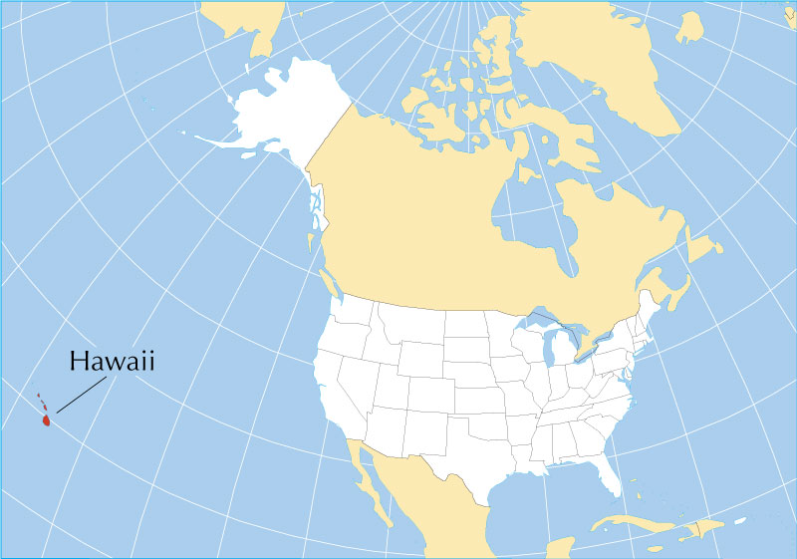
She was the first female pilot to cross the atlantic ocean in a plane in 1932
She was the first person ever to fly from Hawaii to California

Slide 5
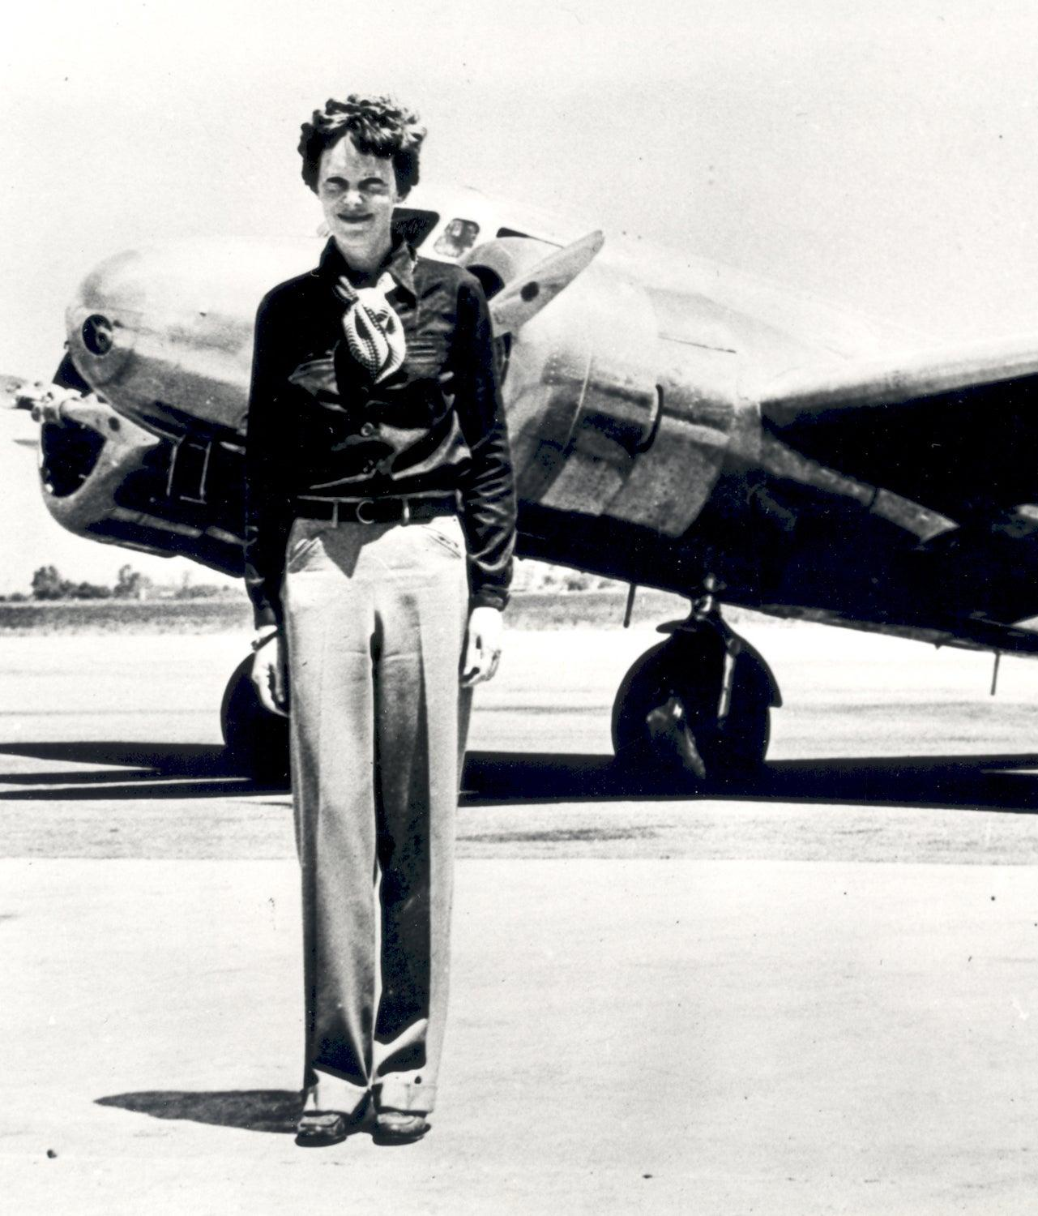
She died in 1937 on a flight around the whole world. It is a mystery. No one knows where she went

