Slide 1
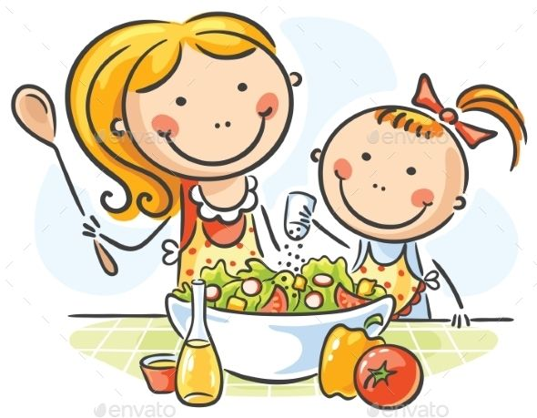
COOKING VOCABULARY

Slide 2
