Slide 1
Christmas in the UK
Albie Woolfenden

Slide 2
Christmas in the UK (England, Wales, Scotland and Northern Ireland) is not the same as Spain.
We do not have the same dates for this period.

Slide 3
Different Dates
In UK, the main dates are:
24th December (Christmas Eve)
25th December (Christmas Day)
26th December (Boxing Day)

Slide 4
Whereas in Spain:
22 Dec.
“El Gordo".
24 Dec.
(Nochebuena).
25 Dec.
(Navidad) .
5 Jan.
(Noche de Reyes): (Cabalgata de Reyes)
6 Jan.
(Día de Reyes).

Slide 5
Gifts
In the UK, we give gifts on Christmas Day ( 25thDecember).
This is different to Spain: you receive your gifts on 6thJanuary!
Our presents are brought by Santa Claus (Papa Noel) on Christmas Eve (December 24th).
Your presents are brought by the Three Wise Men, or Reyes Magos.

Slide 6
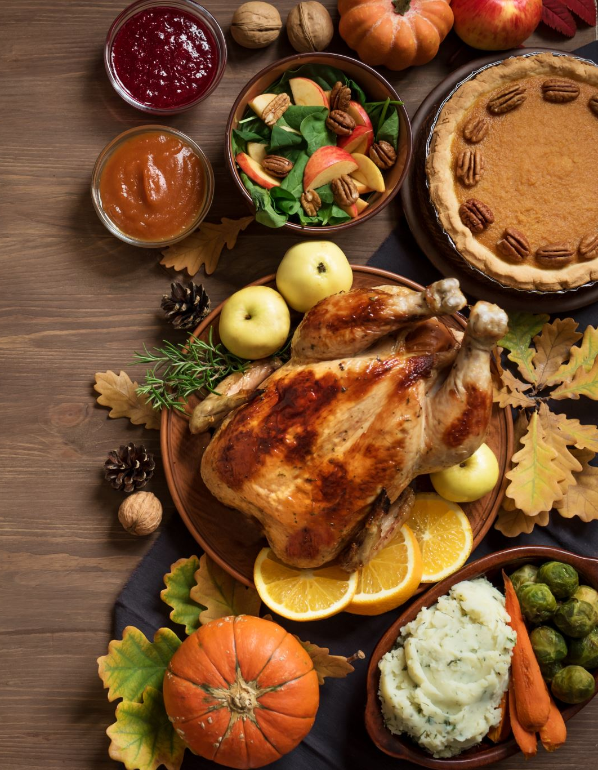
Food
Traditional British Christmas food:
Roast turkey, Brussel sprouts, gravy, roasted vegetables, pigs in blankets, stuffing.
This differs greatly from Spanish Christmas food:
Prawn, lobsters, lamb, turrón, polvorones, and roscón de Reyes.

Slide 7
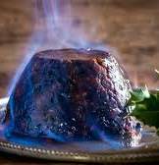
Food II
Desserts in the UK are also a huge part of the meal.
We have Christmas pudding, mince pies, and yule log;
Alongside Mulled wine and eggnog (for adults).

