Slide 1
Easter in the United Kingdom
By profe Albie

Slide 2
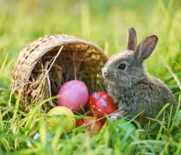
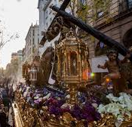
In Easter in England, Scotland, Wales and Northern Ireland (the countries that make up the UK), is very different to that of Spain.
In Spain you call it ‘Semana Santa’.
In England, we call it ‘Easter’.

Slide 3
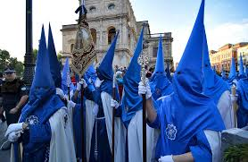
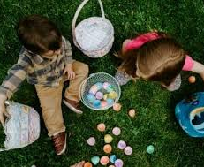
Differences
In Spain, there are more religious events:
People carrying statues of Jesus and Mary.
They sometimes wear special robes and pointy hats.
In England, Easter is about eggs, chocolate and the Easter bunny. We also enjoy Easter Egg Hunts
We still have church services, but it is more about spending time with mum and dad.

Slide 4
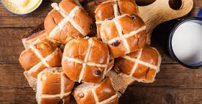
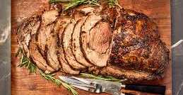
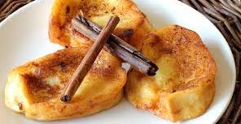
Food
We eat different food during Easter!
In Spain, you might eat ‘Torrijas’, ‘bacalao’ or ‘hornazo’.
Whereas in England, we have chocolate eggs, hot cross buns and roast lamb.

Slide 5
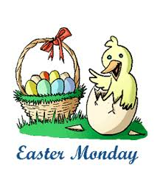
Holidays
In terms of holidays, in Spain you may get many days off.
These would be the Thursday and Friday before Easter.
In England, we are only allowed Good Friday and Easter Monday as days off.

Slide 6
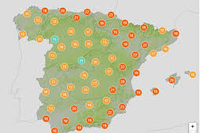
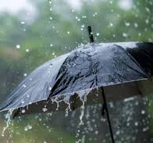
Weather
Spain is often warm and sunny around this time in Semana Santa.
In England, it is rainier and colder.

Slide 7
Conclusion
Finally, Spain’s easter is very religious and dramatic.
The United Kingdom’s easter is more about chocolate and family fun.

