Slide 1
Guess the form of energy!
By Albie

Slide 2
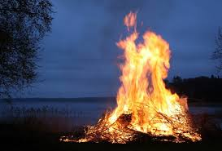
What form of energy is this?

Slide 3
Answer: Thermal energy

Slide 4
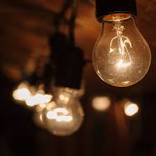
What form of energy is this?

Slide 5
Answer: Light energy

Slide 6
What form of energy is this?

Slide 7
Answer: Mechanical Energy

Slide 8
What form of energy is this?

Slide 9
Answer: Light energy

Slide 10
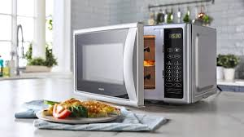
What form of energy is this?

Slide 11
Answer: Electrical energy

Slide 12
What form of energy is this?

Slide 13
Answer: Chemical energy

Slide 14
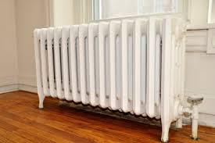
What form of energy is this?

Slide 15
Answer: Thermal energy

Slide 16
What form of energy is this?

Slide 17
Answer: Mechanical energy

Slide 18
What form of energy is this?

Slide 19
Answer: Electrical energy

Slide 20
What form of energy is this?

Slide 21
Answer: Chemical energy

Slide 22
What form of energy is this?

Slide 23
Answer: Mechanical energy

Slide 24
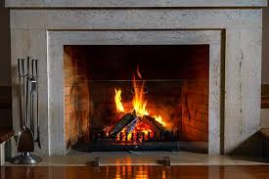
What form of energy is this?

Slide 25
Answer: Thermal energy

Slide 26
What form of energy is. This?

Slide 27
Answer: Electrical energy

Slide 28
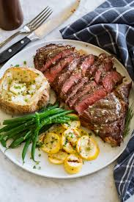
What form of energy is this?

Slide 29
Answer: Chemical energy

