Slide 1


I.C. Statale "21 Marzo"

Slide 2
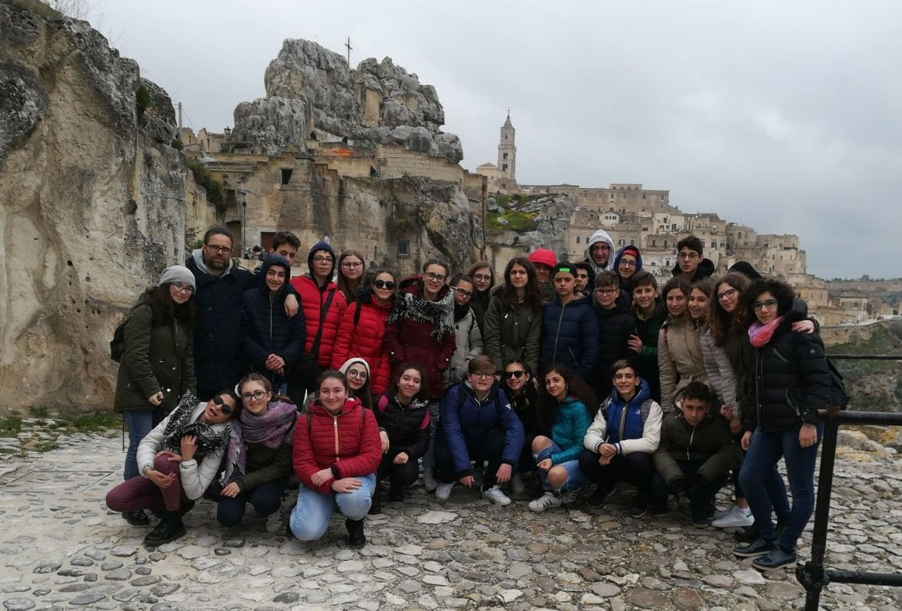

Slide 3
The Comprehensive Institute “21 Marzo” of Petralia Sottana, Geraci and Alimena was born around the end of the 90s and it includes infant, primary and secondary school of First grade in three separate schools in three different small villages Petralia Geraci and Alimena. The Comprehensive Institute located inside the Madonie Park benefits from a natural environment almost uncontaminated, rich in springs, woods and healthy air.
The institute currently has a school population of 402 pupils and about 80 teachers. The Institute classes are equipped with LIMs reached by the WI-FI connection., Language and Music laboratories. The Institute has participated in PON projects and currently has started a Trinity course. We enhance students to cultural exchanges and especially to study holidays abroad to improve their knowledge of foreign languages but unfortunately in the village we haven’t foreign tourists in order to practice them.
The socio-economic and cultural status of our student’s families has a Medium-high family background; Schools situated inside the Madonie Park have a strong social and cultural identity.

Slide 4
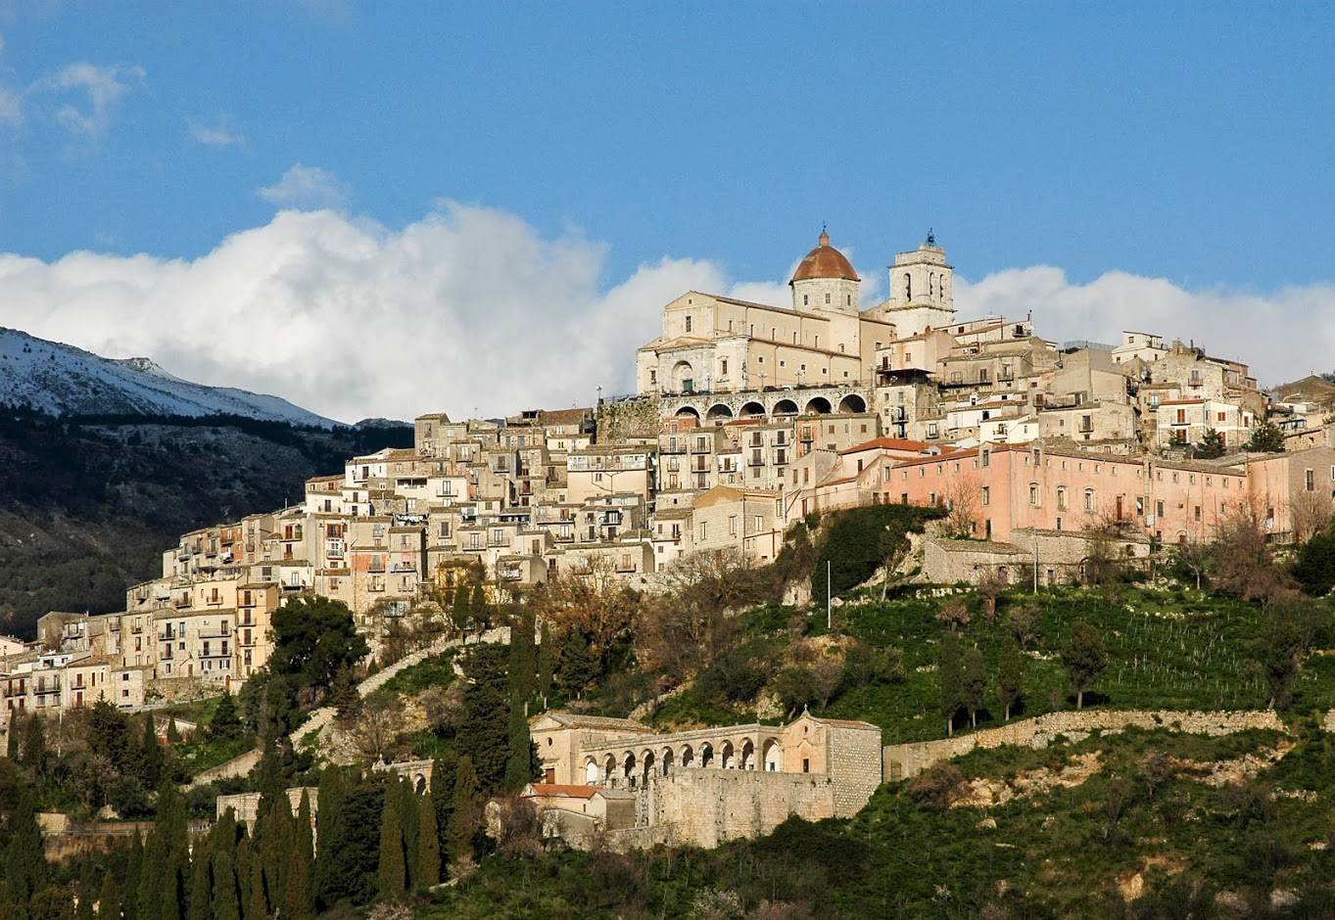
PETRALIA SOTTANA

Slide 5
Petralia Sottana is located in the heart of the Madonie Park, at 1,000 meters above sea level.
By numerous and significant archaeological finds, the origin of Petralia Sottana dates back to 3000 years BC. in the Paleolithic and Neolithic periods. Currently the town economy, which maintains an important central position in the Madonie area, is based on a strong contribution from public employment, on modest agricultural and commercial activities with a growing tourism sector, also thanks to the tourist resort of Piano Battaglia.

Slide 6
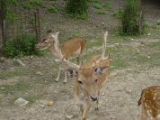
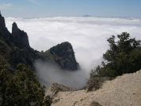

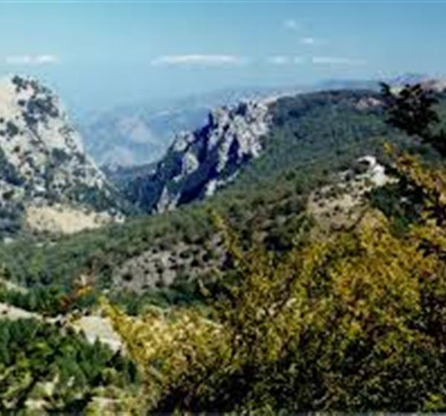
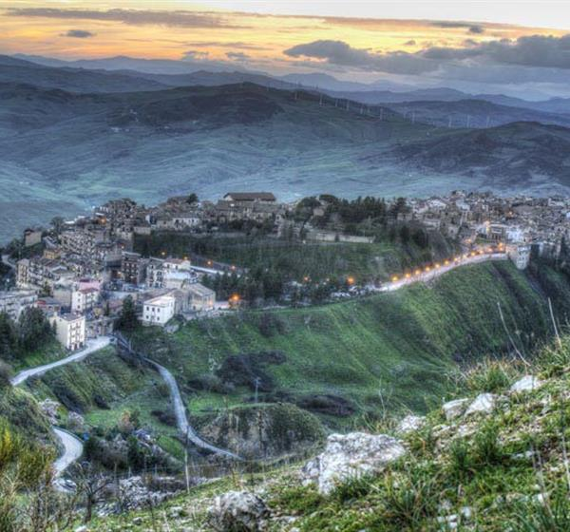
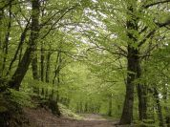
I
MADONIE GEOPARK

Slide 7
MADONIE GEOPARK represents nearly all aspects of Sicilian geology, has a very complex history that started over 220 million years ago, and is mainly composed of dolomitic limestone evoking unknown and vanished worlds. Interesting karstic morphologies, both at surface and underground, developed more recently, 23,5 million years ago.
Its position in the central portion of the Sicilian Apennine, its geological-structural arrangement and the morpho-dynamic processes acting in it make this mountain group a fundamental area for knowledge and reconstruction of the geological history of the Apennine-Maghrebine chain and hence of the central Mediterranean. Because of these characteristics, the Madonie have constituted and continue to constitute an exceptional study area, as well a teaching “gymnasium” for generations of university students in geological sciences and natural history. The area contains seven type formations accepted by the international scientific community and more than forty geosites. Recent tectonics also make the area an excellent training ground on geo-hazards.
The Madonie UNESCO Global Geopark also preserves a very rich and rare natural heritage. In a very small area, about 2 percent of the surface area of Sicily, over half of the species of the most evolved flora grows: about 2,600 plants, almost the same number as the species present in Egypt, Tunisia and Algeria. In Madonie there are also hundreds of endemic plants which are unique in the world; often there are very few exemplars of these, so that they risk extinction. The best known and most "courted" is the Nebrodi fir, but there are plenty of others. Equally interesting are the signs left by man in the landscape: fields, watercourses, village and hamlets bear witness to the thousand ways in which communities have lived in Madonie, leaving indelible prints there and expressing the intrinsic reasons of a culture.

