Slide 1
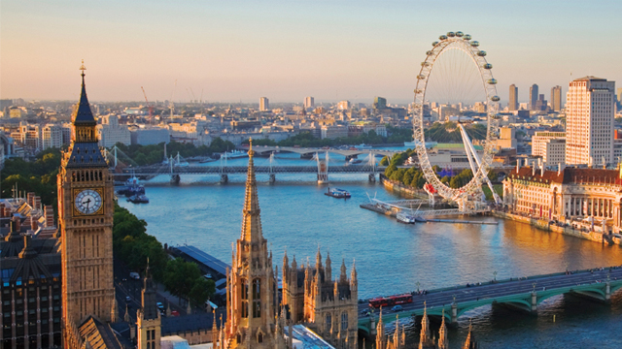
UDI 3. let´s go to London

Slide 2
BEFORE START:
If you want to travel to London you need to know the difference between
DO YOU KNOW THEIR MEANINGS?
VOYAGE
TRIP
TRAVEL
JOURNEY

Slide 3
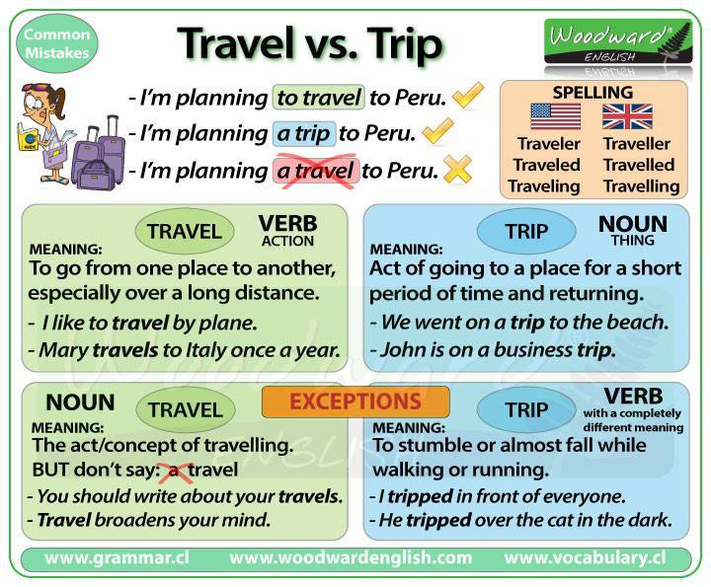

Slide 4
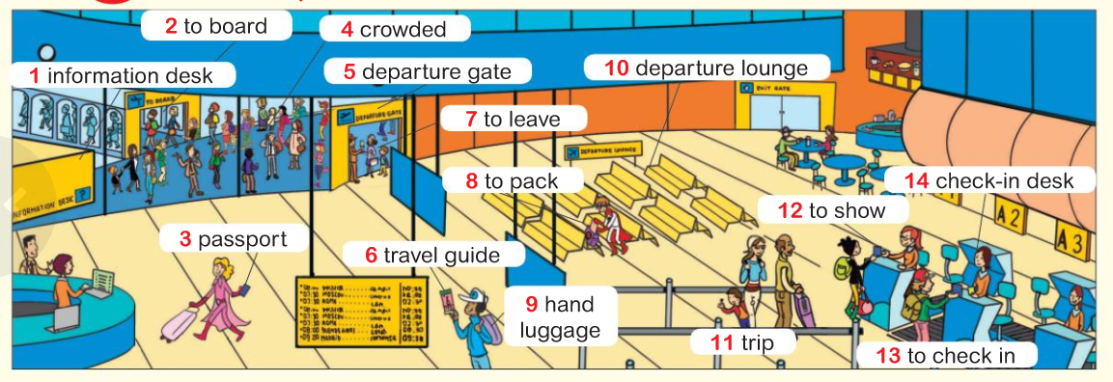
Practice new vocabulary
http://www.wordreference.com/es/
LET´S GO TO LONDON!

Slide 5

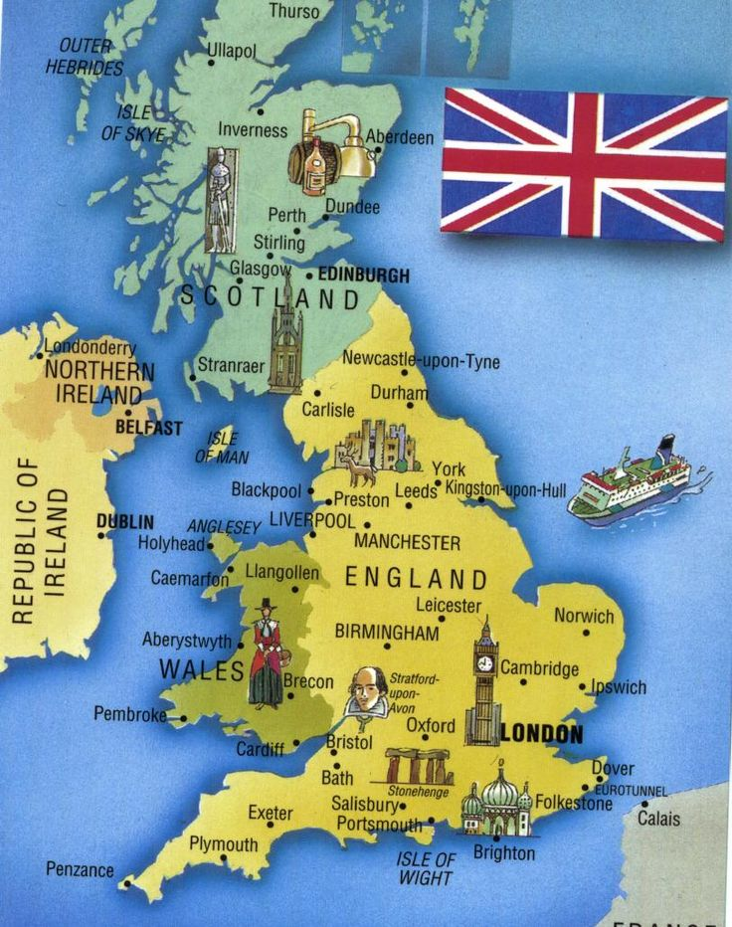

Do you know the place where you want to travel?
READING TIME

Slide 6
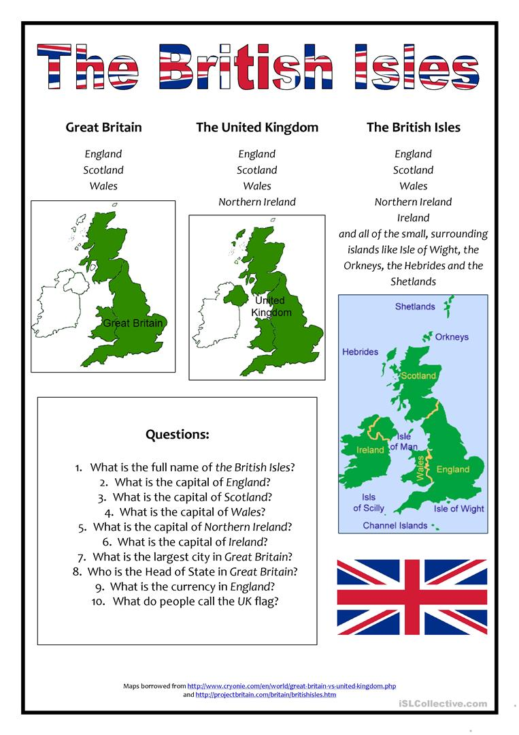
TASK
Answer the questions in groups
ROLES:
-SCRIBE
-TIME KEEPER
-DETECTIVES
-SPEAKER
-LEADER

Slide 7
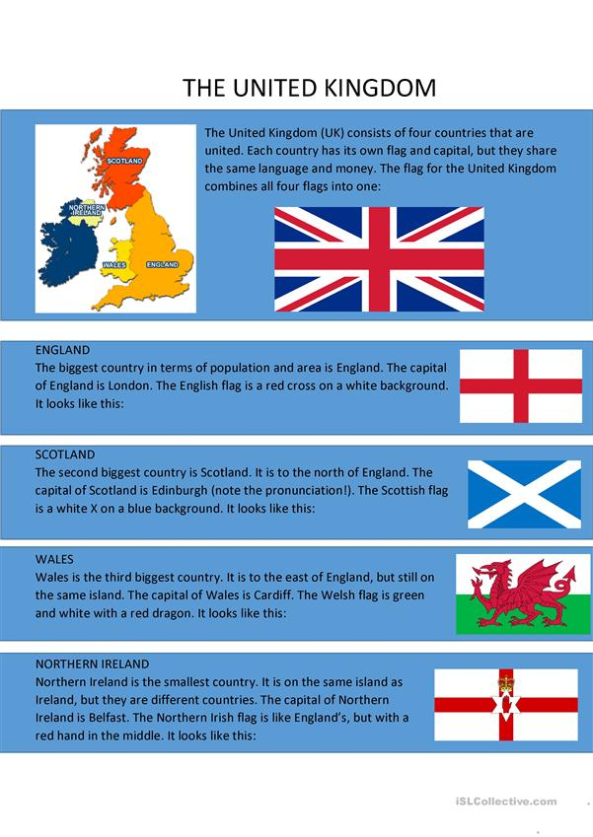

READING TIME
GROUP 1: ENGLAND
GROUP 2 : WALES
GROUP 3 IRELAND
GROUP 4 SCOTLAND

Slide 8
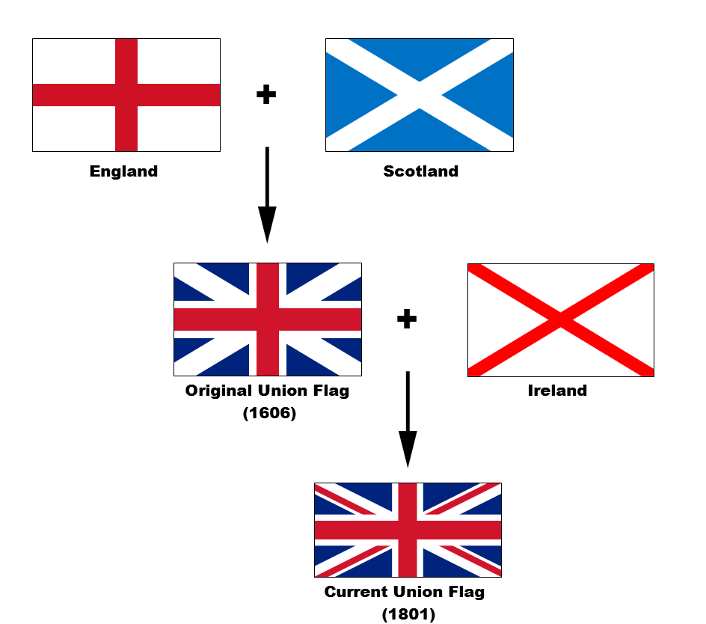
WATH THE FOLLOWING VIDEO
http://learnenglishteens.britishcouncil.org/uk-now/video-uk/four-nations

Slide 9
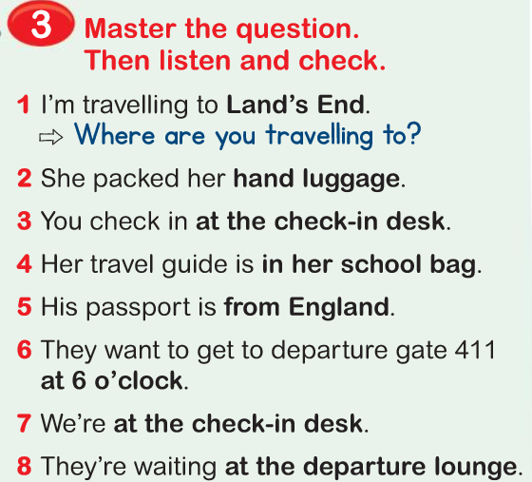
Grammar time
Page 14 (student´s book)
REMEMBER
WHAT
WHERE
WHEN
WHO
WHICH

Slide 10
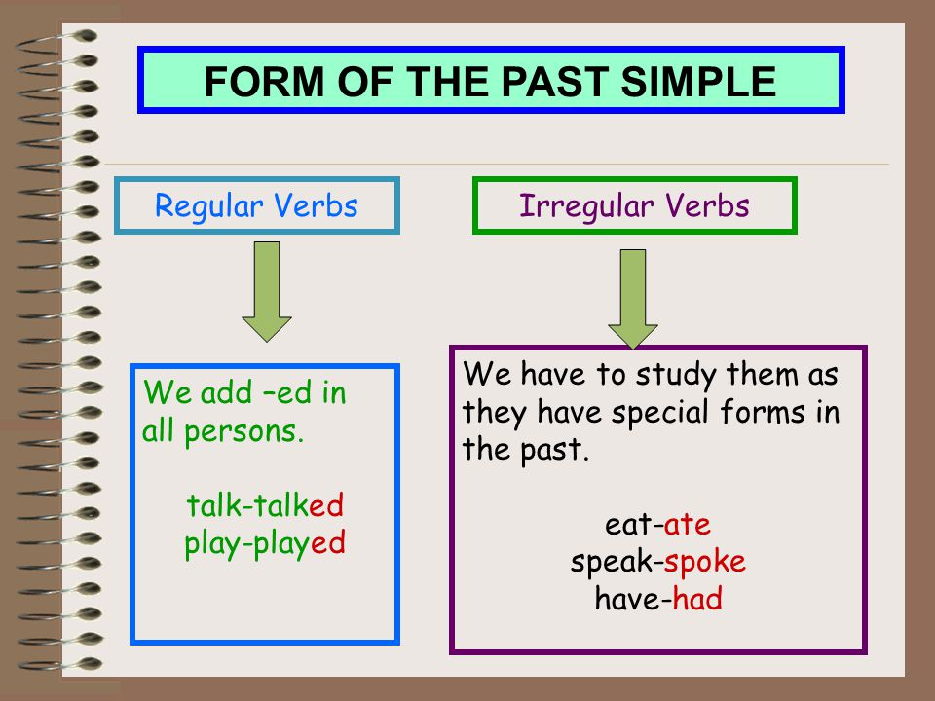
PAST SIMPLE
https://www.youtube.com/watch?v=V9qqD9LHaIk
BINGO TIME

Slide 11
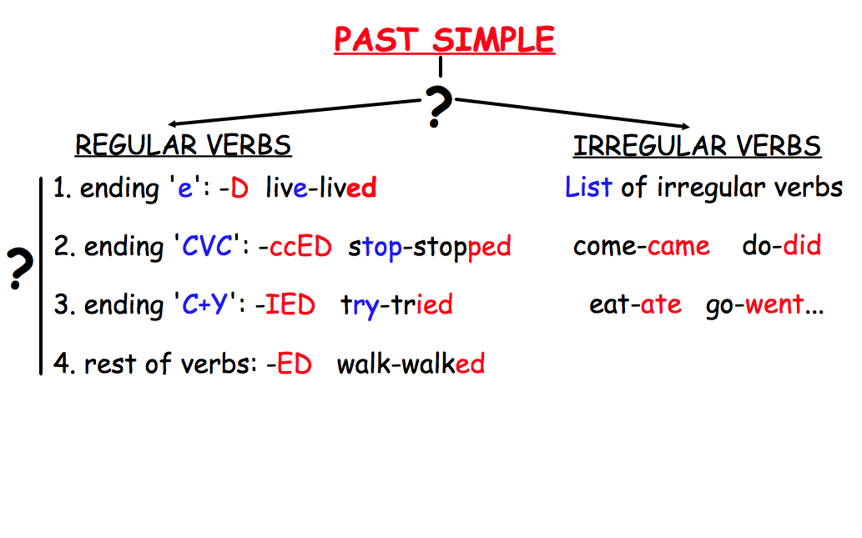

Slide 12
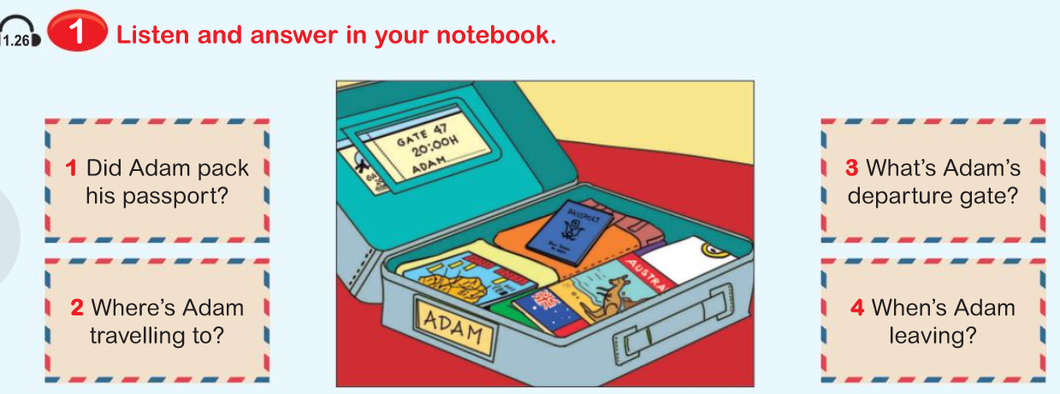
LISTENING

Slide 13
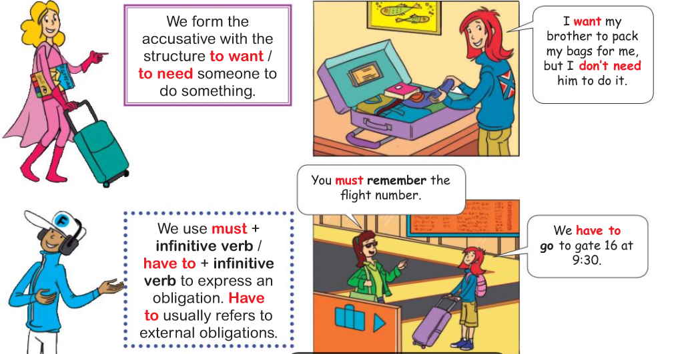
COPY THE GRAMMAR IN YOUR NOTEBOOK

Slide 14
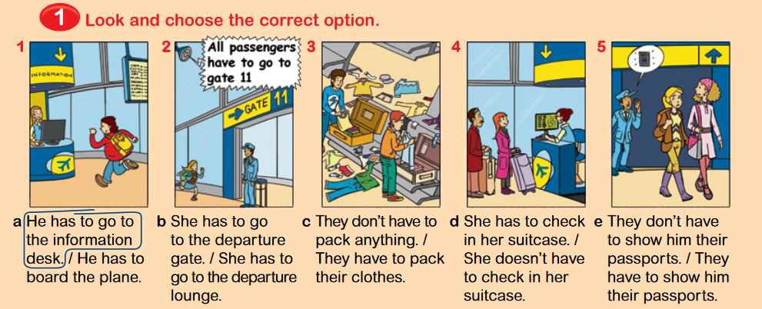

Slide 15
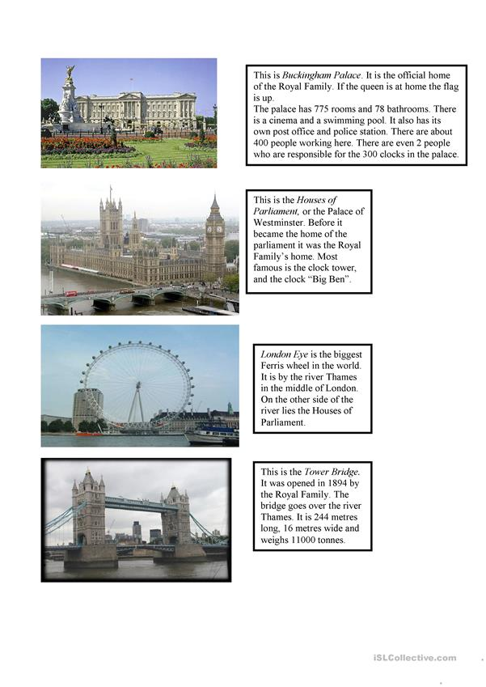
London

Slide 16
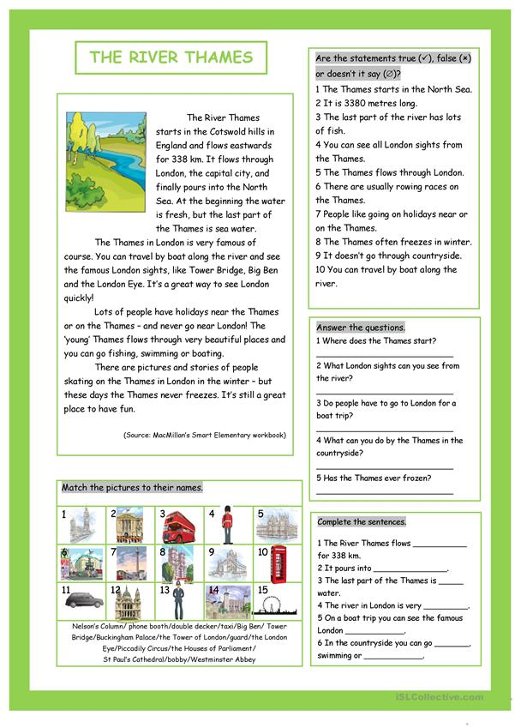
THE RIVER THAMES

