Slide 1
Body Parts

Slide 2
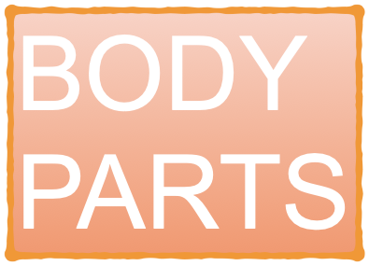

Slide 3


Slide 4
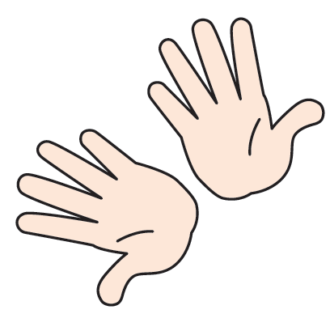
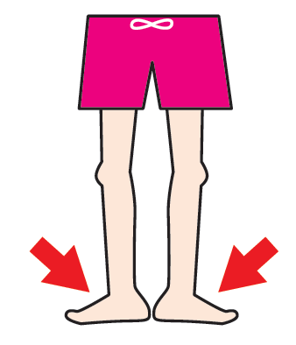


Slide 6
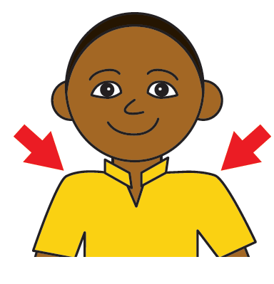
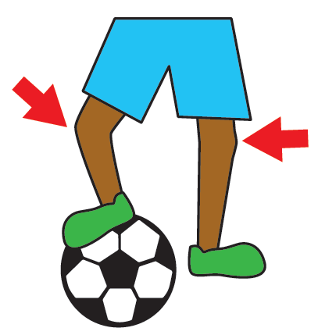


Slide 8
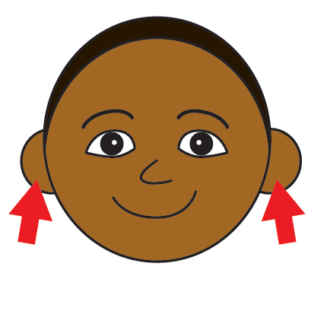
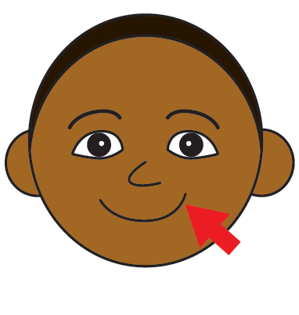


Slide 10
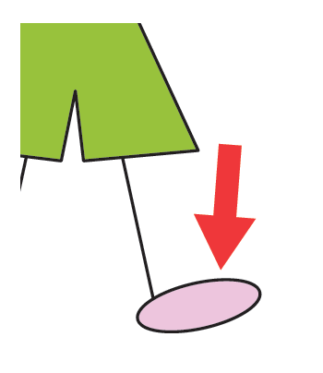
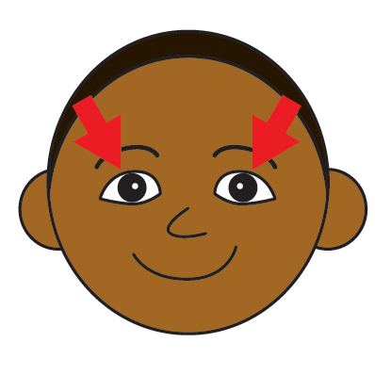


Slide 12
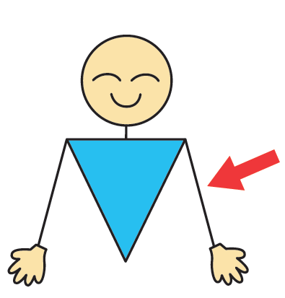
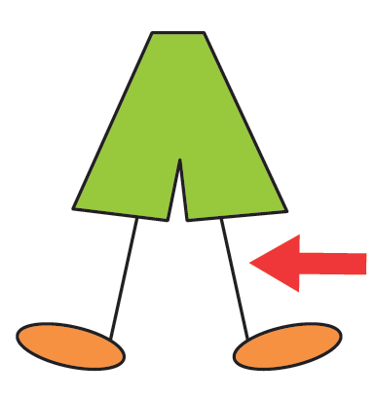


Slide 14
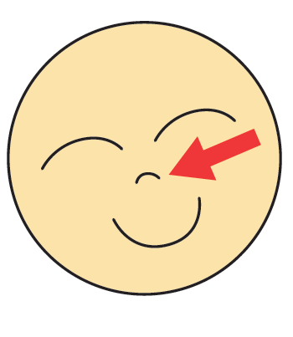


Slide 16
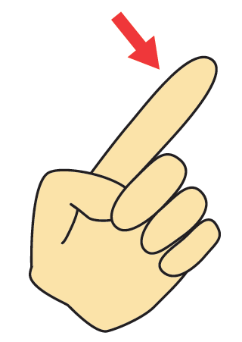
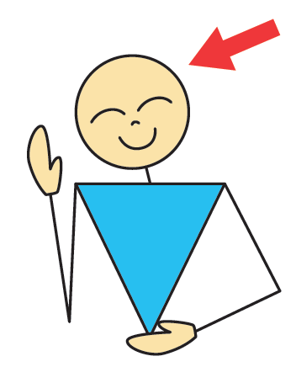


Slide 18


Slide 20


Slide 22
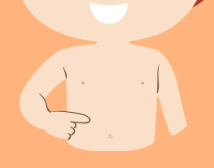
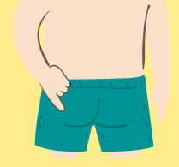


Slide 24


Slide 26


Slide 30


Slide 32
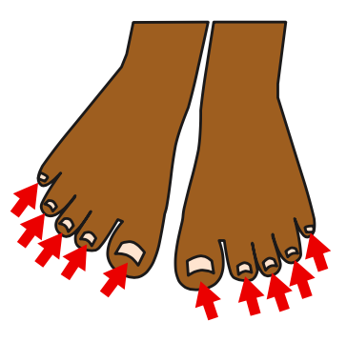


Slide 34


Slide 36



Slide 38
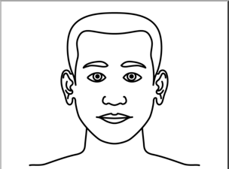
Parts of the face!

Slide 39
What is missing?

Slide 40
What is missing?
nose

Slide 41
What is missing?

Slide 42
What is missing?
mouth

Slide 43
What is missing?

Slide 44
What is missing?
eyes

Slide 45
What is missing?

Slide 46
What is missing?
ears

Slide 47
Good job!

Slide 48
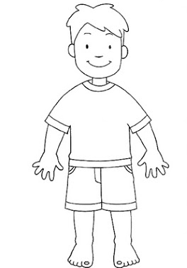
Parts of the body!

Slide 49
What is missing?

Slide 50
What is missing?
hands

Slide 51
What is missing?

Slide 52
What is missing?
feet

Slide 53
What is missing?

Slide 54
What is missing?
legs

Slide 55
What is missing?

Slide 56
What is missing?
head

Slide 57
What is missing?

Slide 58
What is missing?
arms

Slide 59
Good job!

