Slide 1
THE MIDDLE AGES

Slide 2
What are the periods of human history?
Middle Ages
Contemporary Age
Prehistory
Ancient History
Modern Age

Slide 3
The Middle Ages
476 CE
Starts with the fall of the Roman Empire

Slide 4
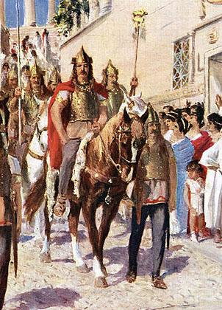
The Visigoths
Before the fall of the Roman Empire, different tribes migrated to Hispania (Roman name for the Iberian Peninsula)
The Roman emperor encouraged Visigoths from Gaul to attack the other tribes
They forced the other tribes out and settled on the Iberian Peninsula

Slide 5
The Middle Ages
Visigoths settle on the Iberian Peninsula
476 CE
Fall of the Roman Empire
507 CE

Slide 6
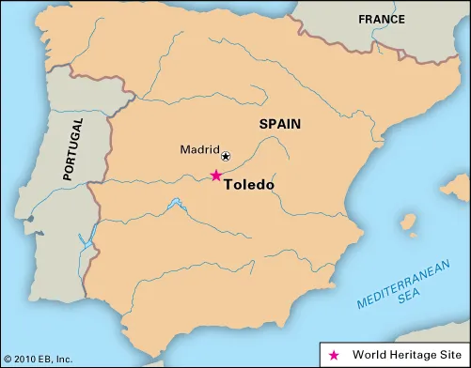
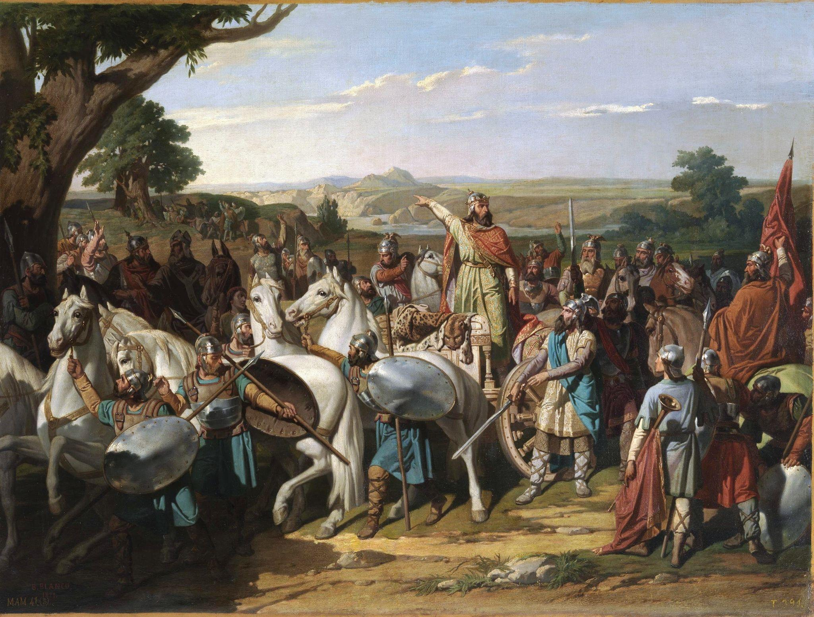
The Visigoths
Established a capital in Toledo
Adopted Roman law and spoke Latin
Most Visigoths converted to Catholicism in 589 CE
Visigoths were defeated in the Battle of Guadalete by the Muslims of North Africa

Slide 7
The Middle Ages
Visigoths settle on the Iberian Peninsula
476 CE
711 CE
Fall of the Roman Empire
507 CE
Battle of Guadalete

Slide 8
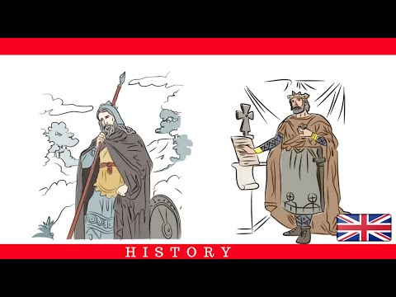

Slide 9
The Middle Ages
Visigoths settle on the Iberian Peninsula
476 CE
711 CE
Fall of the Roman Empire
507 CE
Battle of Guadalete
and beginning of Muslim rule and expansion

Slide 10
Islamic Spain

Slide 11
ISLAM
Founded by Muhammad (the prophet of Islam)
Based on the idea of submission to the will of God
God in Arabic is Allah
Their holy book is the Quran
The religious obligations of all Muslims are called the Five Pillars of Islam

Slide 12
5 Pillars of Islam
1 “There is no God but God. Muhammad is his messanger”
2 Prayer 5 times a day (facing Mecca)
3 Fasting during Ramadan
4 Help the poor
5 Pilgrimage to Mecca

Slide 13
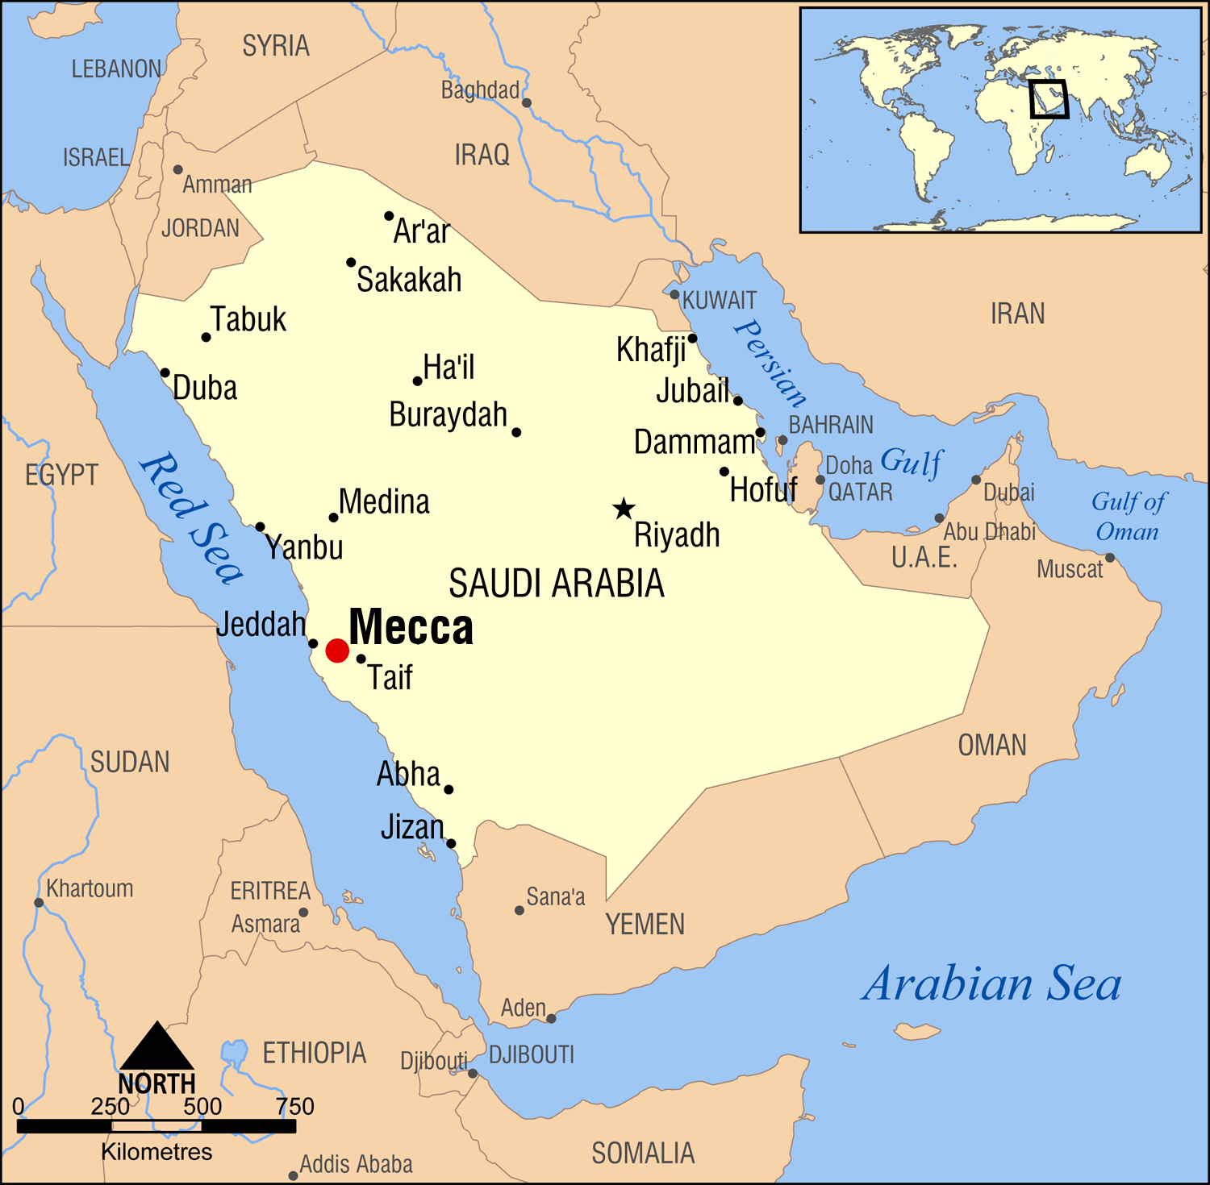

Slide 14
Muslim rule of Spain
The Muslims called Iberian Peninsula al-Ándalus
711 - 756 CE: became a caliphate (province) of Islamic Empire
756 CE: Prince Abd al-Rahman I proclaimed al-Ándalus an independent emirate
929 CE: Abd al-Rahman III declared caliphate of Córdoba (became a centre for learning and arts)
1031 - 1492 CE: caliphate of Córdoba on the decline and divided into 28 taifas (kingdoms)

Slide 15
The Middle Ages
Visigoths settle on the Iberian Peninsula
476 CE
The end of Islamic Spain
711 CE
Fall of the Roman Empire
507 CE
Battle of Guadalete and beginning of Muslim rule and expansion
1492 CE

Slide 16
Daily Life in al-Ándalus

Slide 17
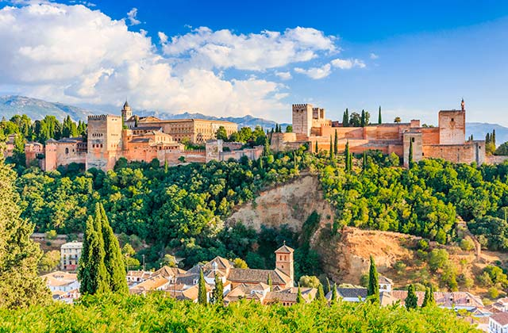

Slide 18
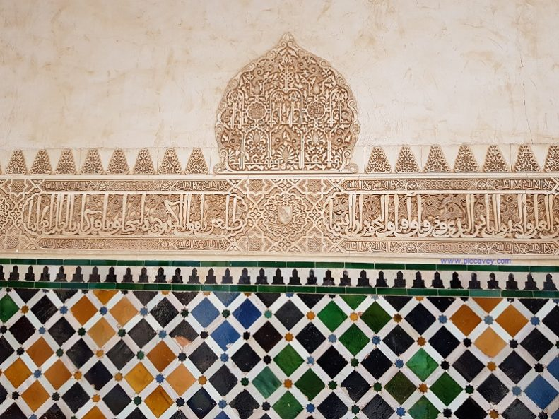
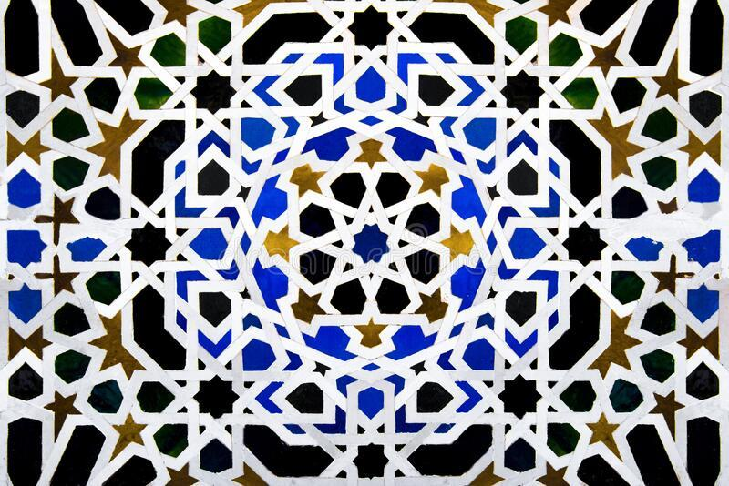
Muslim contributions to the Iberian Peninsula
ART
Tiles with geometric patterns

Slide 19
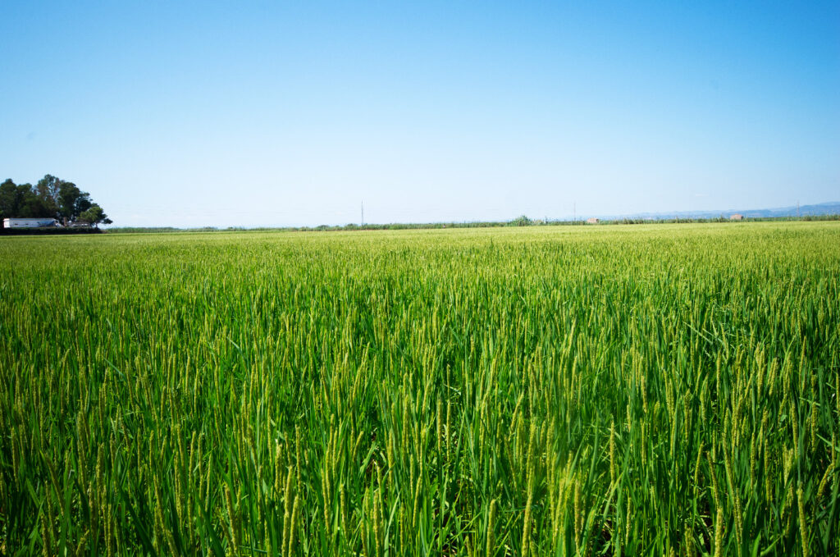
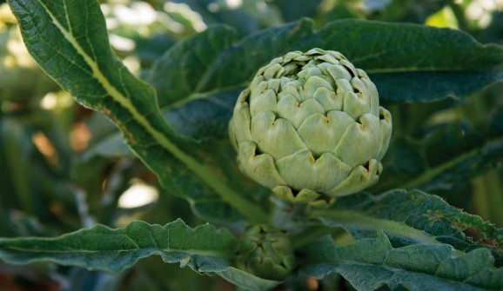
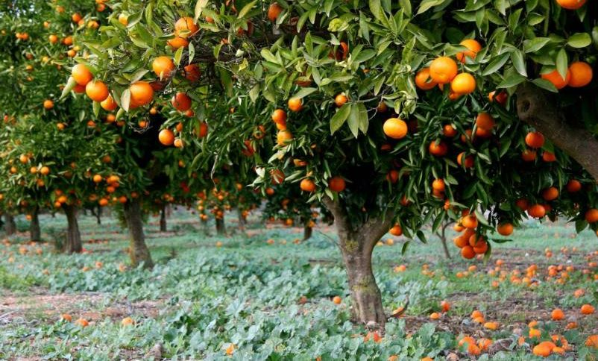
Muslim contributions to the Iberian Peninsula
AGRICULTURE
New irrigation systems and crops (rice, melon, oranges, lemons, artichokes, aubergines, saffron, and sugarcane)

Slide 20
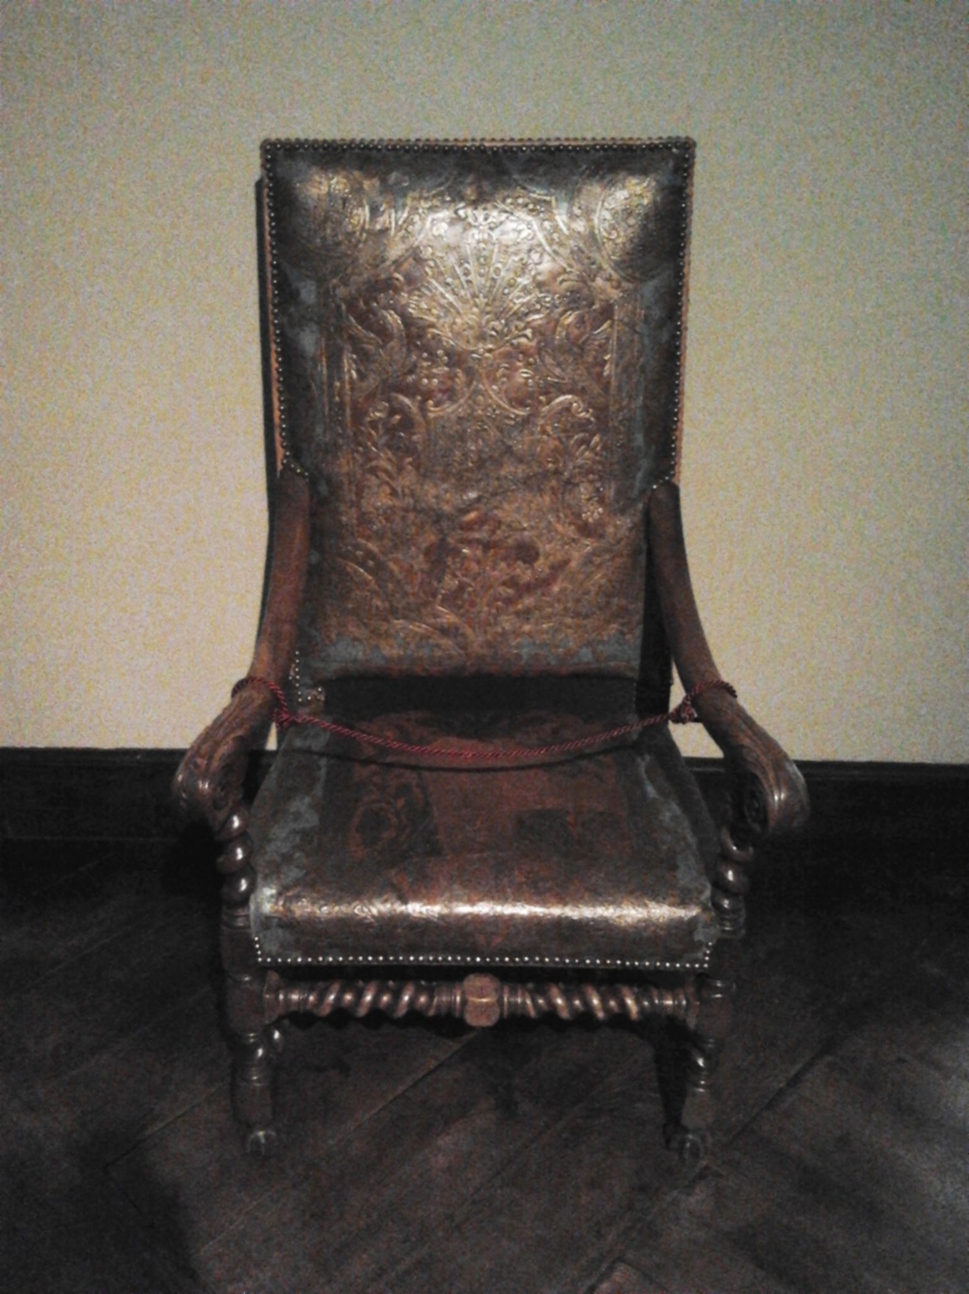
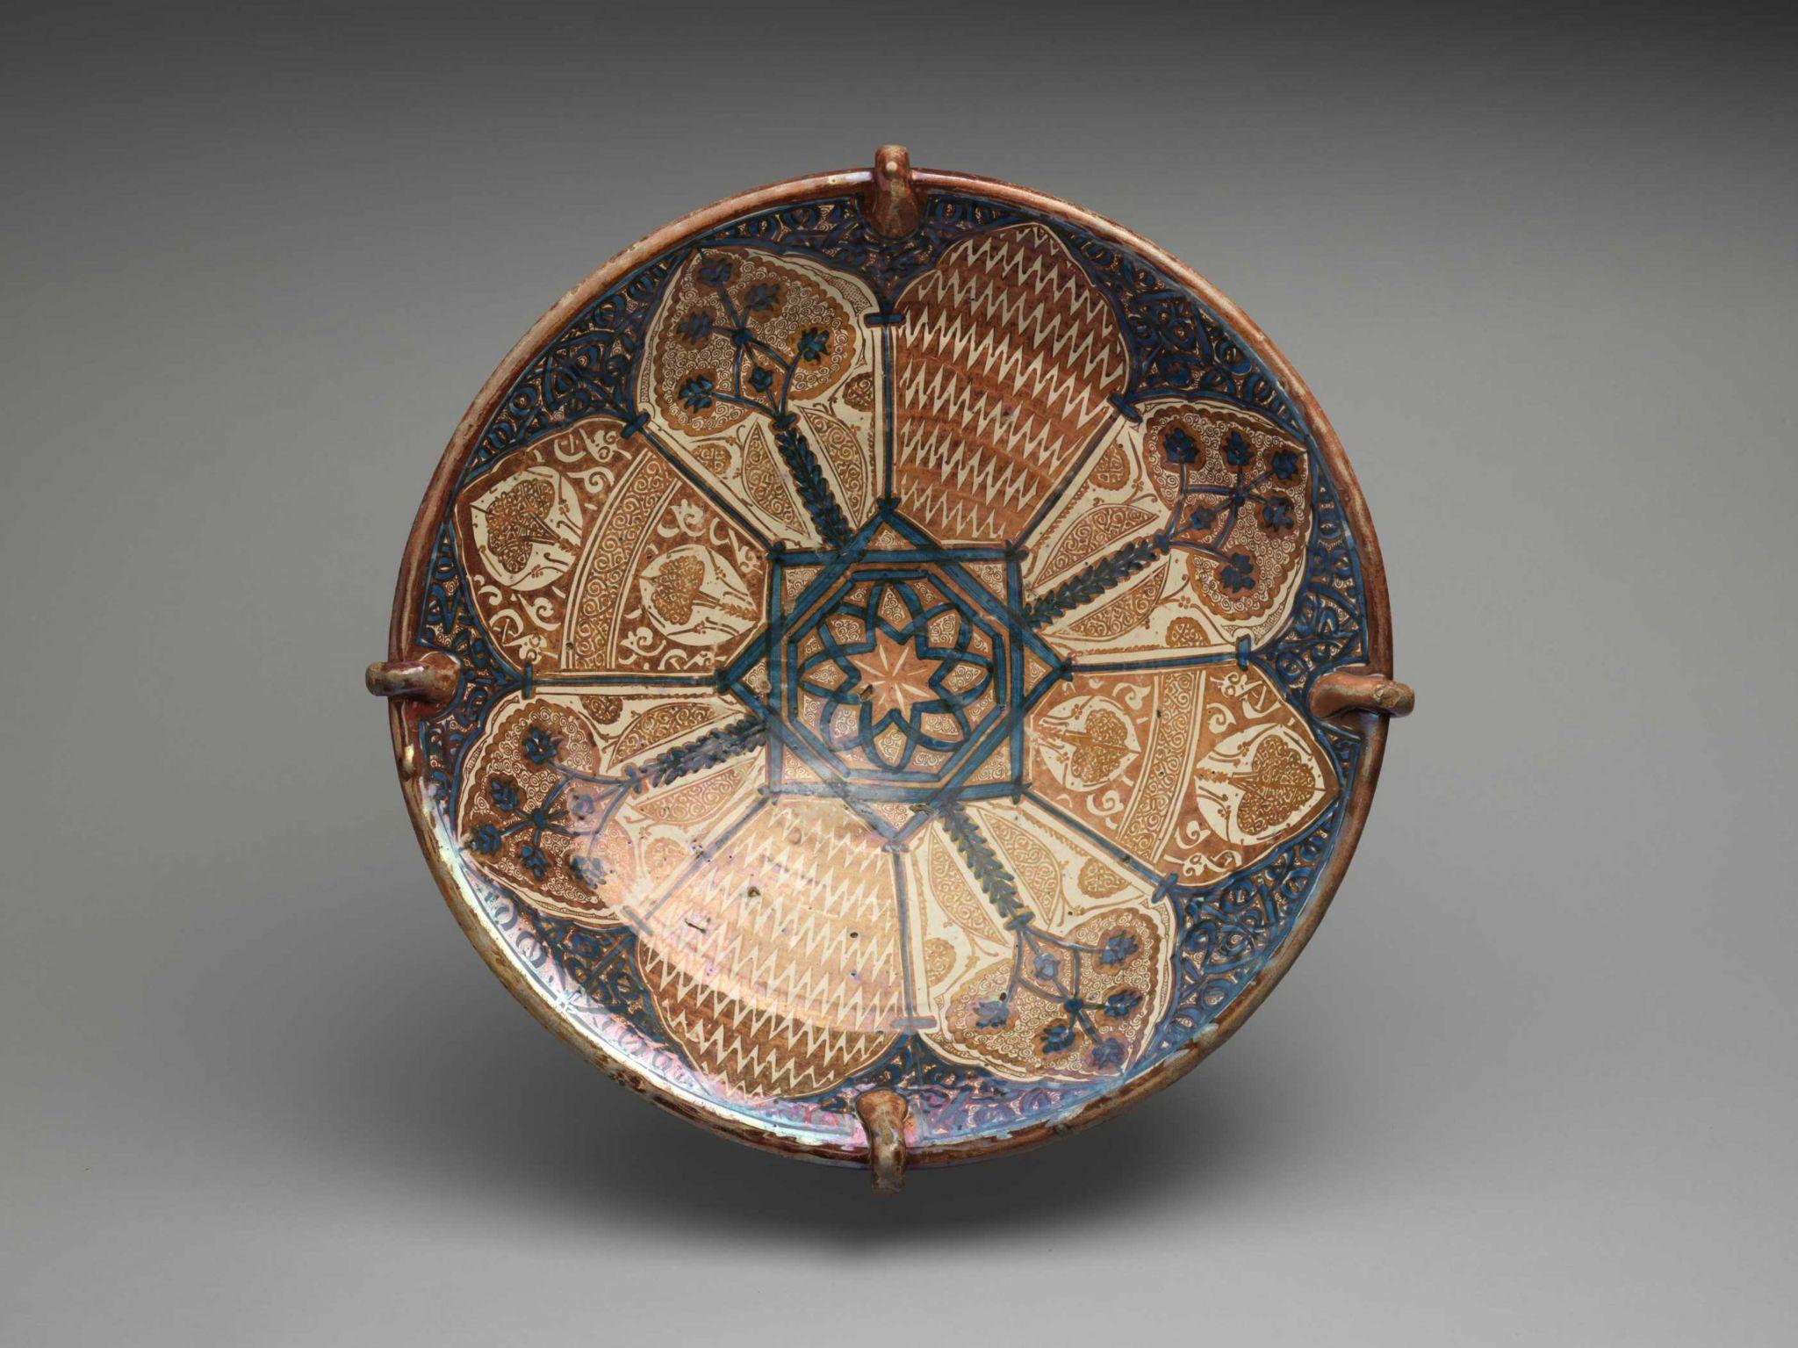
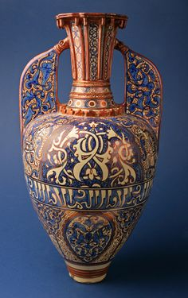
Muslim contributions to the Iberian Peninsula
CRAFTS
Made crafts with leather, cloth, glass, and ceramics

Slide 21
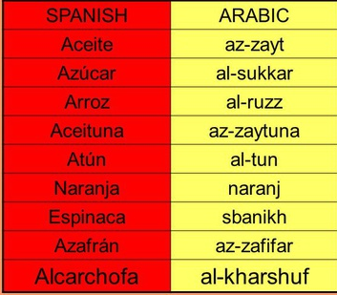
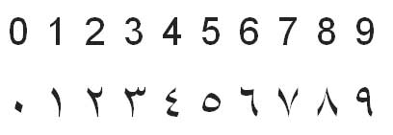
Muslim contributions to the Iberian Peninsula
Mathematics
LANGUAGE
Zero and Arabic numerals
Many Spanish words come from Arabic

