Slide 1
Darcey
Bussell
Famous British Dancer

Slide 2
Vocabulary
Principal dancer
Retire
Judge
Ballet company
Lead role
Bailarina principal
Jubilarse
Juez
Grupo de bailarinas
Papel principal

Slide 3
Who is Darcey Bussell?

Slide 4
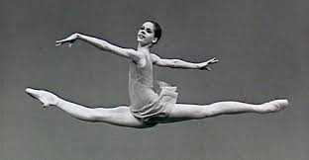
Dance Career
April 27, 1969
London, England
Started serious training at 13
White lodge, Royal Ballet
Youngest principal dancer in the Royal Ballet of London
Retired in 2007

Slide 5
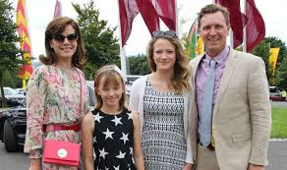
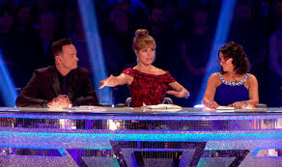
Life After Dance Career
Australia
Ballet themed children’s books
Judge on Strictly Come Dancing

Slide 6
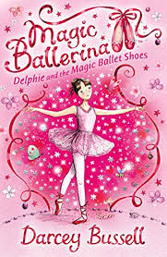
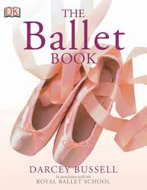

Slide 7
Have you ever watched a talent show on TV like Strictly Come Dancing?
Do you like shows like that?

Slide 8
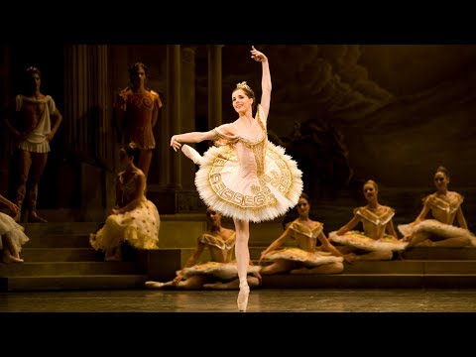

Slide 9
Describe Darcey’s dancing and the music that you hear.

Slide 10
Ballet and Health

Slide 11
Health Benefits
Better posture
More confidence
Improved flexibility
Builds muscles
Challenges your brain
Cardio

Slide 12
Common Injuries
Tendon inflammation
Ankle/knee injuries
Stress fracture
Disc Injury
Snapping hip syndrome
Arthritis

Slide 13
Other Types of Dancing
Ballroom
Contemporary
Hip hop
Jazz
Tap
Traditional

Slide 14
Have you ever taken dance classes?
Do you like dancing?

