Slide 1
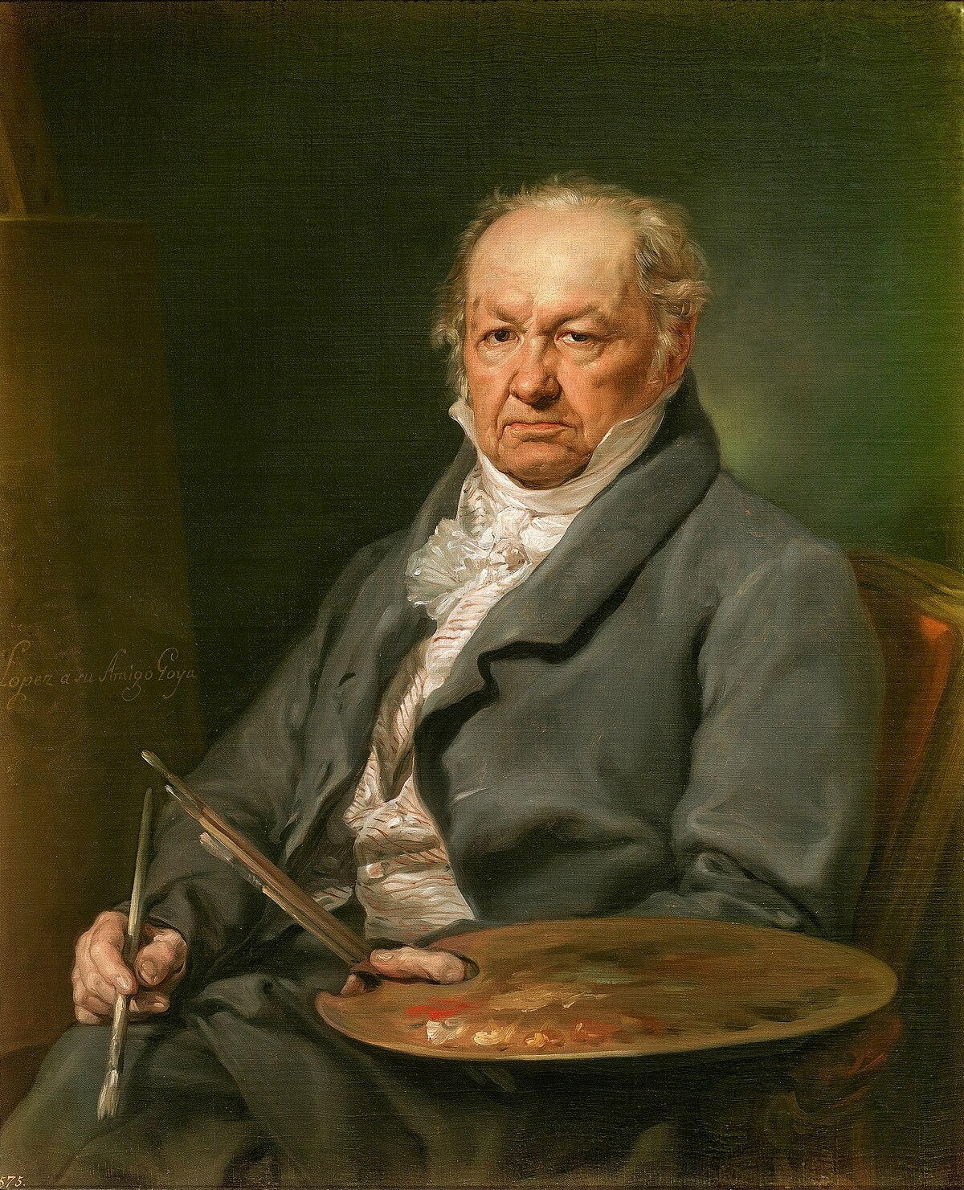
Francisco Goya

Slide 2
Biography
Francisco Jose de Goya y Lucientes was born in Aragón on 30th March 1746
He began studying art at the age of 14 when he was an apprentice to a painter called José Luzán
In 1786 he was appointed court painter by Charles IV
In winter 1792 Goya became seriously ill and was left completely deaf (sordo). His paintings changed from the Rococo style to a more expressionistic and dark themes
Goya died in 1828 in exile in Bordeaux. After his death 14 fresco paintings on the walls of his house were discovered and are now on display in the ‘Black Paintings’ exhibition in the Museo del Prado in Madrid. Many people interpret these painting as his depressive thoughts towards the end of his life.

Slide 3
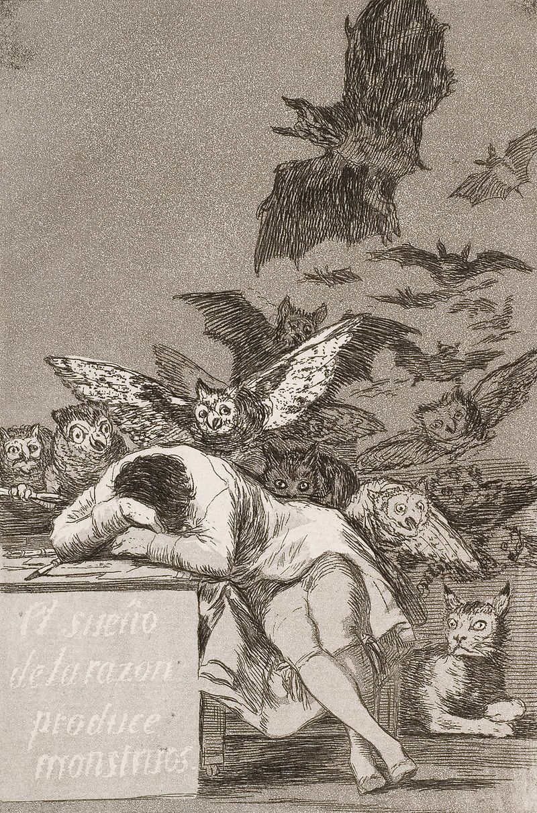
‘The Sleep of Reason Produces Monsters’ [c. 1799]

Slide 4
‘The Sleep of Reason Produces Monsters’ [c. 1799]
https://www.youtube.com/watch?v=PXhHqQMsHqs

Slide 6
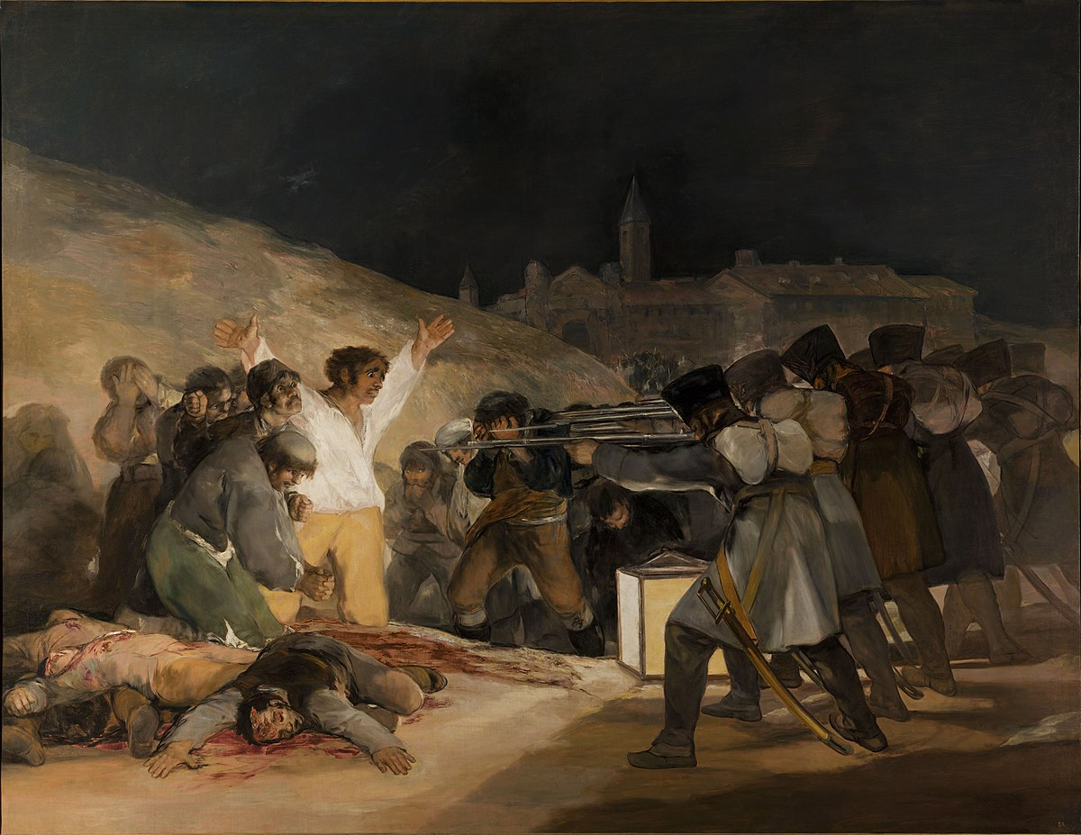
‘The Third of May 1808’ or ‘The Executions’ [c. 1814]

Slide 7
‘The Third of May 1808’ or ‘The Executions’ [c.1814]
This painting is in the Museo del Prado in Madrid
In the painting, Goya attempts to commemorate Spanish resistance to Napoleon’s armies during the occupation of 1808 in the Peninsular war
The painting depicts the execution of soldiers from Madrid by a firing squad from Napoleon’s army in response the the uprising that took place on the 3rd May 1808.
The painting centers on the emotional horrors of war and uses light to illuminate the soldiers to depict them as heroes
This painting inspired other paintings surrounding war like Picasso’s Massacre in Korea and Guernica

Slide 9
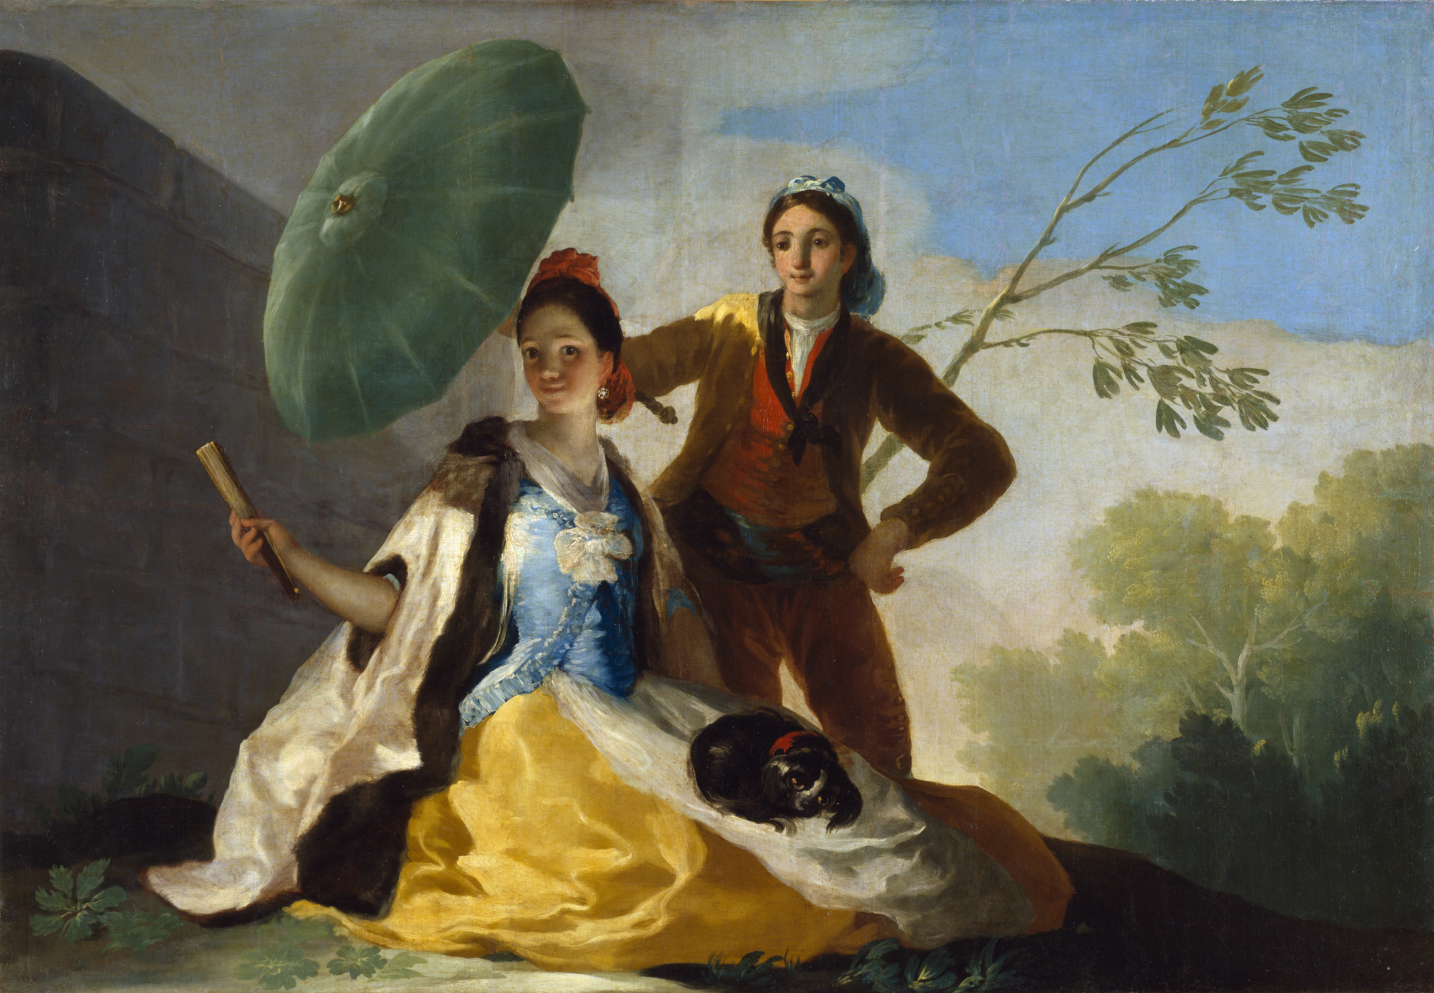
‘The Parasol’ [c.1777]

Slide 10
‘The Parasol’ [c. 1777]
Currently located in the Museo del Prado but was originally painted to be placed in the Royal Palace of El Pardo
The painting was made at the time for the Prince and Princess of Asturias, who later became King Charles IV and Maria Luisa of Parma
The Queen wanted to decorate the rooms with cheerful scenes
The painting has the characters in the foreground reflecting the classical Italian style of painting and depicts a young woman with a dog, and a man holding a parasol above her head

Slide 12
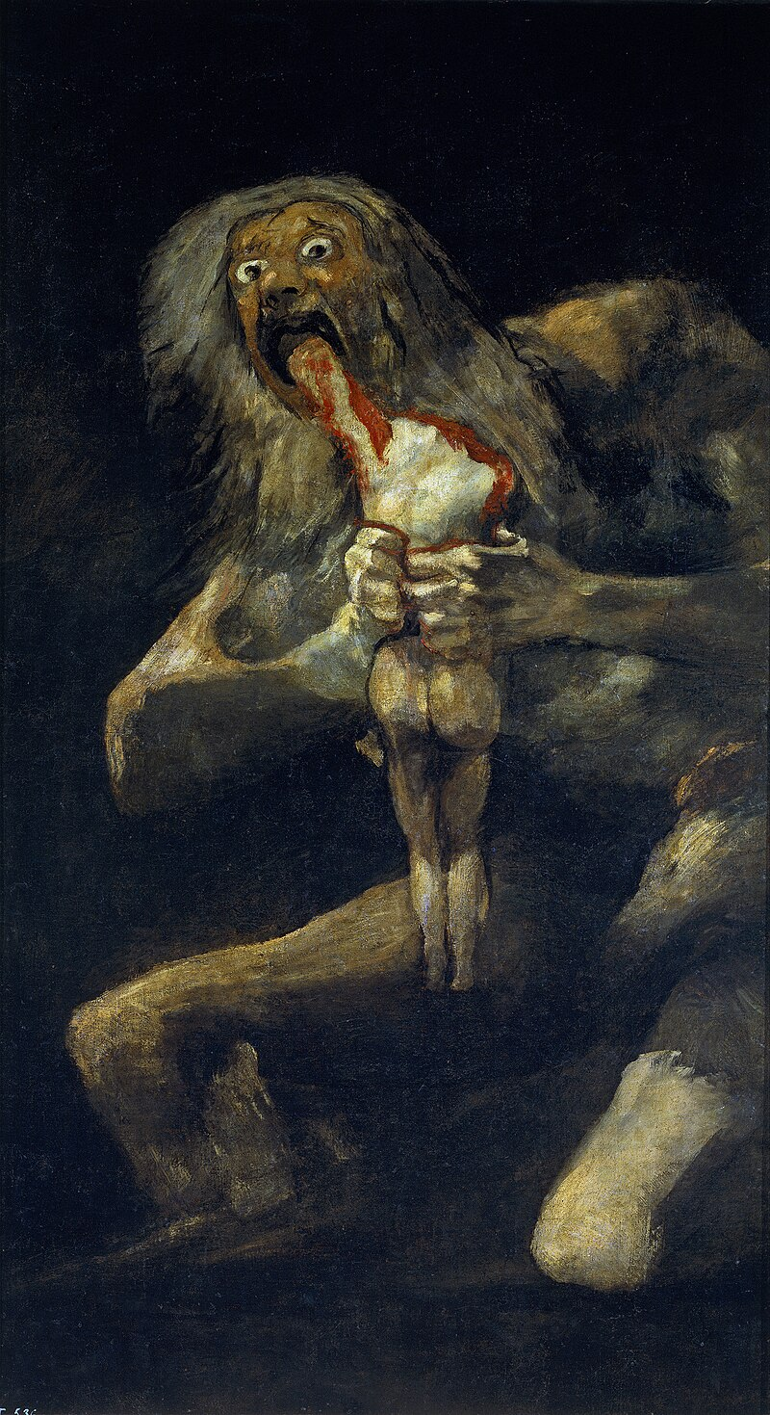
'Saturn Devouring His Son’ [c. 1820 – 1823]

Slide 13
'Saturn Devouring His Son’ [c. 1820 – 1823]
Saturn devouring his son is part of a 14-piece collection known as the ‘Black Paintings’ that Goya painted directly onto the walls of his house between 1820 and 1823
Many believe that these paintings reflect his state of mind after witnessing the violence and terror of war
Goya depicts a large figure potentially the Roman God Saturn eating an object which resembles a human, various interpretations have been made such as conflict between young and old, the wrath of God and an allegory of the situation of war and revolution in Spain
Guillermo del Toro has said that this painting was the inspiration for the character ‘The Pale Man’ in Pan’s Labyrinth

Slide 15
‘The Third of May 1808’
'Saturn Devouring his Son’
'The Sleep of Reason Produces
Monsters’
'The Parasol’
Notes:
Which one stands out the most to you? Why?
Which do you like the most?

