Slide 1
Visual Communication

Slide 2
The Visual Communication Process
The communication process occurs when a sender creates a message and sends it through a channel and a receiver receives and understands it
There is a common language that exists to creates these messages called Visual Language Codes
Sender – the person or group that conveys information, news, ideas, feelings, emotions etc. By creating the message, the sender uses visual codes the receiver already knows and understands well
Receiver – the person or group that receives or interprets the information or message sent by the sender eg. TV viewers
Message – the information conveyed by the sender to the receiver
Channel – the way in which the sender conveys the message to the receiver eg. Through an advert during a TV show

Slide 3
Iconicity and Abstraction
Abstract Images
Abstract images have the lowest level of iconicity (level of similarity between the image and the depicted object)
In other words, they can have multiple interpretations
Images that are more abstract offer more ambiguity and capability for suggestion

Slide 4
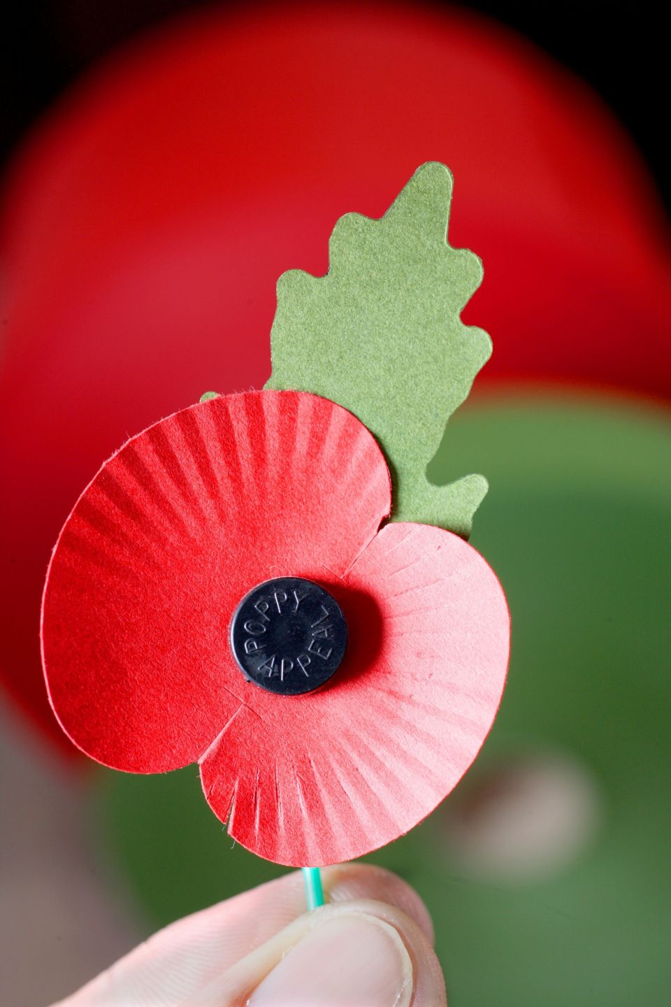
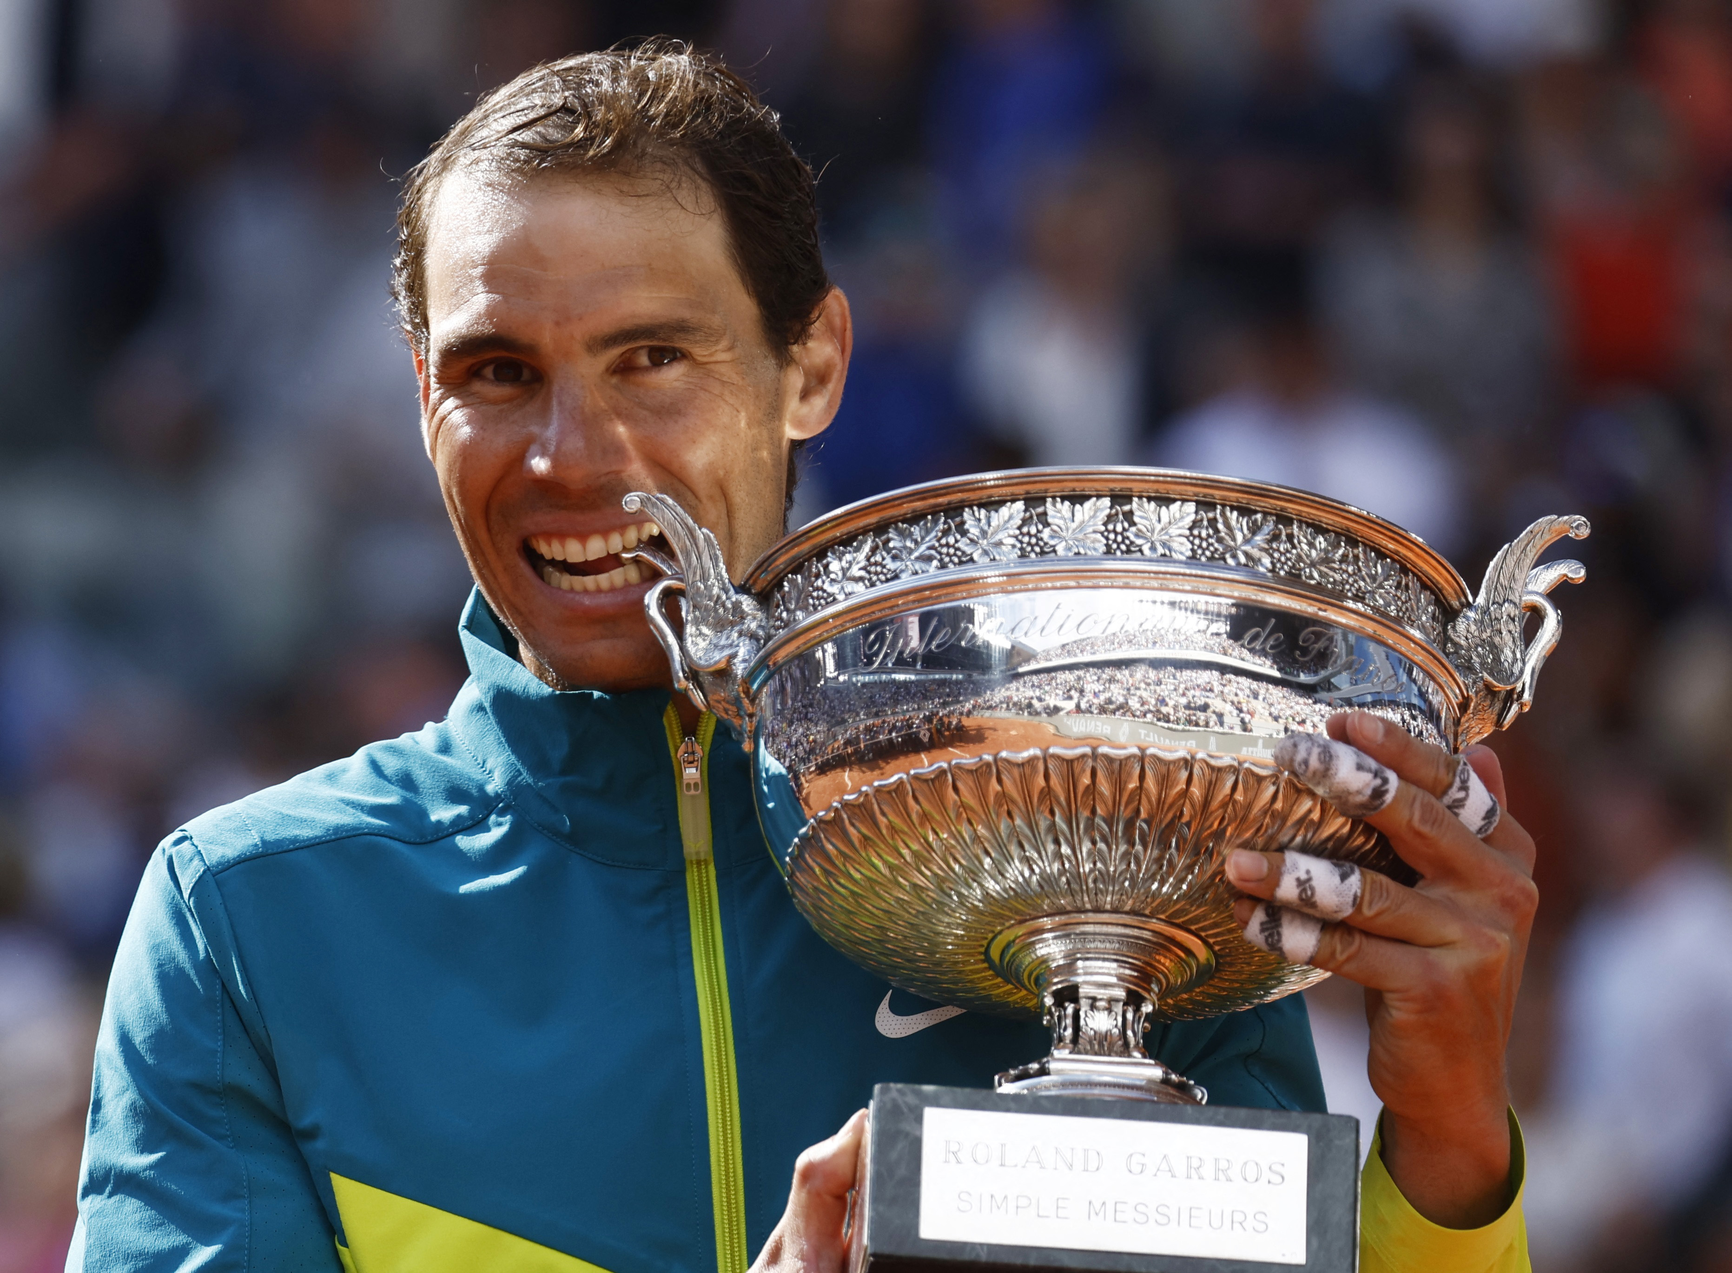
Iconicity and Abstraction
Symbolic Image
The symbolic image refers to representing an idea or concept to a visual form
Examples include, a dove to symbolize peace, black to symbolize mourning and so on…
The effectiveness of a symbol comes from its popularity and how much of a connection people form with it
Icons are often used in these images – it is a sign or image that allows us to establish a relationship of similarity with the represented object.
Icons can be used in many different means such as sports, photography and traffic signs

Slide 5
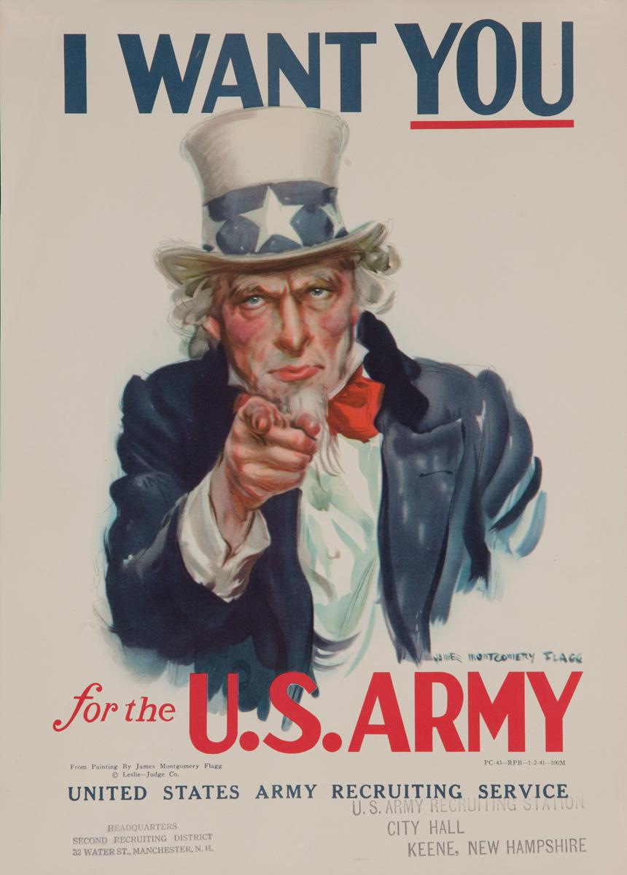

Advertising
Advertising is a mass communication technique that aims to convince an audience to buy certain products, goods or services by spreading messages through the media
Advertising messages transmit information in a very simple comprehensible way that is easy to remember.
There are two main forms of advertising:
  Advertising – this has a commercial purpose and serves to inform consumers about products and services
  Propaganda – This aims to spread ideas, beliefs and opinions and tries to convince others to believe them

Slide 8

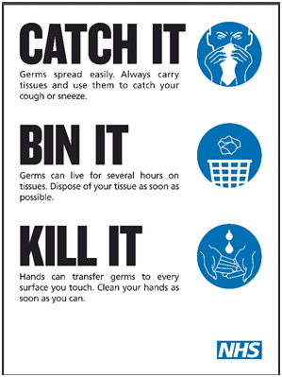

Advertising
Advertising is not just used commercially by companies that want to sell things
It is used in a positive way: for example, it can be used in campaigns to promote good health, road safety and preventing smoking, drinking and taking drugs

Slide 9
Advertising
COMPARISON | Offers or presents two images or two elements and compare both of them for similarities or differences
PERSONIFICATION | This method personifies the product. It gives human – like qualities to animals or objects that appear in the advert
METAPHOR | This resource consists of describing an object using another one. Some type of relationship should exist between the first and second object
HYPERBOLE | This resource aims to attract out attention by exaggerating the message
SYNECDOCHE | This resource alludes to a particular object by showing it partially.
Notes:
https://www.youtube.com/watch?v=_uBo4esCZvE

Slide 10

Which technique is used here?

Slide 11
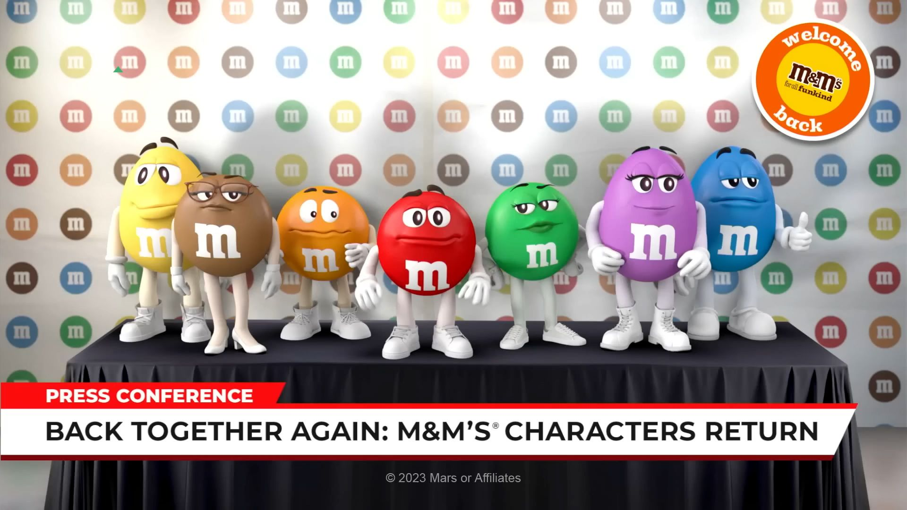
Which technique is used here?

Slide 12

Which technique is used here?

Slide 13

Which technique is used here?

Slide 14
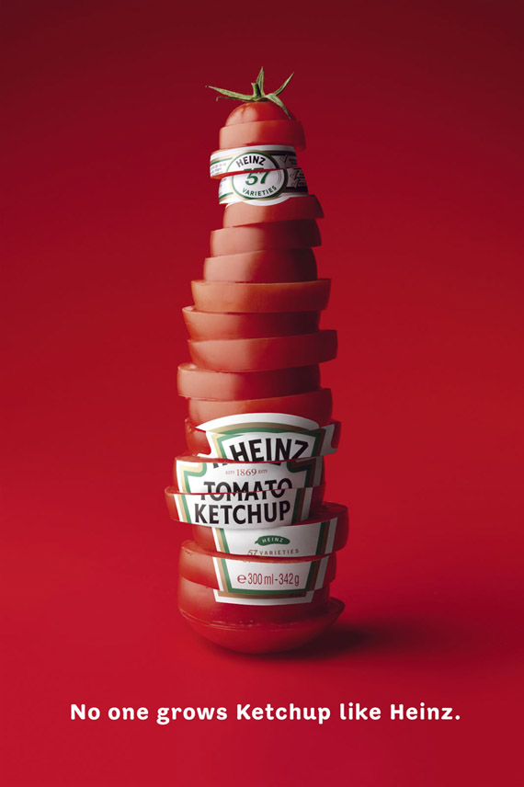
Which technique is used here?

