Slide 1
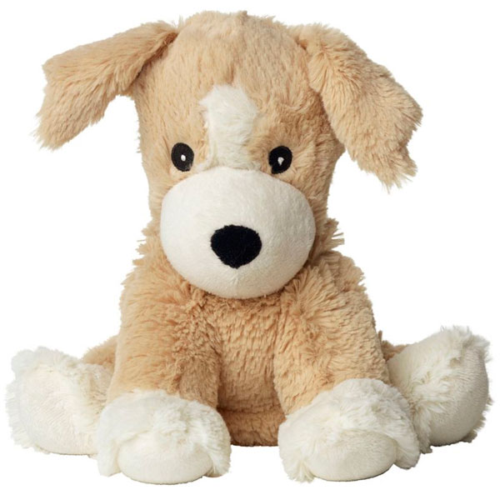
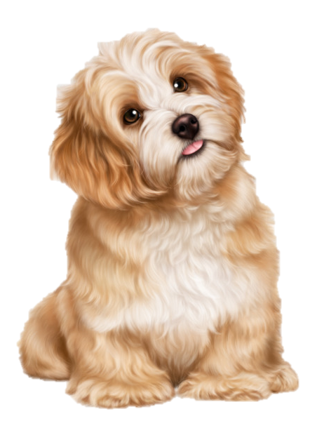
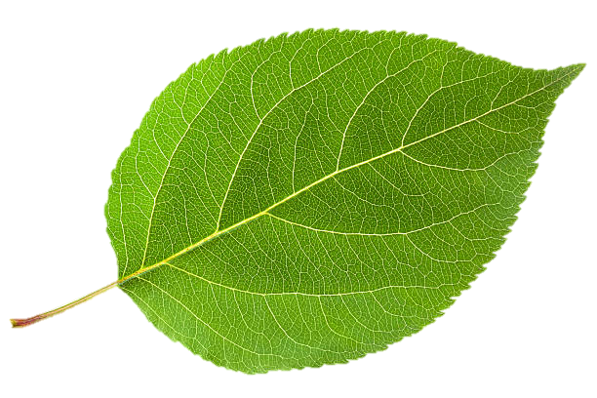
LIVING AND NON-LIVING THINGS
UNIT
NATURAL
SCIENCE
by Rafael Rodríguez Pérez
CLASS 6

Slide 2
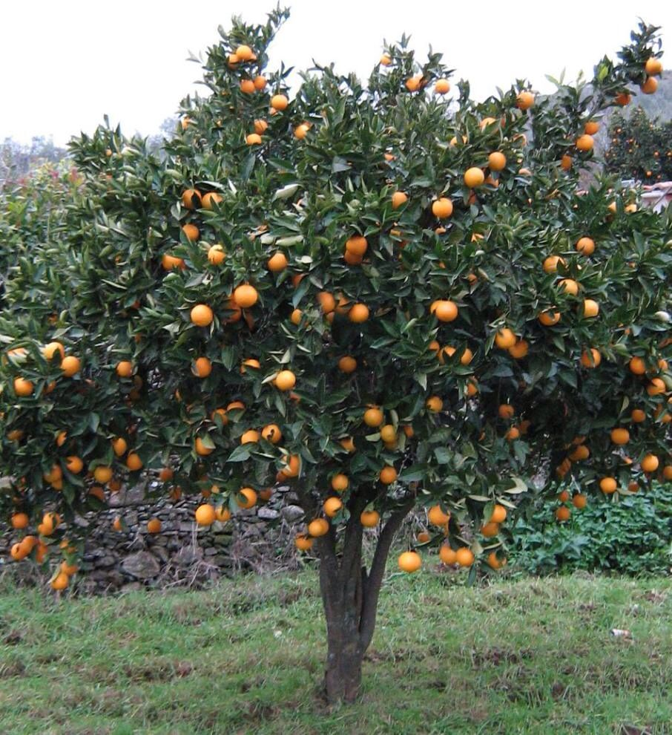
It was
It was not
orange tree
It can
It can’t
It can
It can’t
It can
It can’t

Slide 3
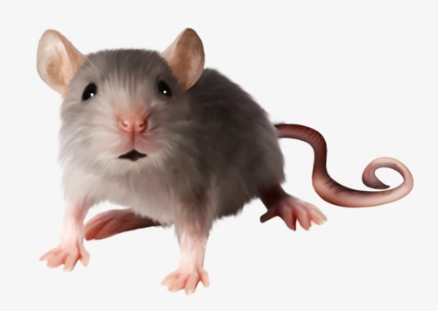
mouse
It was
It was not
It can
It can’t
It can
It can’t
It can
It can’t

Slide 4
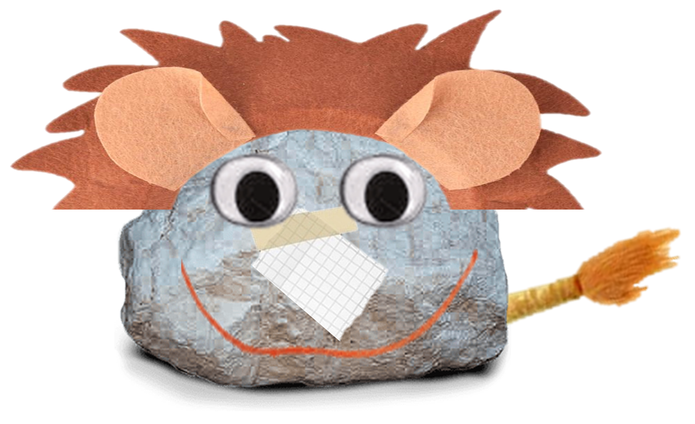
It was
It was not
It can
It can’t
It can
It can’t
It can
It can’t

