Slide 1
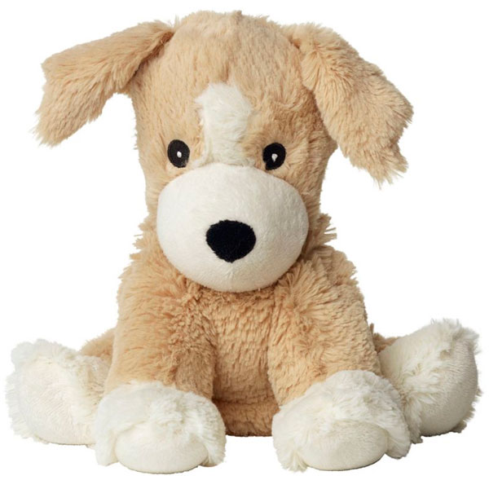
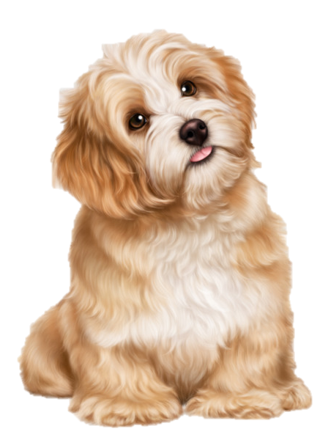
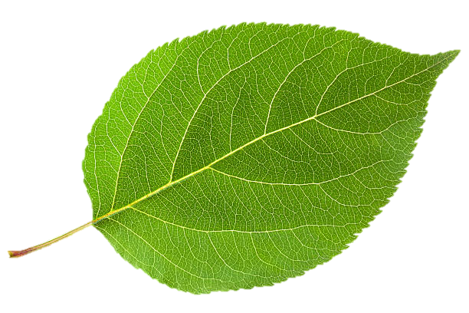
LIVING AND NON-LIVING THINGS
UNIT
NATURAL
SCIENCE
by Rafael Rodríguez Pérez
CLASS 7

Slide 2
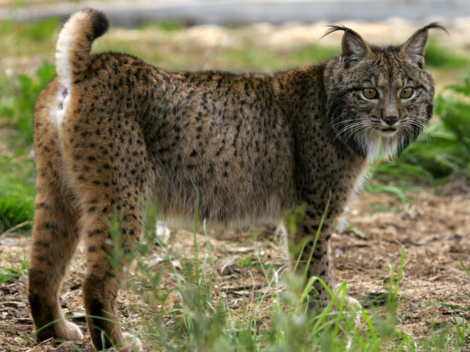

Slide 3
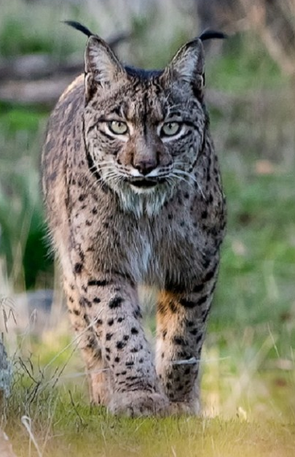

Slide 4
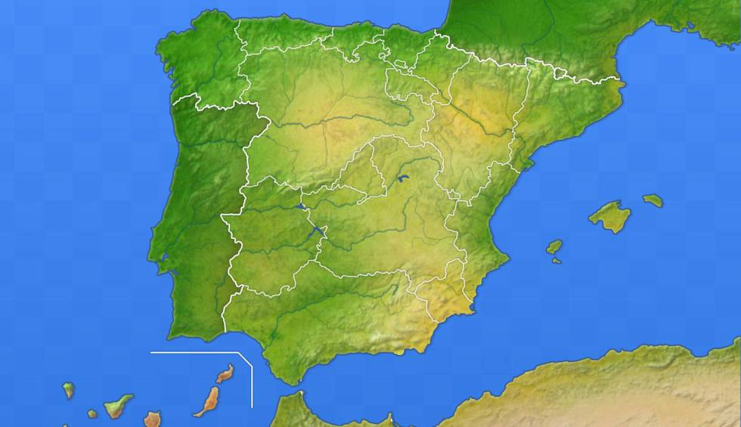
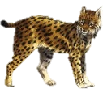
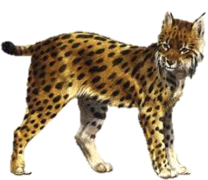

Slide 5
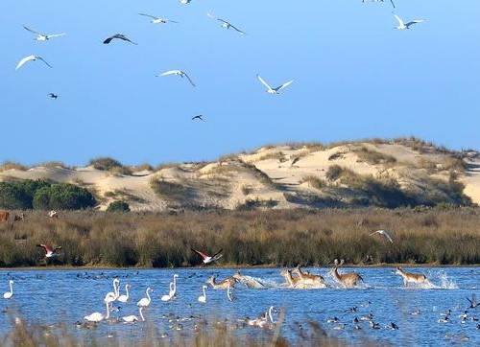
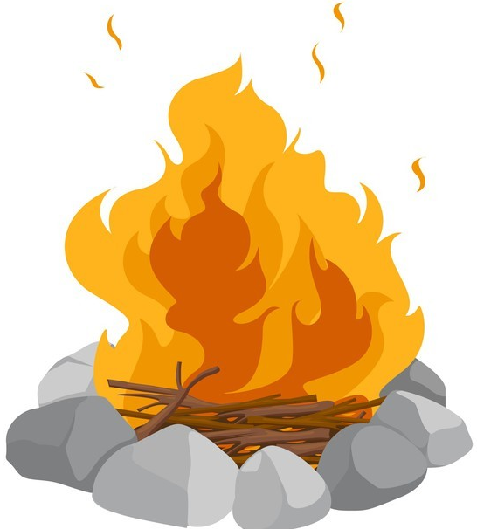
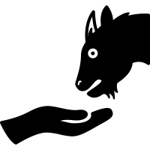
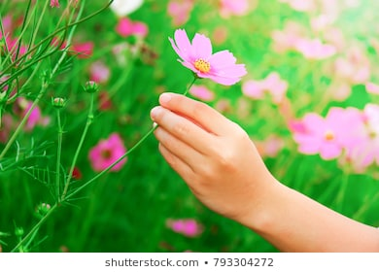
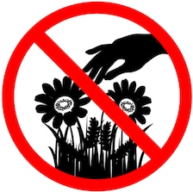
Can you feed the wild animals?
Can you pick wild flowers?
Can you make a fire?
Yes, I can.
Yes, I can.
Yes, I can.
No, I can’t.
No, I can’t.
No, I can’t.
Don’t feed wild animals.
Don’t pick wild flowers.
Don’t make a fire.

Slide 6
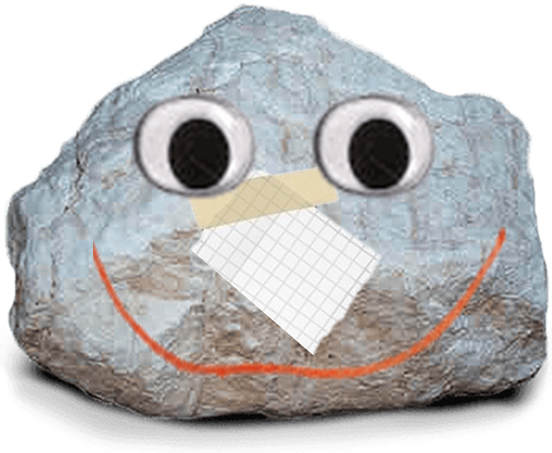
See you later,
alligator!

