Slide 1
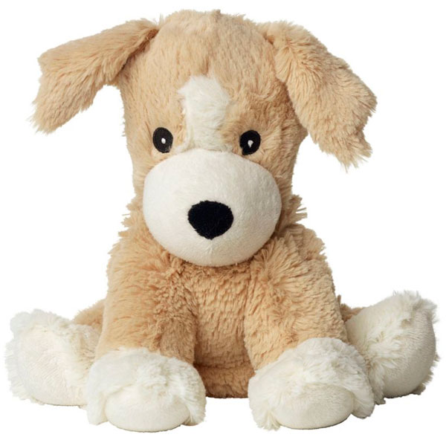
LIVING AND NON-LIVING THINGS
UNIT
NATURAL
SCIENCE
by Rafael Rodríguez Pérez
CLASS 9

Slide 2
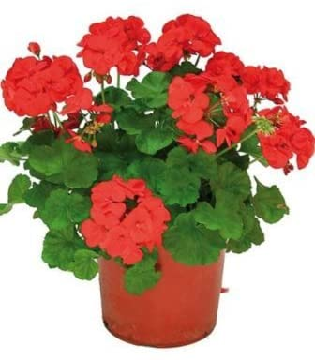
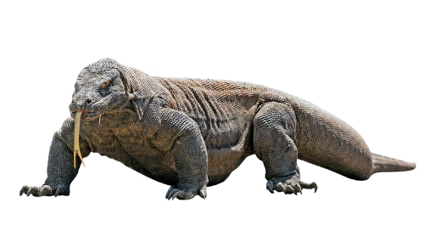
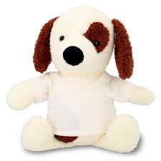
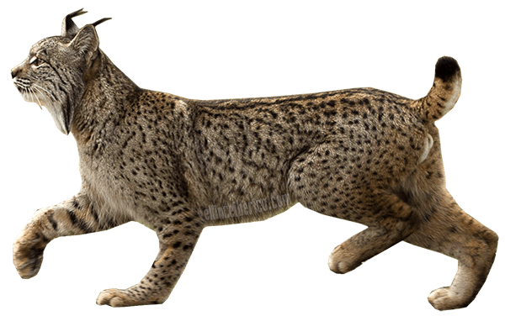
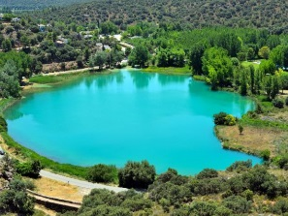
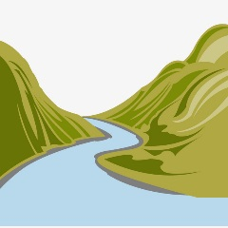
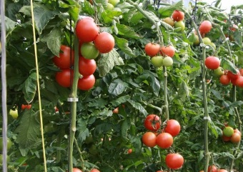
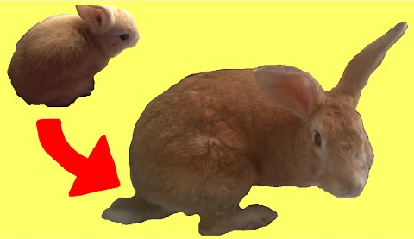
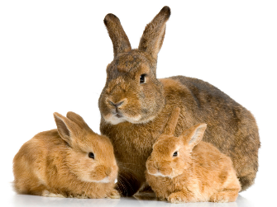
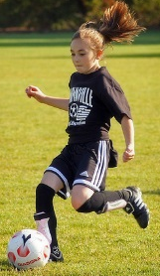
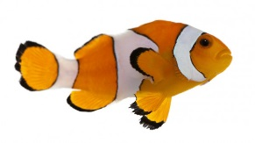
Name: Rocky the Rock
SCIENCE EXAM
1. Classify:
2. Write ANIMAL, PLANT or PERSON.
3. What do living things need to live?
4. Order the stages of life or a rabbit.
person
plant
Iberian lynx
toy
person
Living things need…
lake
river
tomato
living things | non-living things
Iberian lynx | river
rock | person
tomato | lake
Rabbits grow.
Rabbits die.
Rabbits are born.
Rabbits reproduce.
animal
rock
1
2
3
4

Slide 3
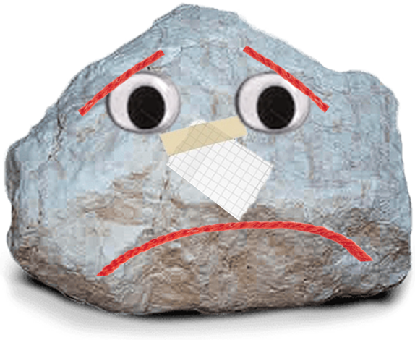

Slide 4
PROTECTION OF LIVING THINGS
Don’t feed wild animals.
Don’t pick wild flowers.
Don’t make a fire.

