Slide 1
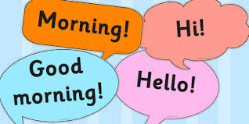
GREETINGS
Hello
> , or !
Hi > name or another informal expression
Hey man*, dude* - bro* buddy (ies) – honey* - darling*
Yo guy(s) - mate(s) - pal(s) - friend(s)
Hi there Honey/Darling is a way of addressing someone you like
Hiya Man/Dude/Bro is another way to say "friend." Usually used as slang when addressing a male friend.
Good morning , name or a title (Sir - Madam,
Good afternoon etc.)
Good evening * they can be made informal.

Slide 2
GREETINGS
-What´s up? Nothing/Not much.
-What´s going on?
-What´s new? +
-You?
-What ´s up with you?
-And you? How are you?
……
……

Slide 3
GREETINGS
How´s it going? It´s going well/great. Great. Not bad. (It) couldn´t be better. (It) could be better
How´s everything? Everything is ok
How are things going? Things are ok.
How is your day going? It’s going great/well……
What about you?
you? How are you (doing?)

Slide 4
GREETINGS
How have you been? Pretty good. Good. I’ ve been good.
Important:
Use this greeting when you have not seen the other person for more than one week I’m good. I’m doing well. I’m great. Pretty good.
How are you (doing)?

Slide 5
FAREWELLS
GOOD-BYE
BYE-BYE
SEE YOU SOON
SEE YOU THEN
TAKE CARE
SO LONG
SEE YOU TOMORROW/NEXT WEEK/LATER
SEE YOU/SEE YA
GOOD NIGHT

