Slide 1


A WALK THROUGH SPACE- PRIMARY 1

Slide 2

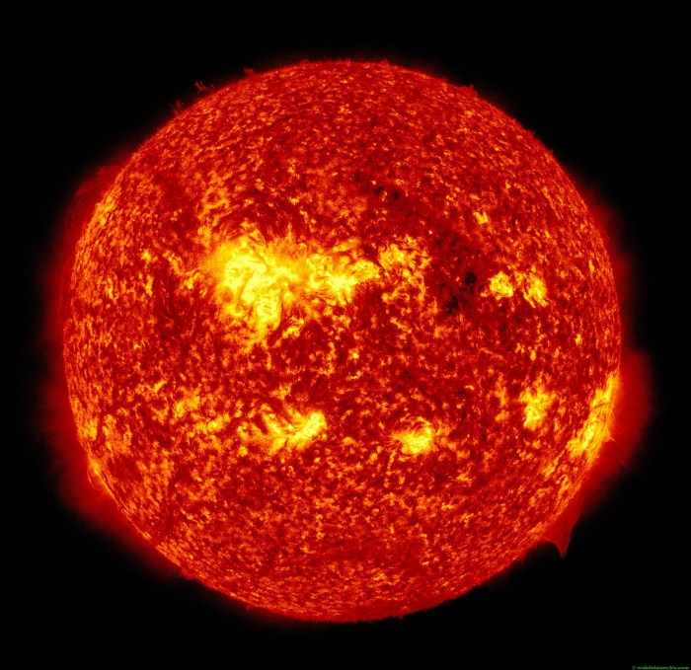
THE SUN

Slide 3

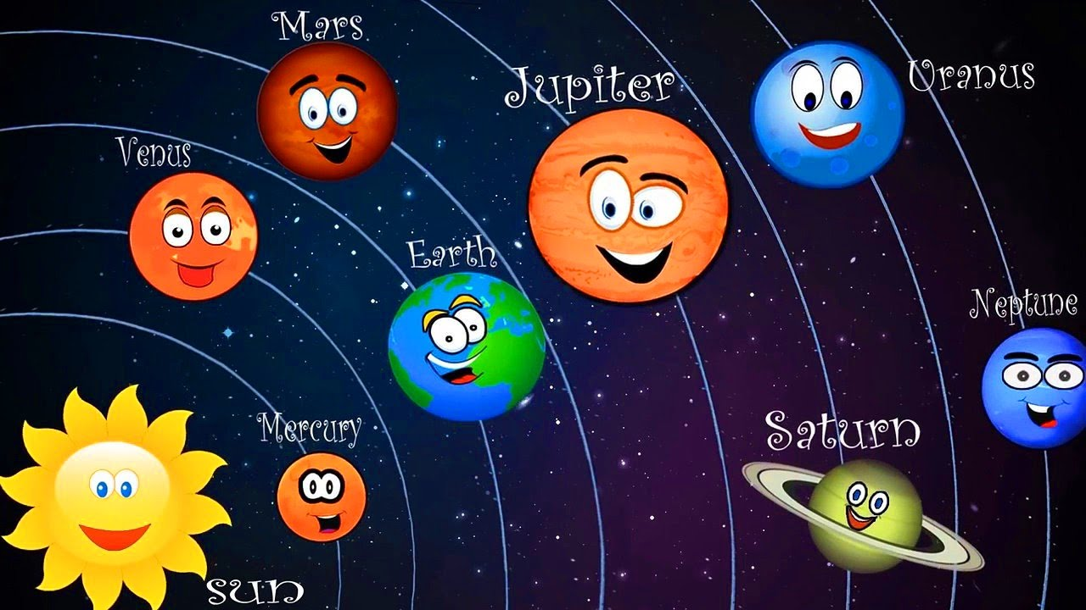
THE SOLAR SYSTEM

Slide 4
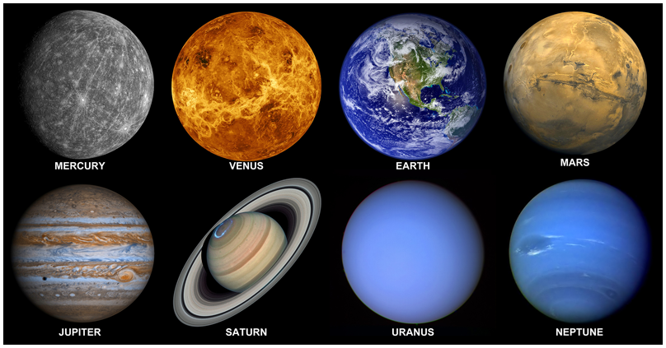
PLANETS

Slide 5
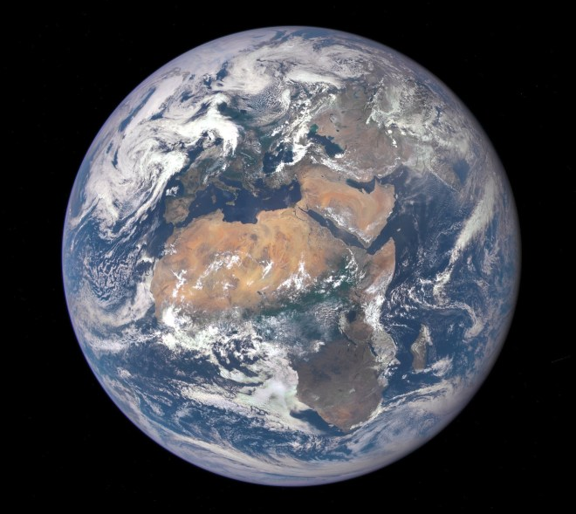
EARTH

Slide 6
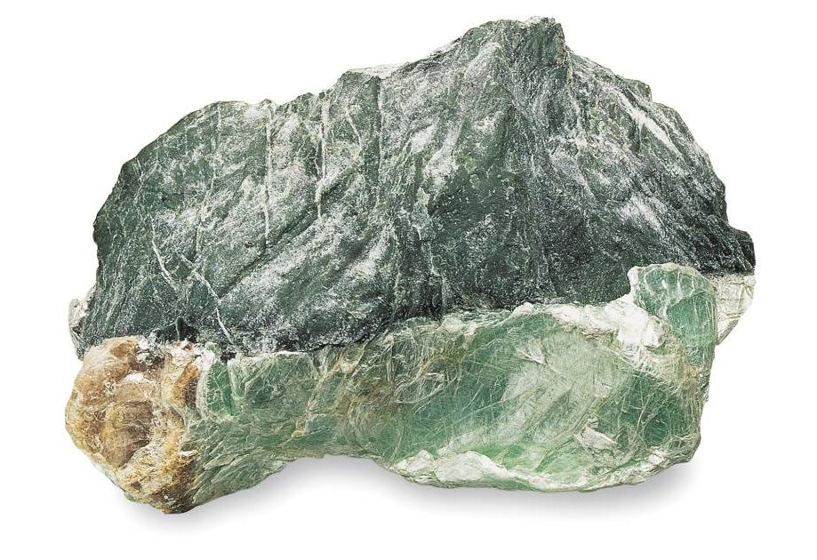
ROCK
Continents are made of ROCKS.

Slide 7
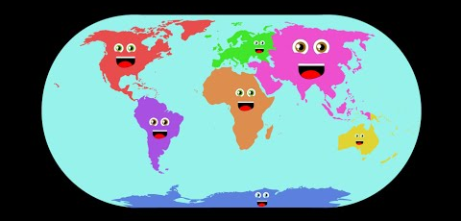
CONTINENTS AND OCEANS

Slide 8
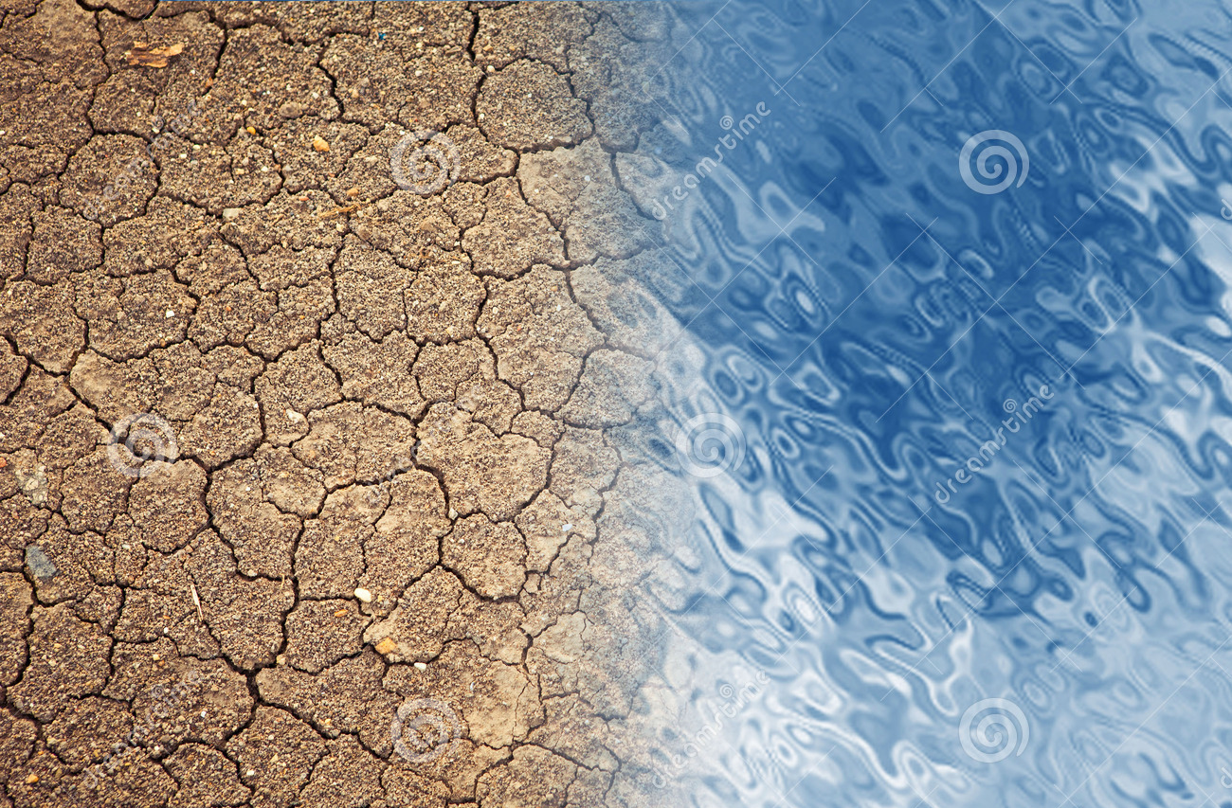
LAND
WATER

Slide 9
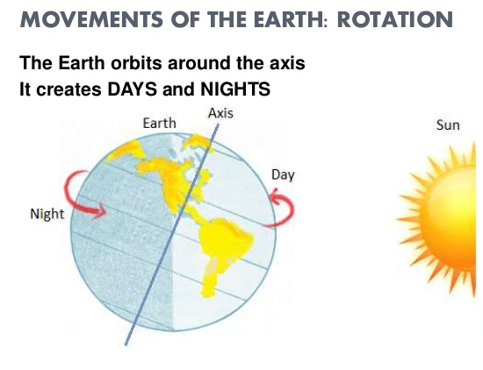
NIGHT
DAY

Slide 10

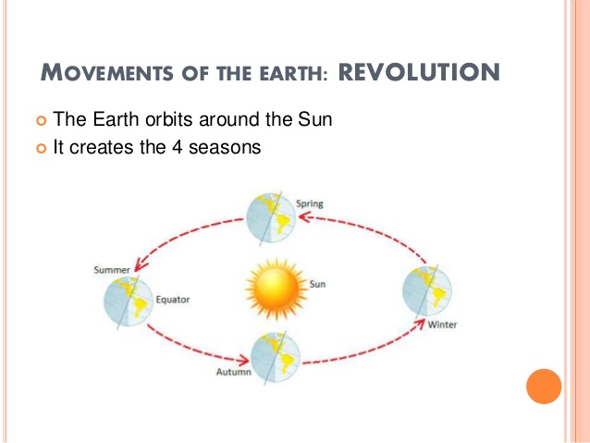
SEASONS

Slide 11
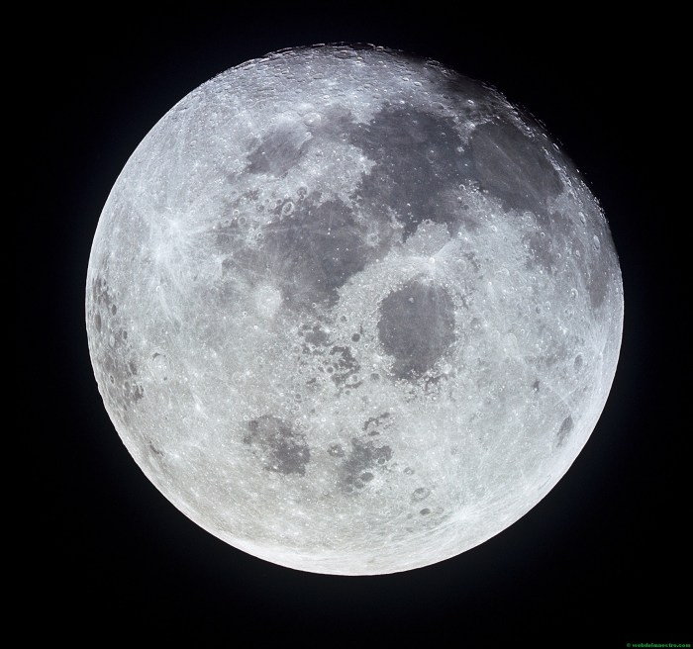
MOON

Slide 12
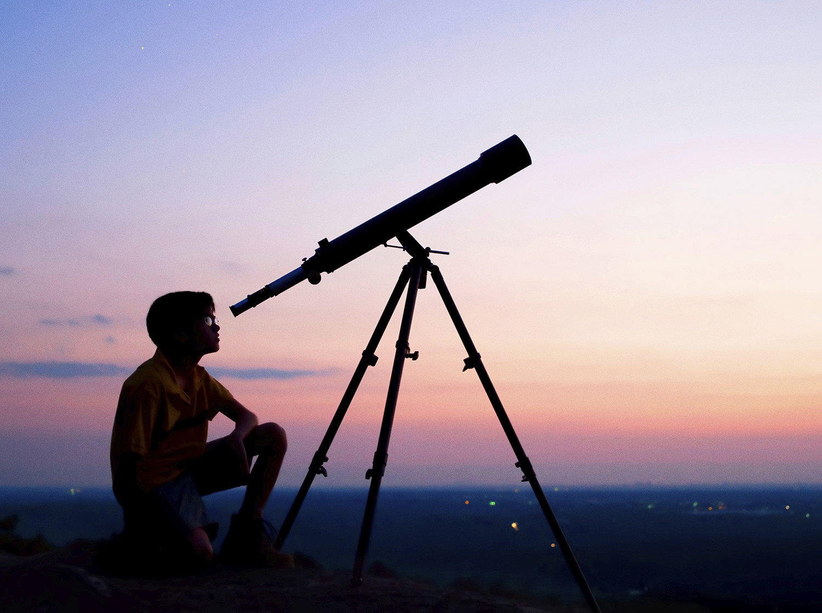
TELESCOPE

