Slide 1
The Physics of Ziplining!

Slide 2
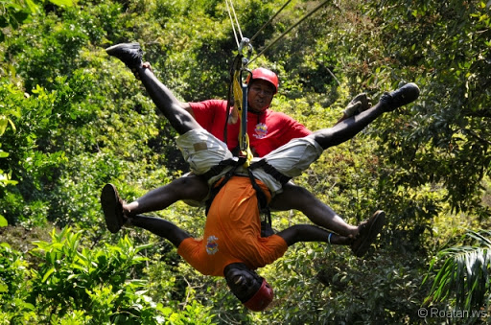
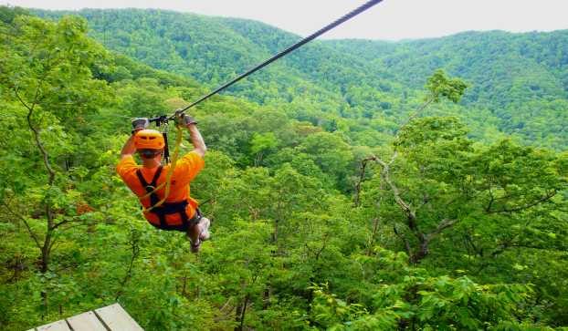
How you ever ziplined before?
If you had the opportunity, would you zip line?
Why or why not?

Slide 3
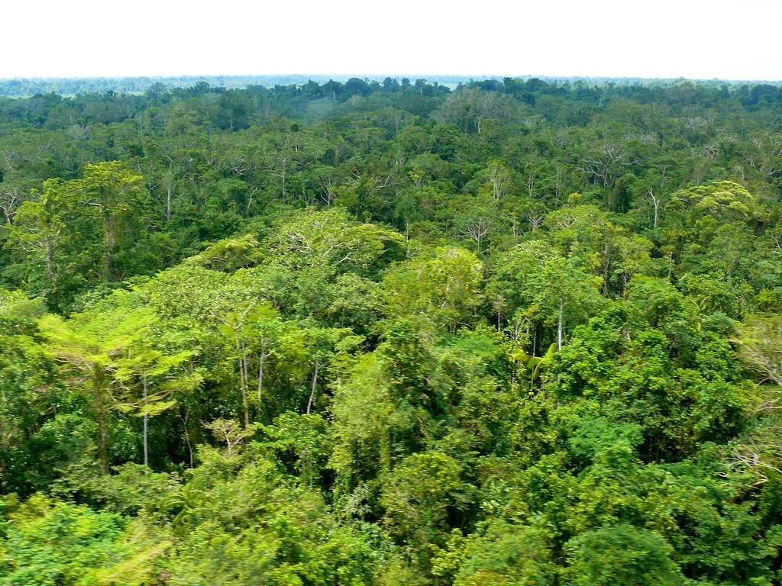
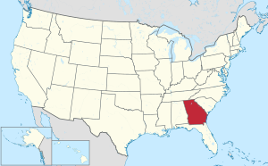
Background Info -- Things to Know Before Watching
The video takes place in the state of Georgia in the United States.
In English, a canopy is the top layer of a forest.
35 mph = 56.2 kilometers per hour 70 feet up is 21 meters up

Slide 4
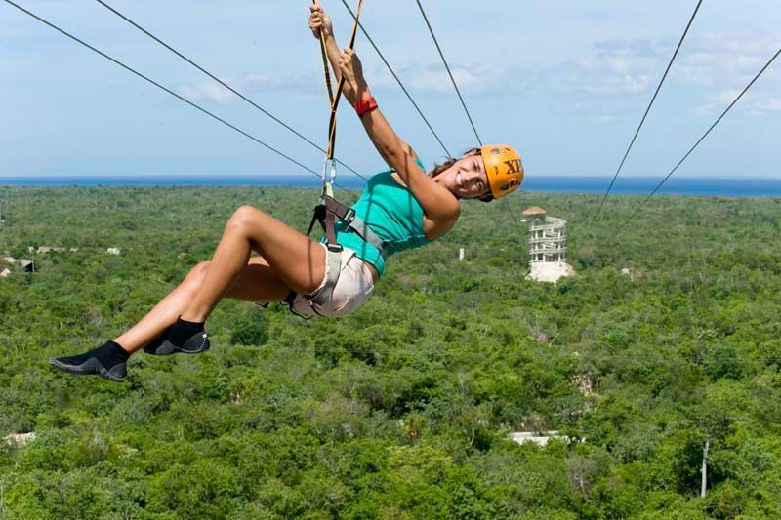
Let's watch the Video!
https://www.youtube.com/watch?v=v4fFwNrSH3I&ab_channel=GPBEducation
https://docs.google.com/document/d/1J0HEr4qr9rILBaB-HKp81Us-OcnFOFEc7bl1Jq-ShC0/edit?usp=sharing

