Slide 1
Extreme Sports

Slide 2
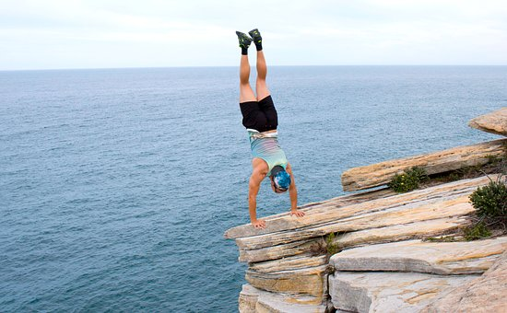
What do you think the word daredevil means?

Slide 3
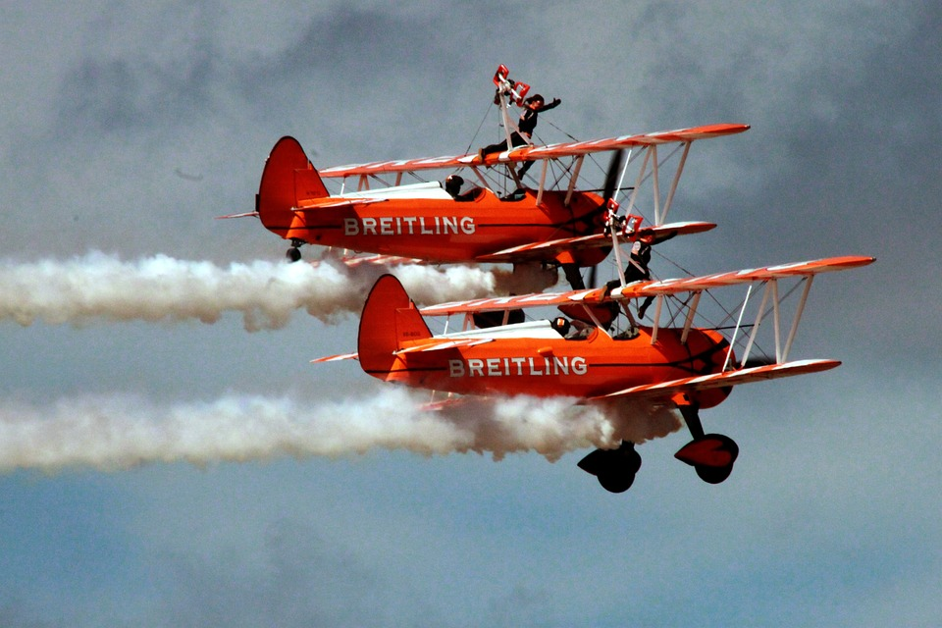
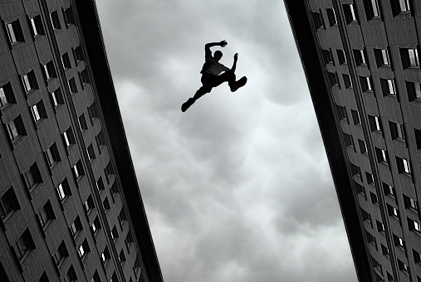
A daredevil is a person who enjoys doing dangerous activities.
Biplane

Slide 4
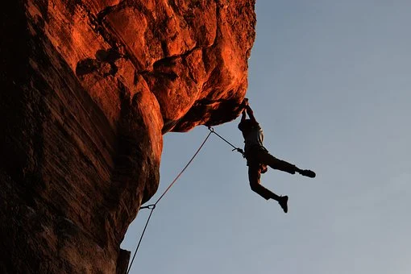
More words to know:
Adrenaline Junkie (noun) = a person with a compulsive desire for excitement and adventure.
Death defying (adjective) = Very perilous; involving a lot of danger.

Slide 5
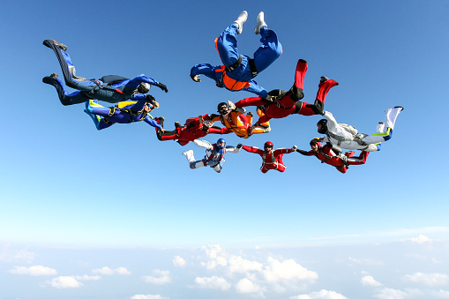
Video Practice: Skydiving!
https://en.islcollective.com/video-lessons/skydiving-and-other-flying-sports

Slide 6
Partner Questions
Have you ever done anything that made you afraid? What was it?
How did you overcome (superar) that fear (miedo)?

Slide 7
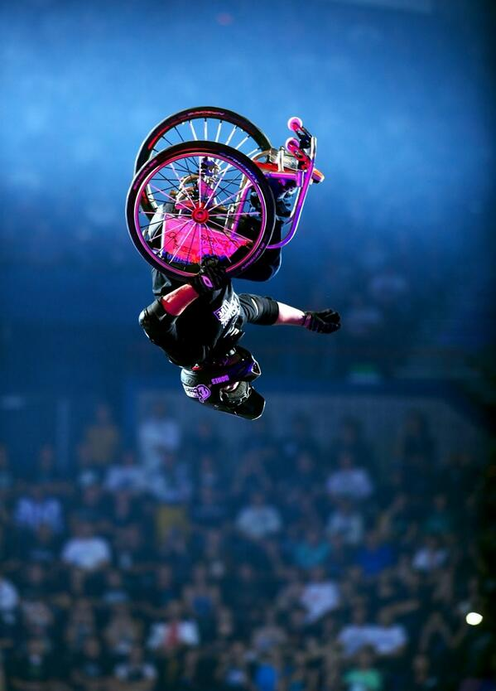
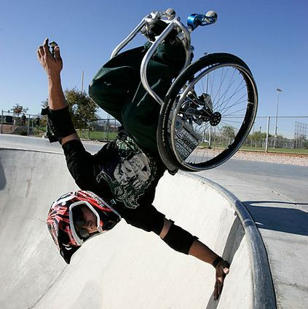
Nothing is Impossible: Aaron ‘Wheelz’ Fotheringham
https://www.youtube.com/watch?v=ZssWpUQHnvc&ab_channel=truly

