Slide 1
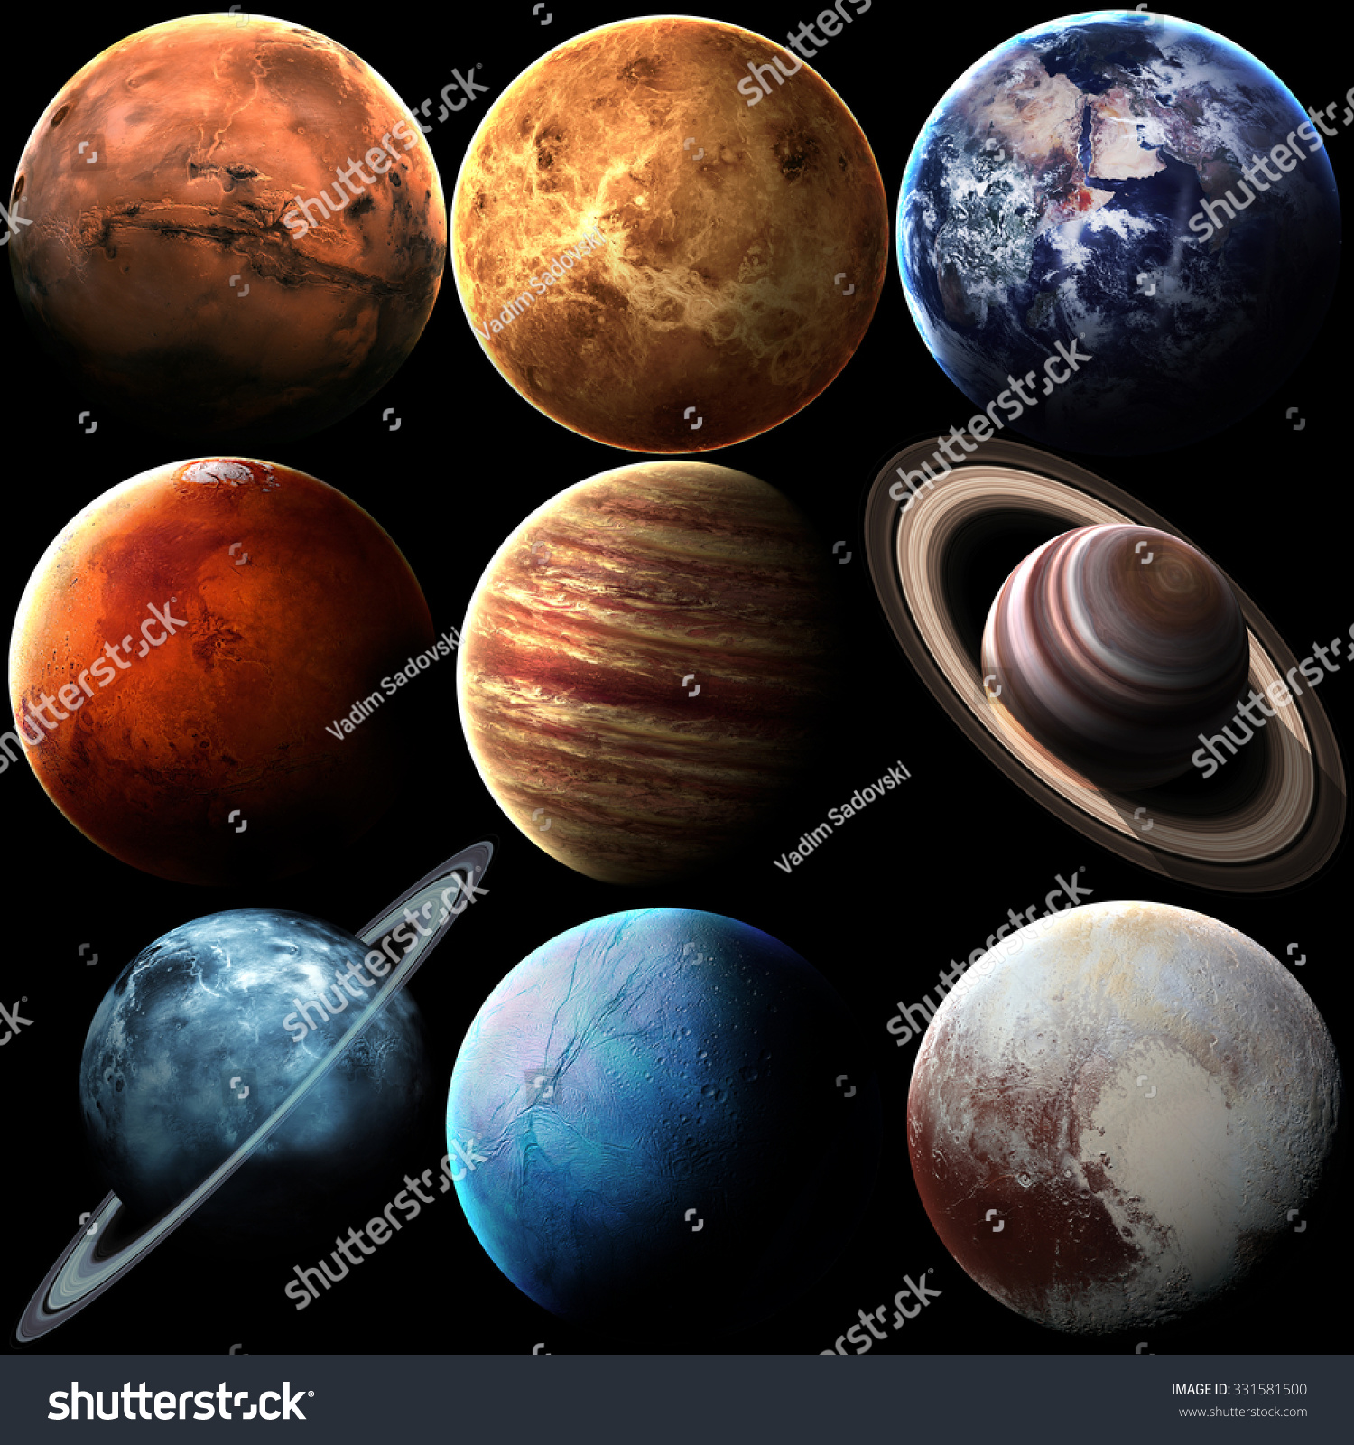
The Solar System
Bilingual Biology Activity for 1ºESO
with Olivia Gillespie

Slide 2
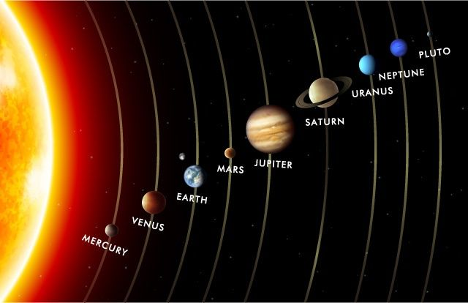
The Order of the Planets
https://www.pinterest.com/pin/532972937141601858/

Slide 3
Cardinal Numbers and Planet Order
(1º) First planet from the sun: Mercury
(2º) Second planet from the sun: Venus
(3º) Third planet from the sun: Earth
(4º) Fourth planet from the sun: Mars
(5º) Fifth planet from the sun: Jupiter
(6º) Sixth planet from the sun: Saturn
(7º) Seventh planet from the sun: Uranus
(8º) Eighth planet from the sun: Neptune
(9º) 9th dwarf planet from the sun: Pluto

Slide 4
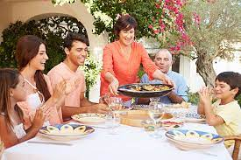
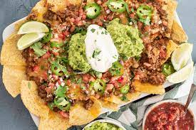
My Very Excellent Mother Just Served Us Nachos
(Mi madre más excelente acaba de servirnos nachos)
https://www.istockphoto.com/es/search/2/image?phrase=mom+serving+food
https://www.simplyrecipes.com/recipes/nachos/

Slide 5
REMEMBER THE ORDER OF THE PLANETS WITH THIS SENTENCE
My: Mercury
Very: Venus
Excellent: Earth
Mother: Mars
Just: Jupiter
Served: Saturn
Us: Uranus
Nachos: Neptune
FOR COPYING

Slide 6
Questions?

