Slide 1
Menu & Gratitude
English Activity for 1º-2ºESO With Olivia Gillespie

Slide 2
Menu: carta/menú
Gratitude: aprecio/gratitud
Turkey: pavo
Thanksgiving Feast: banquete del Día de Acción de Gracia

Slide 3
Movie Time!

Slide 4
Let’s read!

Slide 5
Kahoot Time!

Slide 6
Time to Plan!
In groups of 4 or 5 people: tenéis que completar tres tareas.
Create a Thanksgiving menu with all of your group’s favorite foods.
Show gratitude by creating a list for everything that you are thankful for.
Share your menu and your list with the class.

Slide 7
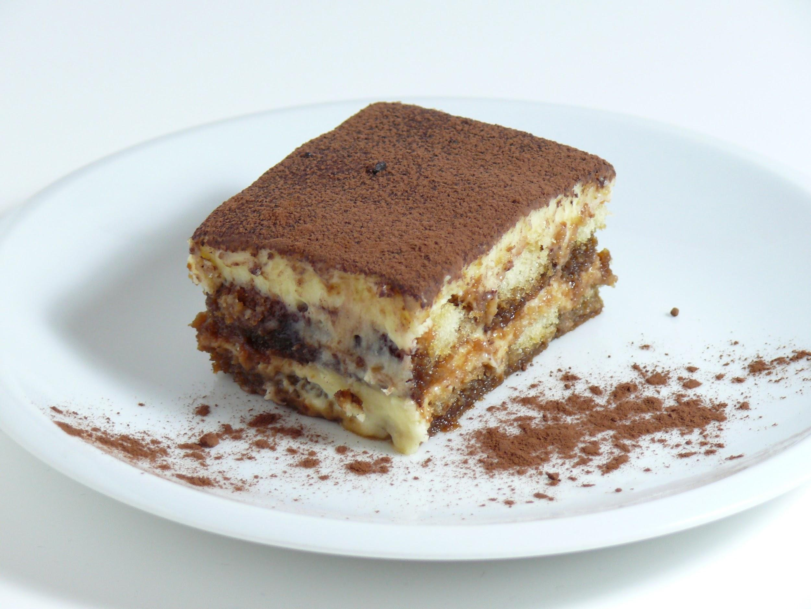
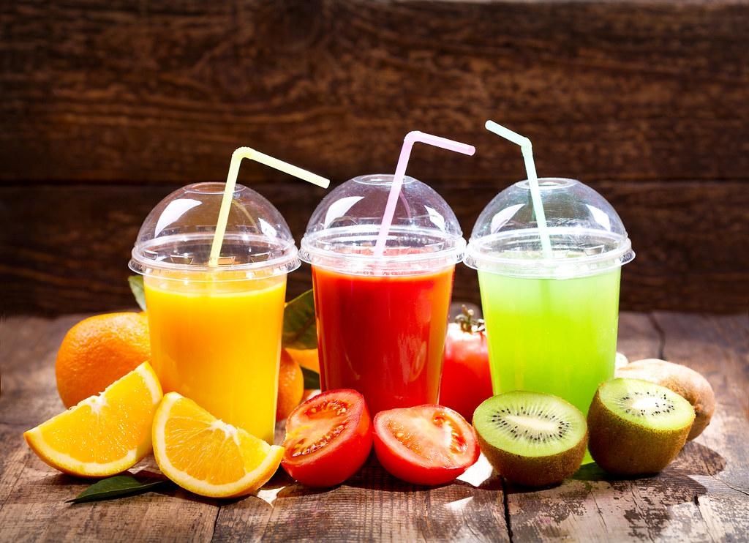
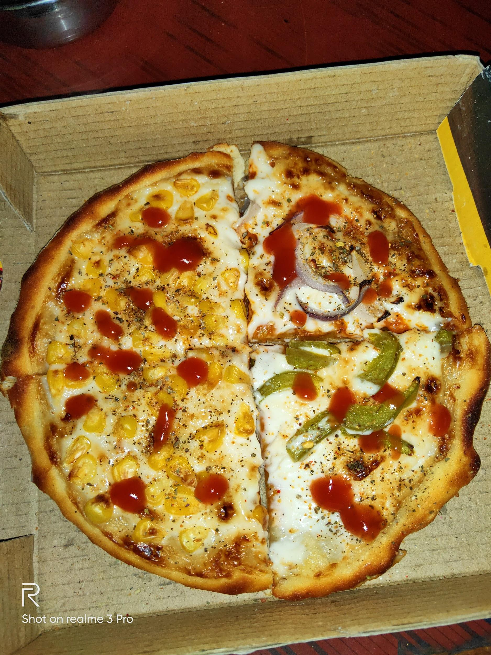
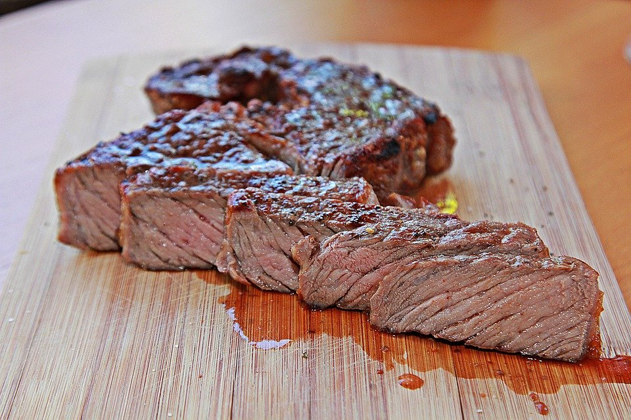
Vuestra carta de Thanksgiving
(Your Thanksgiving Menu)
Vuestra lista de gratitud
(Your List of Gratitude)
We are thankful for/Estamos agradecidos por…
Family
Friends
Pets
Our homes and toys
Our school and teachers
Entrante: Appetizer
Plato principal: Main Dish
Guarnición: Side Dish
Postre: Dessert
Bebidas: Drinks

